Slide 1

PERIOD 55
UNIT 7 : TRAFFIC
LESSON 1: GETTING STARTED

Slide 2


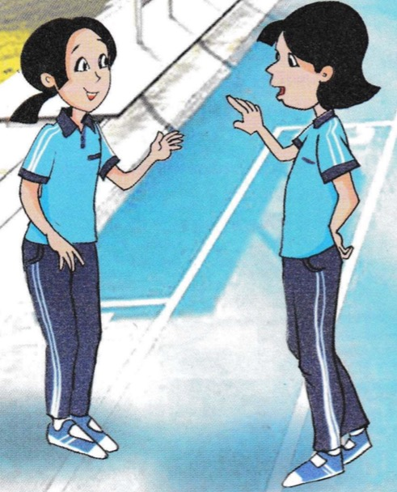
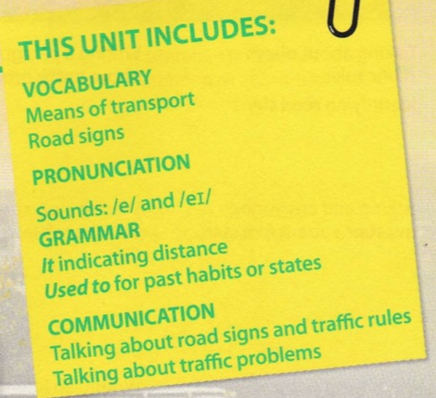



Slide 3
I. Vocabulary
- traffic (n): giao thông
- traffic jam (n): ùn tắc giao thông
- (to) except: ngoại trừ
- can't wait: rất mong đợi
- (to) get on: lên ( xe buýt/ tàu,…)
- (to) get off: xuống ( xe, tàu,…)
- (to) cycle for exercise: đạp xe tập thể dục

Slide 4
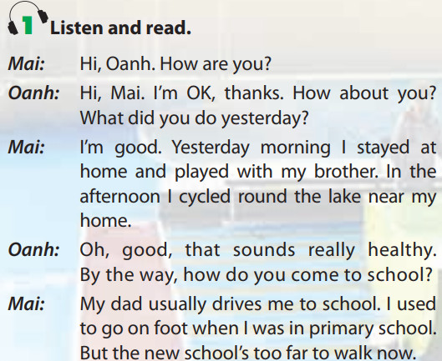
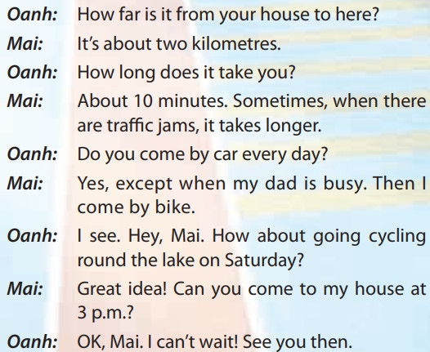

Slide 5
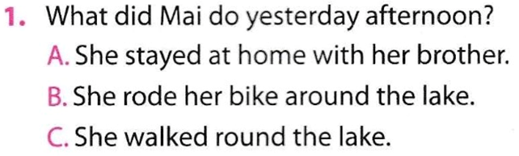


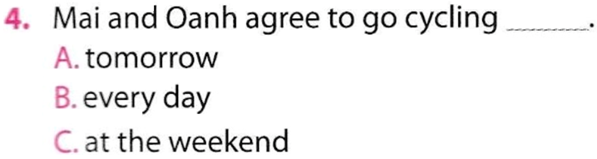

Slide 6


She stayed at home and played with her brother .
It’s about 2 kilometres.
She usually goes to school with her dad.
Because sometimes there are traffic jams.
She goes to school by bike.

Slide 7
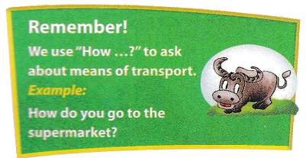

Slide 8




to have someone’s attention.
when you strongly support or agree with something .
very excited and keen to do something .

Slide 9
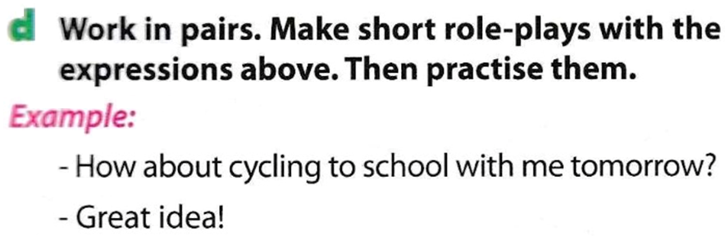

Slide 10

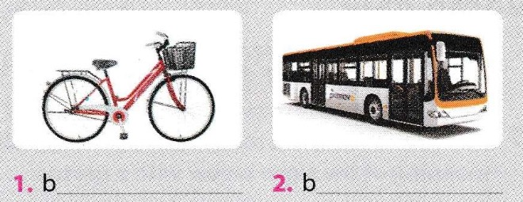
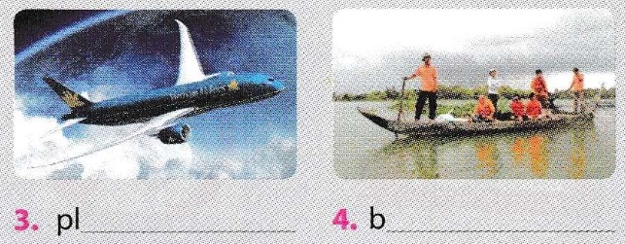
icycle
us
ane
oat

Slide 11
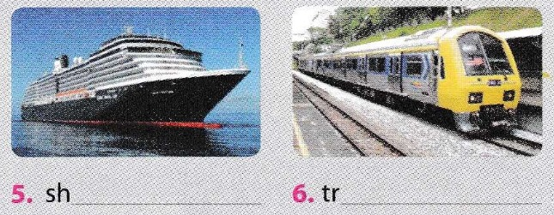
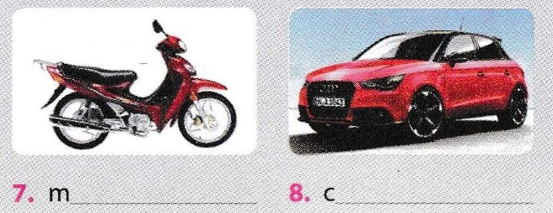
ip
ain
otorbike
ar

Slide 12
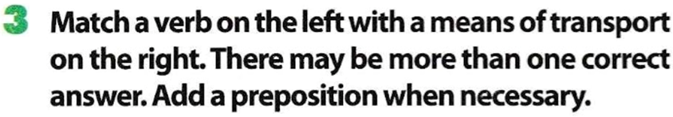
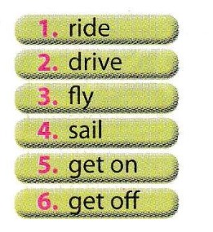
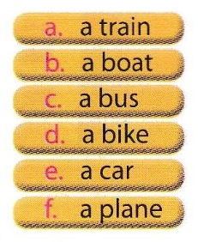
by
on/in
Then make your own sentences with these phrases
1/ My sister taught me how to drive a car.
2/ My mother flew by plane to HCM city.
3/ She got off a bus at Hung Vuong street.

Slide 13
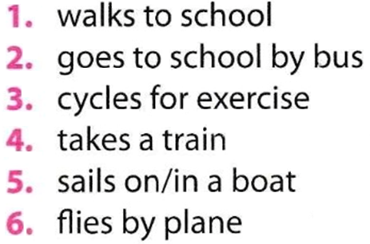
Nam never walks to school.
Lan never takes a train.

Slide 14
Homework
Learn by heart the new words.
Speak with your friends
Prepare for the next..

