Slide 1
PERIOD 1st
UNIT 7 : RECIPES AND EATING HABITS
LESSON 1: GETTING STARTED

Slide 2

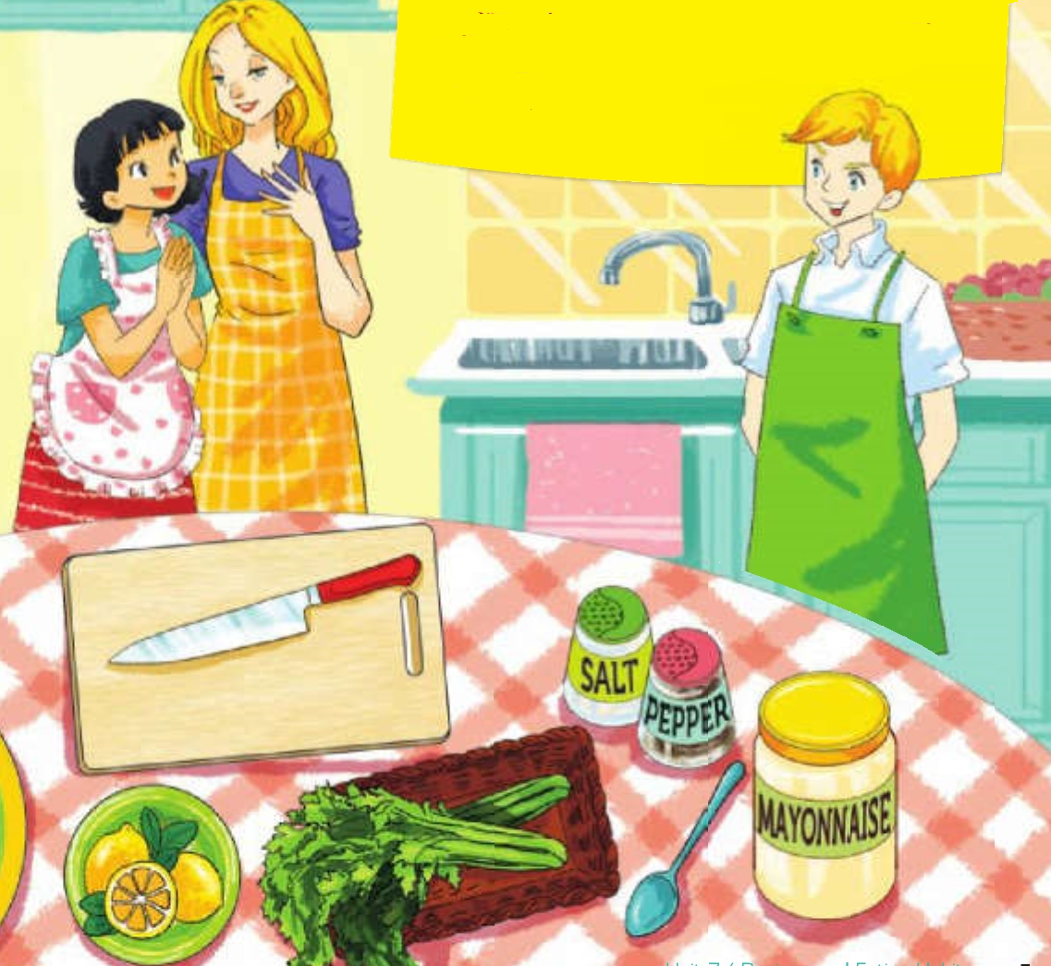
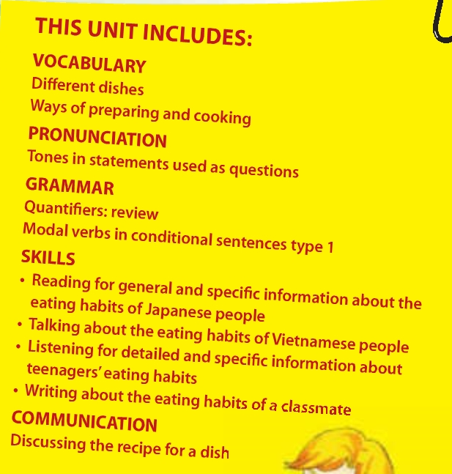

Unit 7/ Recipes and Eating Habits

Slide 3
Vocabulary:
- recipe (n): công thức làm món ăn
- prawn (n): tôm
- celery (n): cần tây
- starter (n): món khai vị
- versatile (adj): đa dạng, linh hoạt
- (to) drain: làm ráo nước
- (to) peel: gọt vỏ, bóc vỏ
- (to) chop: xắt, chặt
- pasta (n): món mì
- avocado (n): lê tàu
- outer layer (n): vỏ ngoài
['resəpi]
[prɔ:n]
['sələri]
['və:sətail]
[,ævou'kɑ:dou]

Slide 4
Nick’s mum: Today we’re making a prawn salad, which is a favourite of mine.
Mi: Fantastic. I love salad.
Nick’s mum: This salad is simple but delicious. Here are the ingredients: prawns, celery, spring onions, mayonnaise, lemon juice, salt and pepper.
Nick: What should I do first, Mum?
Nick’s mum: Get a big bowl for me. And then can you wash the celery?
Nick: Sure.
Mi: I can wash the spring onions if you like, Mrs Warner.
Nick’s mum: Please, do. I’ll boil the prawns.
Mi: So, do English people eat lots of salad?
Nick’s mum: Yes, especially in the summertime. People often serve salad as a starter. But salads also make a healthy lunch or supper.
Mi: You’re right, they’re so versatile. And you can put anything in a salad.
Nick: Mum, the prawns are pink now.
Nick’s mum: They’re pink?
Nick: Yes.
Nick’s mum: Good, they’re ready. I’ll drain them. Nick, can you peel them? Mi, could you chop the celery and spring onions? You should be careful if you use the red knife – it’s sharp.
Mi: Right, everything’s ready. What do we do next?
Nick’s mum: OK, first, combine the prawns and celery in the bowl. Add two tablespoons of mayonnaise, half a teaspoon of salt, half a teaspoon of pepper and some lemon juice. Now, mix all the ingredients well.
Nick: OK.
Nick’s mum: Finally, add the spring onion on top. Now we cover the bowl and leave it in the fridge for an hour. You’ve done a good job, both of you.
Mi: I can’t wait to try it.
Nick: Yeah, I’m starving! An hour is a long time…

Slide 5
a. Can you find a word that means
1. a light dish served as the first part of a meal
starter
2. have lots of uses
versatile
3. pour the water away
drain
4. take off the outer layer of food
peel
5. cut food into pieces with a knife
chop
6. mix
combine

Slide 6
Watch out!
Can’t wait is used to emphasise that you are very excited about something.
Example:
She can’t wait to see her cousin again. I can’t wait for my birthday party.
I’m starving! is an informal way of saying that you are very hungry.

Slide 7
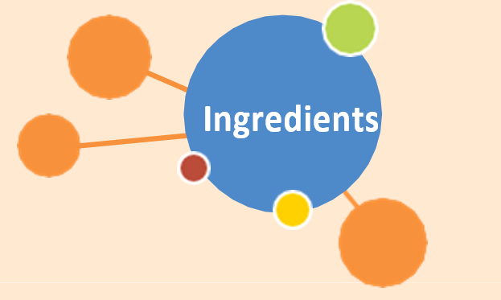
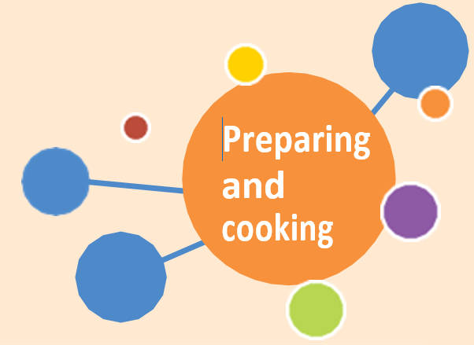
b. Find all the words related to the topic of food in the conversation. Put them in the word webs
pepper
combine
salt
boil
prawns
wash
chop
mayonnaise
add
celery
peel
spring onions
mix
lemon juice
drain

Slide 8
C. Answer the questions:
1. Who knows the recipe for this salad?
Nick’s mum
2. Why does Nick’s mum like this salad?
  Because it’s simple and delicious.
3. When are salads popular in England?
  In the summertime.
4. What does Mi like about salads?
  They are versatile, and you can use lots of different ingredients in a salad.

Slide 9
5. What does each person do to prepare the salad?
  Nick’s mum boils and drains the prawns. Nick washes the celery, peels the prawns, and mixes the ingredients. Mi washes the spring onions, chops the celery and spring onions, and mixes the ingredients.
6. How do we know that Nick wants to eat the salad?
  Because he is finding it difficult to wait for one hour.

Slide 10
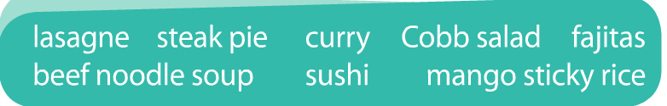
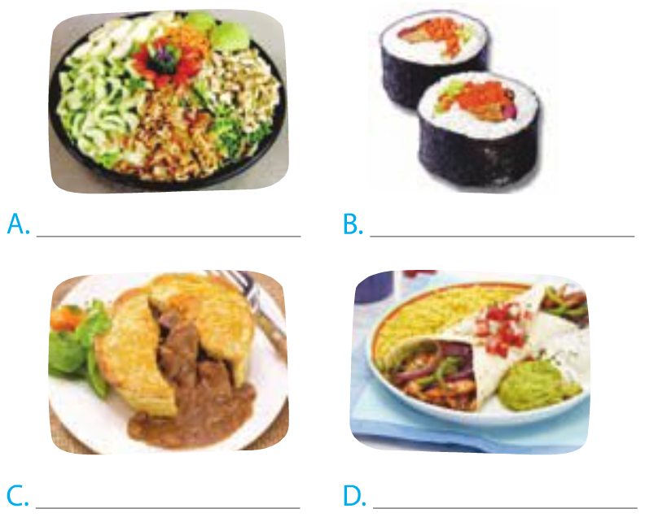
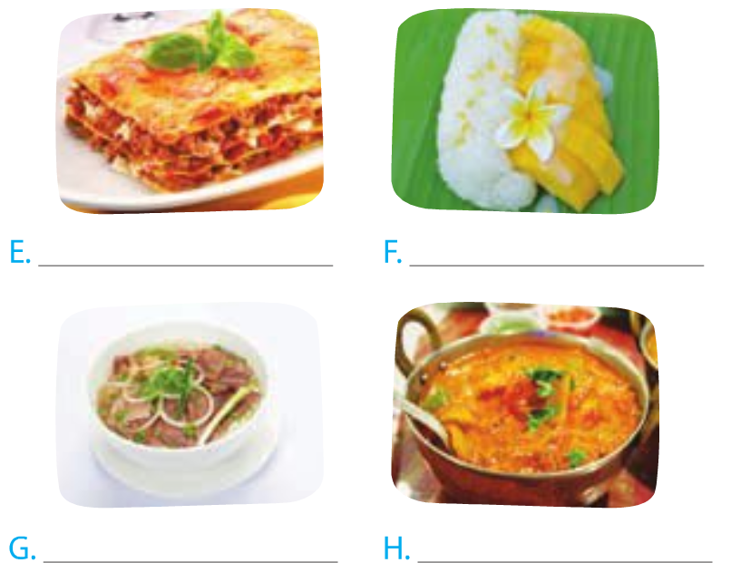
2. Write the name of each dish in the box under each picture.
Cobb salad
sushi
lasagne
mango sticky rice
steak pie
fajitas
beef noodle soup
curry

Slide 11

a. In pairs, discuss which country from the box is associated with each dish in 2.
A.The USA B.Japan C.The UK D.Mexico E.Italy F.Thailand G.Viet Nam H.India

Slide 12
b. Fill each blank with the name of a dish in 2.
    is a traditional dish made from layers of pasta, meat sauce and tomato sauce. It’s popular all over the world.
    If you like spicy food, you should try _____ . It is a dish of meat or vegetables, cooked in a spicy sauce, often served with rice.
    A is a traditional meat pie served in Britain. Beef steak and gravy are enclosed in a pastry shell and baked in the oven.
Lasagne
curry
steak pie

Slide 13
is a dish of meat and vegetables cut into strips. It is cooked and wrapped inside a flatbread.
Fajitas
If you want to eat something healthy, try_____ It is a dish of small cakes of cold cooked rice, flavoured with vinegar and served with raw fish, avocado, etc.
sushi

Slide 14
FOOD QUIZ
Name …
ONE kind of meat
TWO foods which you have to peel
THREE foods which are made from milk
FOUR fruits which are red
FIVE vegetables which are green
beef
prawn, potato
strawberry, lychee, cherry, pomegranate
cheese, butter, ice cream
    broccoli, spinach, lettuce, celery, kohlrabi

Slide 15
Homework
Learn by heart the new words.
Speak with your friends
Prepare for the next..

