Slide 1

PERIOD 2nd
UNIT 7 : RECIPES AND EATING HABITS
LESSON 2: CLOSER LOOK 1

Slide 2
I/ Vocabulary:
- (to) whisk: đánh trứng
- (to) slice: thái lát
- (to) grate: nạo
- (to) dip: nhúng, ngâm
- (to) spread: phết, trải ra
- (to) marinate: ướp
- (to) sprinkle: rắc
- pasta (n): mì ống/ sợi, món mì
- batter (n): bột ( bột nhão làm bánh)
- bacon (n): thịt xông khói
- base (n): đế
[wisk]
[slais]
grate
[spred]
['mærineit]
['spriηkl]
['pæstə]
['bætə]
['beikən]

Slide 3
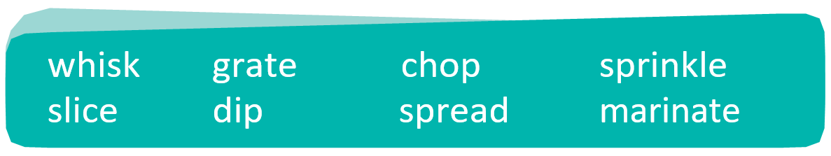
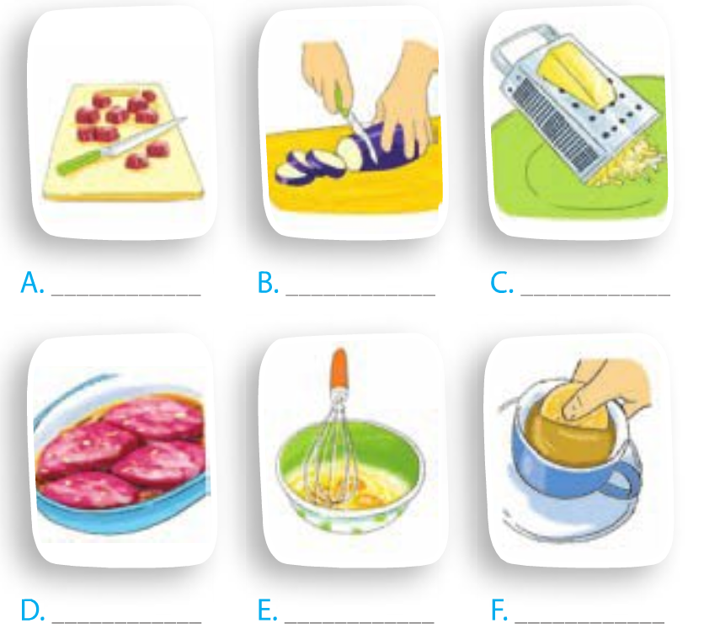
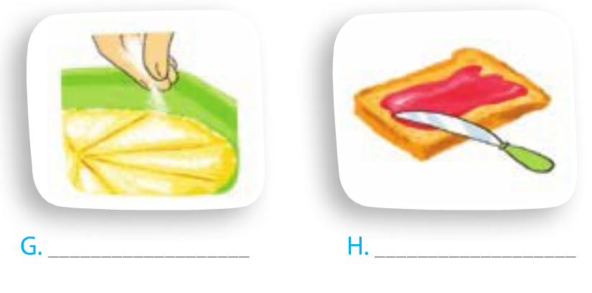
Write a food preparation verb from the box under each picture.
chop
slice
grate
sprinkle
spread
marinate
whisk
dip

Slide 4
2. Complete the sentences with the correct form of the verbs in 1 .
1. Don’t ______ the cucumber into chunks. _____ it thinly.
2. My mother usually ______ some cheese and ________
it over the pasta.
3. ________ the chicken in white wine for one hour before roasting.
4. To make this cake successfully, you should ______the eggs lightly.
5. _____ the prawns into the batter.
6. Can you ______ the butter on this slice of bread for me?
chop
Slice
grates
sprinkles
Marinate
whisk
Dip
spread

Slide 5
Match each cooking verb in A with its definition in B.
A B
1. stir-fry | a. place food over boiling water so that it cooks in the steam
2. deep-fry | b. cook something by keeping it almost at boiling point
3. roast | c. cook food under or over a very strong heat
4. grill | d. cook something slowly in liquid in a closed dish
5. bake | e. cook cakes or bread in an oven
6. steam | f. fry food in oil that covers it completely
7. stew | g. cook thin strips of vegetables or meat quickly by stirring them in very hot oil
8. simmer | h. cook meat, or vegetables without liquid in an oven or over a fire

Slide 6
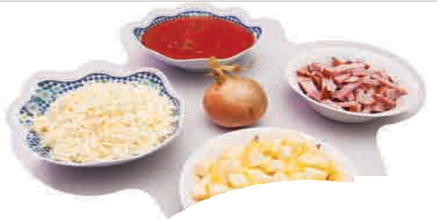

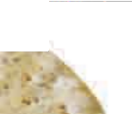


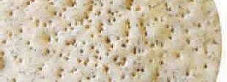
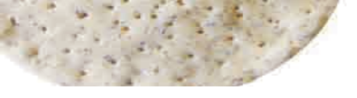
4.a. What can you see in the pictures? Do you know what dish these ingredients are used for?
tomato sauce
tomato sauce, onion, cheese, apple, bacon, pizza base → pizza
bacon
onion
cheese
apple
pizza base

Slide 7
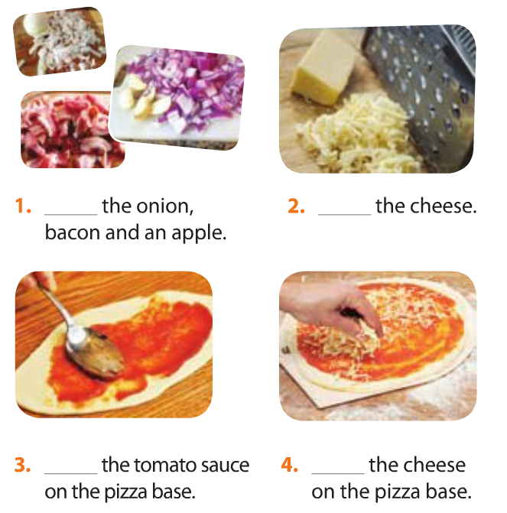
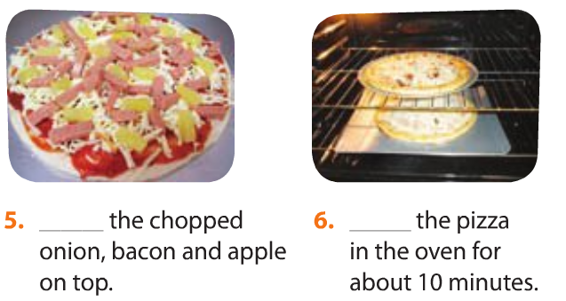
b. Complete the instructions below with the verbs in 1 and 3. One verb is used twice.
Chop
Grate
Spread
Bake
Spread
Sprinkle

Slide 8
Pronunciation:
Tones in statements used as questions
Âm điệu trong câu nhận định được dùng như câu hỏi
-> Câu hỏi nhận định được dùng để kiểm tra thông tin
Example:
-> Khi chúng ta phát âm
một câu hỏi nhận định,
giọng của chúng ta sẽ
lên cao ở cuối câu.
Nick: Mum, the prawns are pink now. (statement)
Nick’s mum: They’re pink? (statement question)
Nick: Yes.
-> Ngược lại chúng ta
xuống giọng ở cuối câu
hỏi với từ để hỏi.
Example:
Where did I put my glasses?
Listen to this part of the conversation in GETTING STARTED again and pay attention to the tone of Nick’s mum’s statement question.

Slide 9
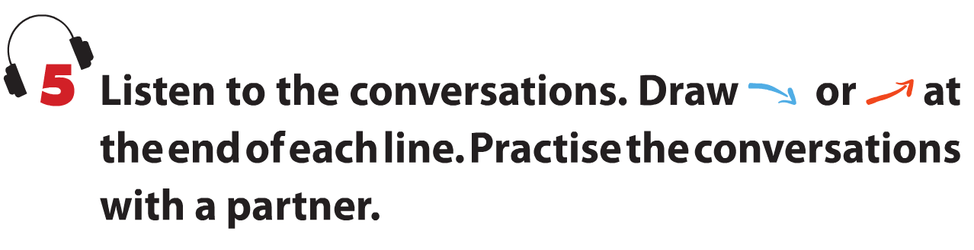
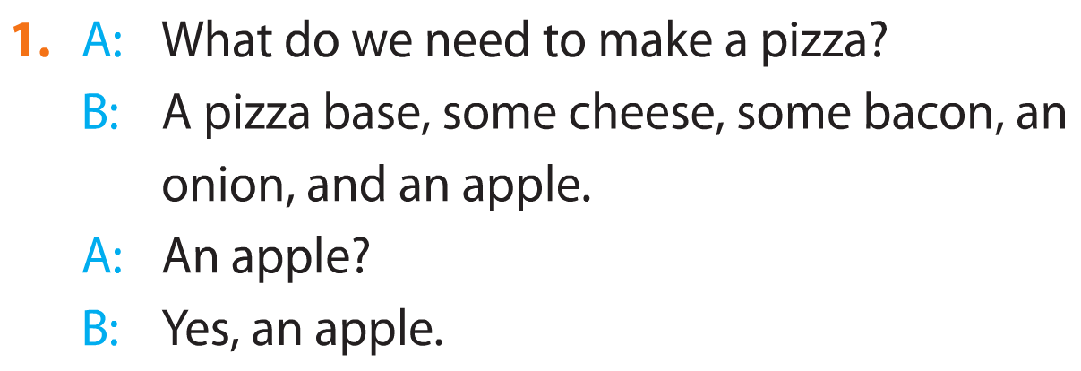
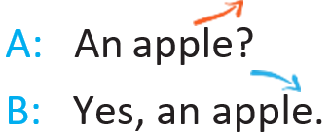
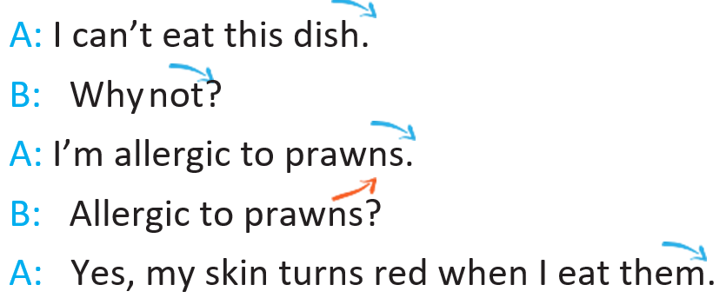
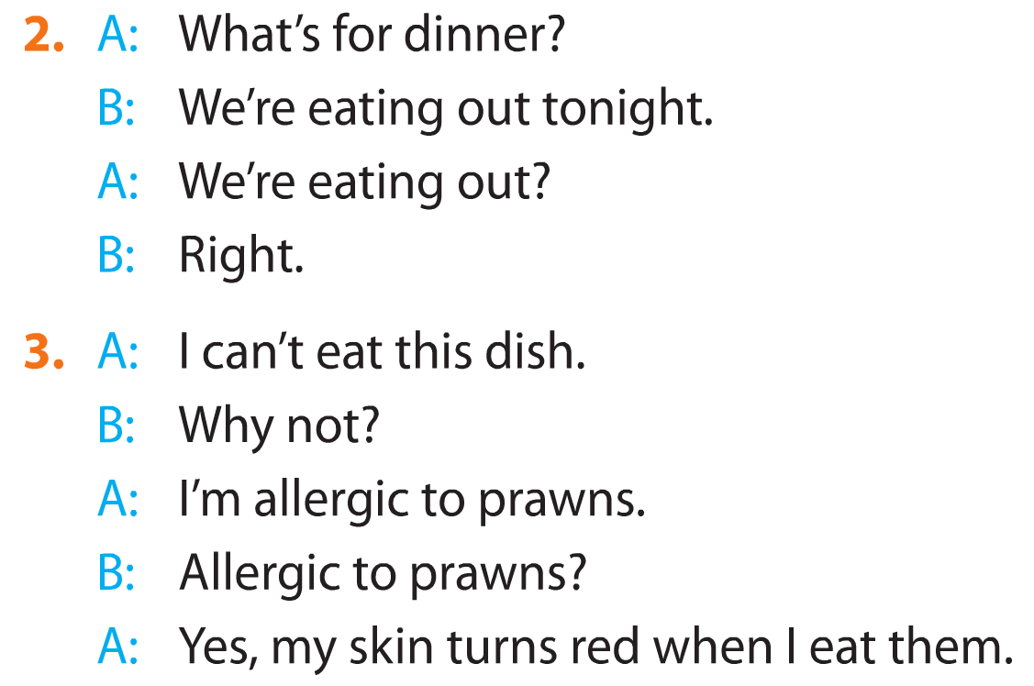
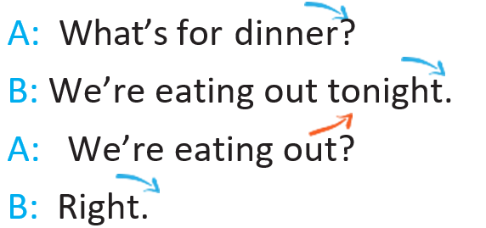


Slide 10
6a. Work in pairs. Complete the mini-dialogues with suitable statement questions.
A: Let’s have pasta tonight.
B: I don’t like pasta.
A: ?
B: No. It makes me fat.
A: What should I do next?
B: Add some salt to the salad.
A: What should I do next?
B: Add some salt to the salad.
You don’t like pasta?
Add some salt?
A: ? I thought you didn’t like salty food.
B: But it’s so tasteless.
b. Practise the mini-dialogues using the correct intonation.

Slide 11
Homework
Learn by heart the new words.
Speak with your friends
Prepare for the next..

Slide 12
Pronunciation
Tones in statements used as questions
Remember
A statement can be used as a question to check that the information we have is correct. When we pronounce a statement question, our voice goes up at the end.
Listen to this part of the conversation in GETTING STARTED again and pay attention to the tone of Nick’s mum’s statement question.
Nick: Mum, the prawns are pink now. (statement)
Nick’s mum: They’re pink? (statement question)
Nick: Yes.
In contrast, our voice goes down at the end of a Wh-question.
Example:
Where did I put my glasses?
Unit 7/ Recipes and Eating Habits

