Slide 1
PERIOD 3st
UNIT 7 : RECIPES AND EATING HABITS
LESSON 3: Closer look 2

Slide 2
Vocabulary:
- a pinch of:1 nhúm - a stick of: 1 cọng
- a bunch of: 1 buồng - a head of : 1 bắp, một bó
- a handful of: 1 vốc tay - a loaf of : 1 cuộn
- a clove of : 1 tép
- a slice of: một lát
- a carton of: 1 hộp giấy
- salami: xúc xích Ý
- lean (adj): nạc
- vinegar (n): giấm
['vinigə]

Slide 3
Grammar: Quantifiers ( Lượng từ: a, an some, any)
1/ - a, an (một)
-> a + Nđđ số ít bắt đầu bằng phụ âm
-> an + Nđđ số ít bắt đầu bằng nguyên âm ( u, e, o, a, i)
2/ - some (một vài, một ít) + Nđđ số nhiều hoặc Nkđđ
dùng trong câu khẳng định, câu yêu cầu, lời mời hoặc lời đề nghị.
Ex: Would you like some drinks?

Slide 4
3/ - any (…nào) + Nđđ số nhiều hoặc Nkđđ,
dùng trong câu PĐ và nghi vấn.
- any có nghĩa (bất cứ): được dùng trong mệnh đề khẳng định, trước N số ít ( đếm được hoặc không đếm được) hoặc sau các từ có nghĩa phủ định ( never, hardly, scarely, without,…)
Ex: I am free all day. Come and see me any time you like.
- any có thể được dùng trong mệnh đề If.
Ex: If he needs any more money, please let me know.

Slide 5
1 Fill each blank with a, an, some, or any.
Tom: Nina, you’re drinking (1)______ cola for breakfast?
Nina: Yes, (2)______ glass of Coke and (3)______ crisps. That’s my favourite.
Tom: Don’t you know that is a very bad way to start your day?
Nina: Why is it bad?
Tom: Breakfast is the rst meal of the day, so it’s very important to eat nutritious things.
Nina: Such as?
Tom: If you can’t cook (4)__________ food yourself, have (5)______ bowl of cereal and (6)______ milk. Then eat (7) ______ apple.
Nina: But there isn’t (8) ______ milk in the fridge.
Tom: Go out and buy (9) ______
a
a
some
some/any
a
some
an
any
some

Slide 6
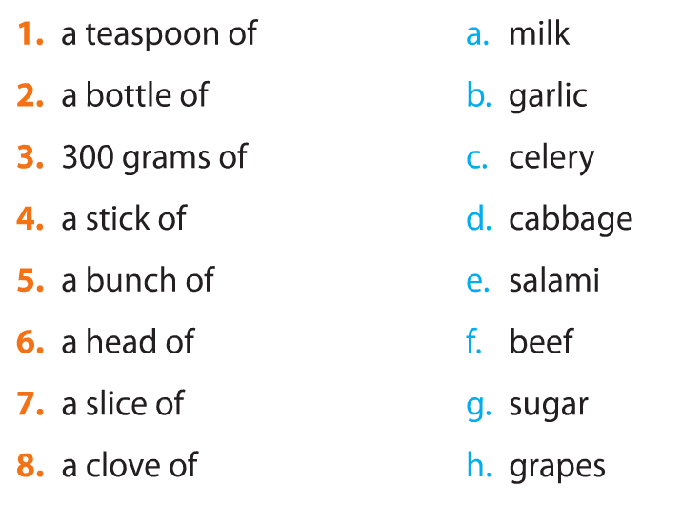
2. Match the food quantifiers with the nouns. Some quantifiers can go with more than one noun.
1-a/g
2-a
3-f/g
4-c
5-h
6-b/d
7-e/f
8-b

Slide 7
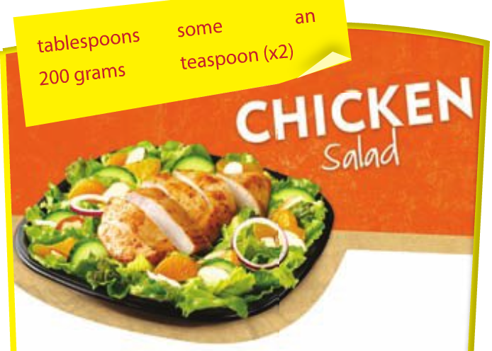
3.a Read the instructions to make a chicken salad. Fill each blank with a word/phrase in the box.

Slide 8
Boil (1)_________of lean chicken. While the chicken is cooking, wash two cucumbers, chop them in half and slice them. Then peel (2)____ onion and slice it. Mix the sliced cucumber and onion in a bowl. Add two (3)___________ of vinegar, a (4)________of salt and a (5)________ of sugar into the bowl and mix well. Leave the mixture to marinate for 10 minutes. Now slice the cooked chicken and combine it with the mixture in the bowl. Before eating, add (6) _____pepper
200 grams
an
tablespoons
teaspoon
teaspoon
some

Slide 9
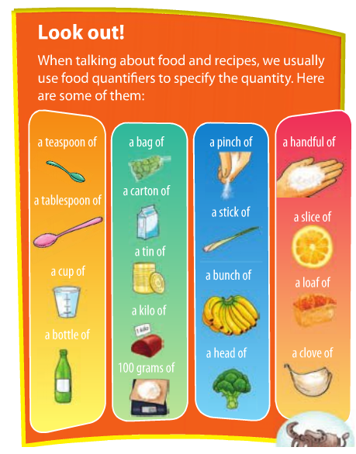

Slide 10
b. Work in pairs. Think about a simple salad. Write the instructions on how to make it using the quantifiers and cooking verbs you have learnt. Share the instructions with the whole class. Vote for the best salad.
Egg salad:
Boil 8 eggs in a medium saucepan with enough cold water to cover, and bring to boil.
Cover saucepan, remove from heat, and let eggs stand in hot for 10 to 12 minutes.
Remove from hot water, peel egg and chop it.
In a large bowl, mix eggs with ½ cup of mayonnaise, some pepper, and ¼ teaspoon of paprika.
Mash with a potato masher or fork until smooth.
Gently stir in the olives.
Refrigerate until serving.

Slide 11
Chicken Caesar salad
Cut the bread into medium pieces and bake for
8-10 minutes until they brown evenly.
Lay the chicken breasts on the pan for 4 minutes
then turn them and cook for another 4 minutes.
While waiting for the chicken, crush the garlic
and mix with the cheese, mayonnaise and white
wine vinegar, stir in a few teaspoon water if you want.
Chop the chicken into bite-size, add the mixture to
chicken and toss.
Sprinkle some cheese on top and serve right away.

Slide 12
Grammar
4. Read these sentences from the conversation in GETTING STARTED. Pay attention to the underlined part and answer the questions.
Mi: I can wash the spring onions if you like, Mrs Warner.
…
Nick’s mum: … You should be careful if you use the red knife – it’s sharp.
1. What does can in the first
sentence express?
ability
  2. What does should in the
  second sentence express?
advice

Slide 13
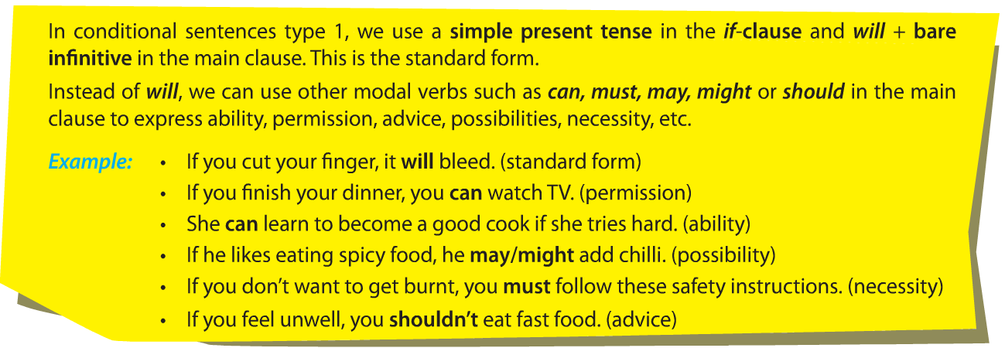

Slide 14
Grammar:
Modal verbs in conditional sentences type 1
(Động từ khiếm khuyết trong câu điều kiện loại 1)
-> Câu đk này diễn tả đk có thể hoặc không thể thực hiện được ở hiện tại hoặc trong tương. lai.
-> Trong câu đk loại 1, chúng ta dùng thì hiện tại đơn trong mệnh đề If và will + V(inf) trong mệnh đề chính. Đây là hình thức chuẩn.
-> Thay vì dùng will, chúng ta có thể sử dụng động từ khuyết thiếu khác như: can, must, may, might hoặc should trong mệnh đề chính để diễn tả năng lực, sự cho phép, lời khuyên, khả năng, sự cần thiết…
Ex: Textbook/P.12

Slide 15
II/ Grammar:
Modal verbs in conditional sentences type 1
(Động từ khiếm khuyết trong câu điều kiện loại 1)
-> Thay vì dùng will, chúng ta có thể sử dụng động từ khuyết thiếu khác như: can, must, may, might hoặc should trong mệnh đề chính để diễn tả năng lực, sự cho phép, lời khuyên, khả năng, sự cần thiết…
If Clause ( Mệnh đề If): dùng thì HTĐ | Main Clause ( Mệnh đề chính) Thì TLĐ
If + S + be (am/is/are) + V/V-s/es + do/does+ not+ V-inf | S + will/won’t + V-inf ( có thể sử dụng các động từ khiếm khuyết: can/ may/might/ /must/should)
Ex: If I have a lot of money, I will buy a big house.
If you want to pass the exam, you must study harder.

Slide 16
1. If we have more money, a.if he wants to eat them raw.
2. If she eats less fast food, b.you should use less salt.
3. He must wash the vegetables carefully c.we can eat out more often.
4. If you cook for Hung, d.you can have a bar of chocolate tomorrow.
5. My mum may be surprised e.she may lose weight.
6. If you eat healthy food tonight, f. if my dad cooks dinner

Slide 17
5. Match the first half of the sentence in A with the second half in B.
A
1.If we have more money,
2. If she eats less fast food,
3. He must wash the vegetables carefully
4. If you cook for Hung,
5. My mum may be surprised
6. If you eat healthy food tonight,
B
a. if he wants to eat them raw.
b. you should use less salt.
c. we can eat out more often.
d. you can have a bar of chocolate tomorrow.
e. she may lose weight.
f. if my dad cooks dinner.
1. c
2. e
3. a
4. b
5. f
6. d

Slide 18
6. What will you say in these situations? Use suitable modal verbs with conditional sentences type 1.
Example:
Your friend, Mai, is not good at cooking, but she wants to study abroad. You think learning to cook is a good idea because she can cook for herself when she’s away from home. Give her some advice.
If you want to study abroad, you should learn to cook.

Slide 19
Your father likes salty food, but you think it is necessary to reduce the amount of salt in his food. Otherwise, his health will suffer. You share your opinion with him.
→If you want to have good health, you must reduce the amount of salt in your food.

Slide 20
Your brother is a good eater. He’s able to eat three bowls of rice when he’s hungry. You tell this to your friend.
→If my brother is hungry, he can eat three bowls of rice.
You want to take a cooking class. Your mum agrees but asks you to choose a class at the weekend. Here is what she says to you.
→You can take a cooking class if it is at the weekend.

Slide 21
Your friend offers you a slice of pork, but you see that it is undercooked. You refuse because it is possible that you will have a stomachache. You tell this to her.
→If I eat this undercooked pork,
I may have a stomachache.
Your sister is making a cake. You advise her to whisk the eggs for 10 minutes so that the cake is lighter.
→ You should whisk the eggs for 10 minutes if you want a lighter cake.

Slide 22
Homework
Learn by heart the new words.
Speak with your friends
Prepare for the next..

