Slide 1
WELCOME TO OUR CLASS!

Slide 2
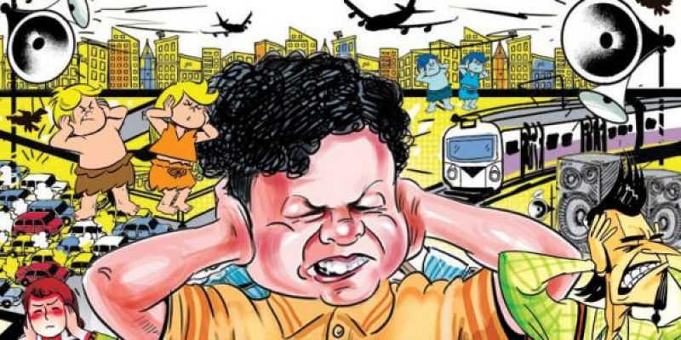
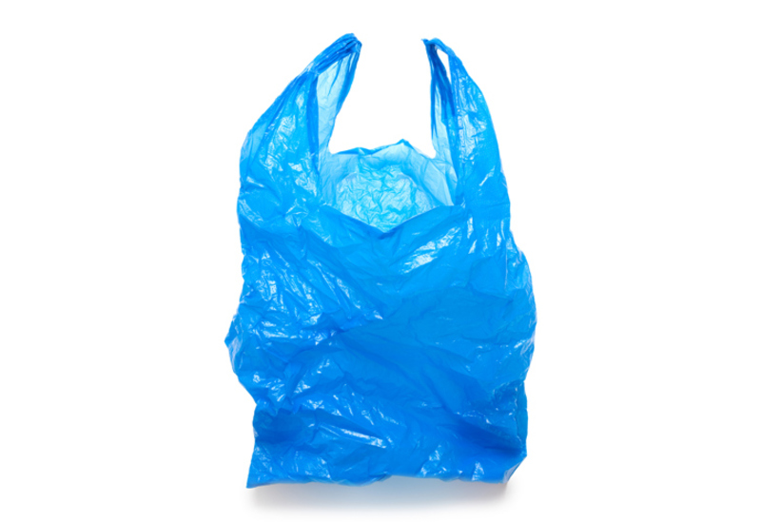
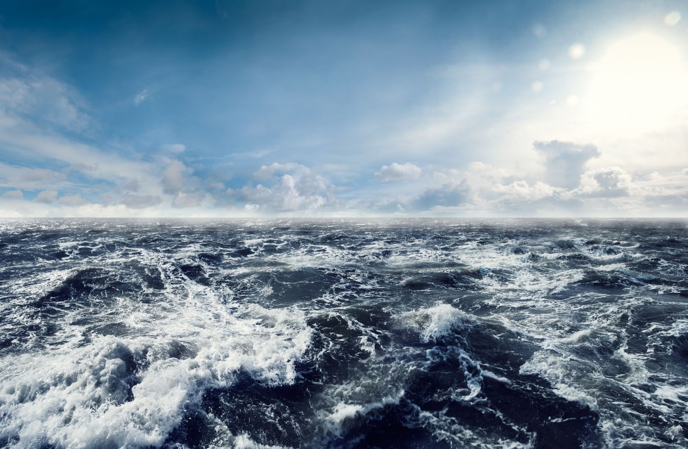
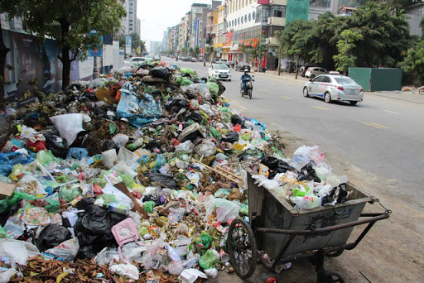
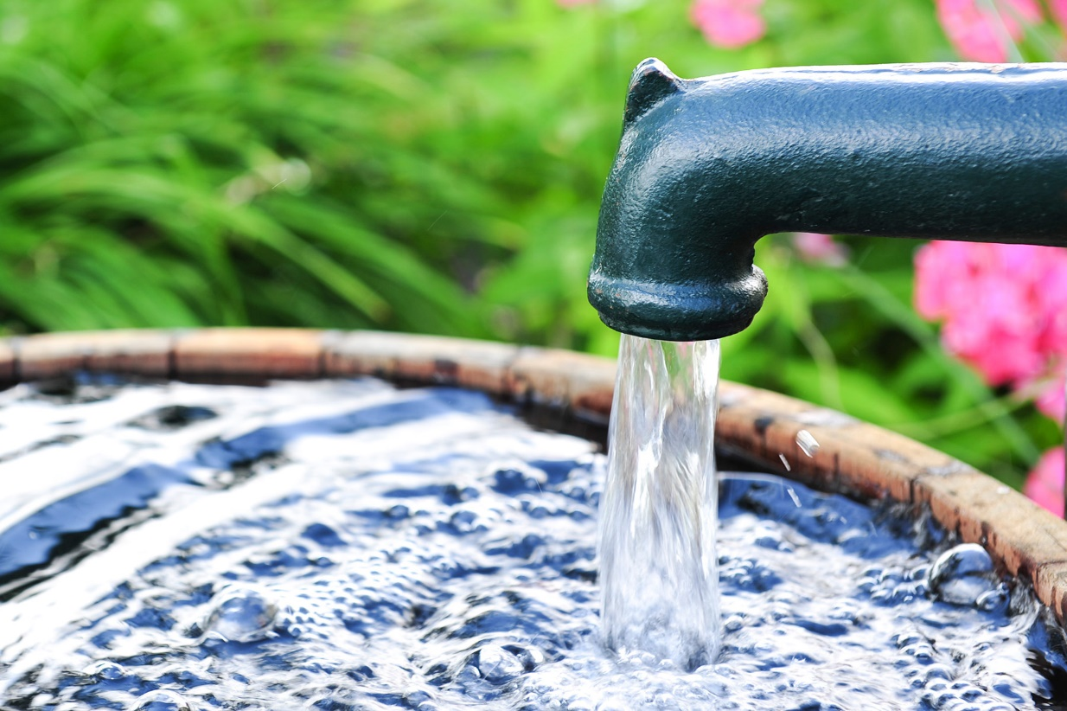
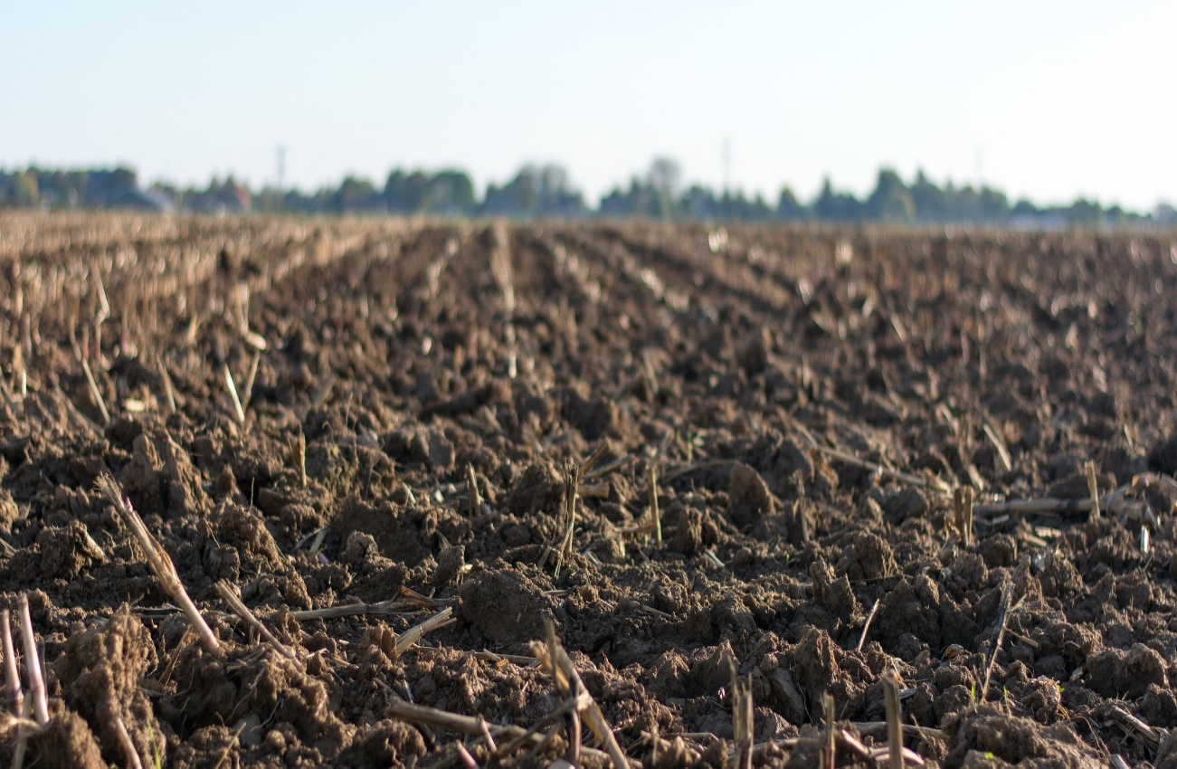
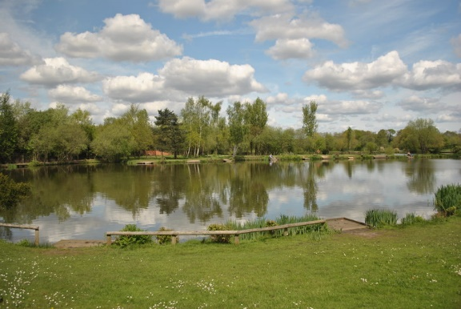
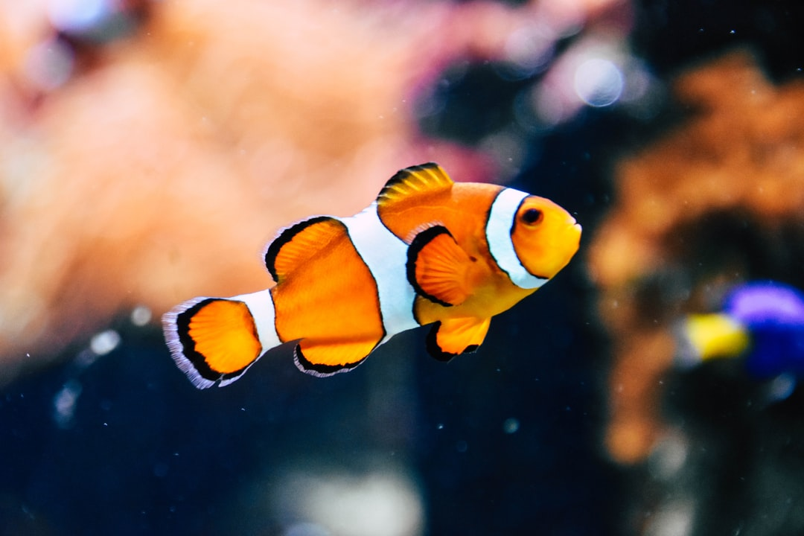
P
L
A
S
T
I
C
P
1
O
2
O
C
E
A
N
L
H
T
3
L
I
G
What is it?
What is it?
4
What is it?
L
K
L
A
E
What is it?
5
U
R
U
B
B
I
S
H
6
W
A
T
E
R
T
7
F
I
I
S
H
The…….is so annoying
What kind of bag is it?
8
What is it?
O
S
O
I
L
What is it?
It’s a …….. bulb.
9
N
N
O
I
S
E

Slide 3
Sunday, 09 January 2022
Period 55.
UNIT 7. POLLUTION
Lesson 1: Getting started

Slide 4
UNIT 7 : POLLUTION
LESSON 1 : GETTING STARTED

Slide 5
I. NEW WORDS:
- pollution (n):
sự ô nhiễm
chất độc
→poison (n): /ˈpɔɪzn/
→ die – dead - dead
- die (v):
chết
- aquatic (adj): /əˈkwætɪk/
dưới nước
- dump (v):
thải
- bless you !
cầu chúa phù hộ cho bạn
- to come up with:
nghĩ ra

Slide 6
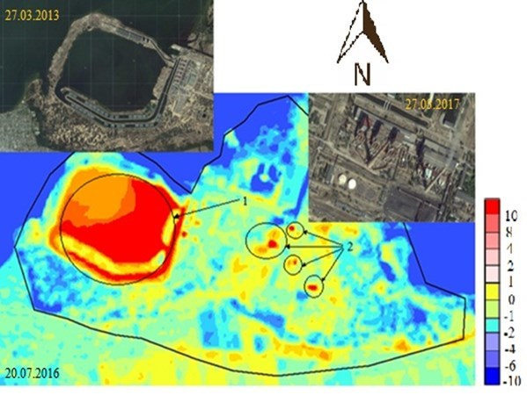
thermal pollution: (n)
/ˈθɜːməl pəˈluːʃən/
ô nhiễm nhiệt

Slide 7
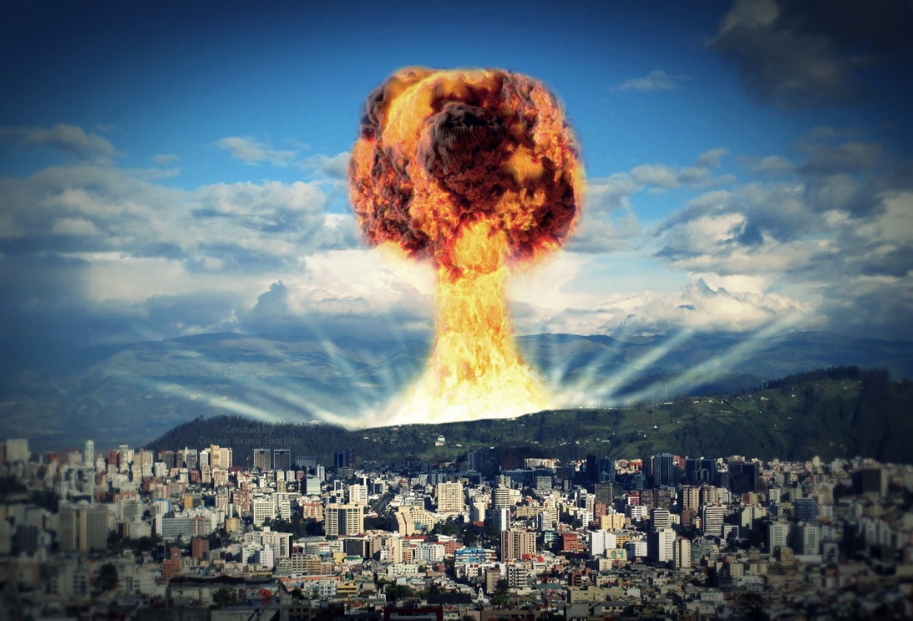
radioactive pollution: (n)
: ô nhiễm phóng xạ
/ˌreɪdiəʊˈæktɪv pəˈluːʃən/

Slide 8
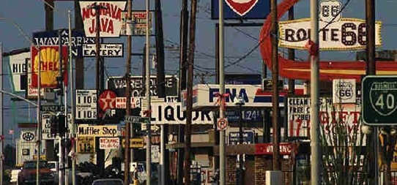
visual pollution: (n)
: ô nhiễm tầm nhìn
/ˈvɪʒuəl pəˈluːʃən/

Slide 9
I. NEW WORDS:
- pollution (n):
sự ô nhiễm
- poison (n):
chất độc
- die (v):
chết
→ die – dead - dead
- aquatic (adj):
dưới nước
- dump (v):
thải, vứt bỏ.
- bless you !
cầu chúa phù hộ cho bạn
- to come up with:
nghĩ ra
- thermal pollution (n):
ô nhiễm nhiệt
- radioactive pollution (n):
ô nhiễm phóng xạ
- visual pollution (n):
ô nhiễm tầm nhìn

Slide 10
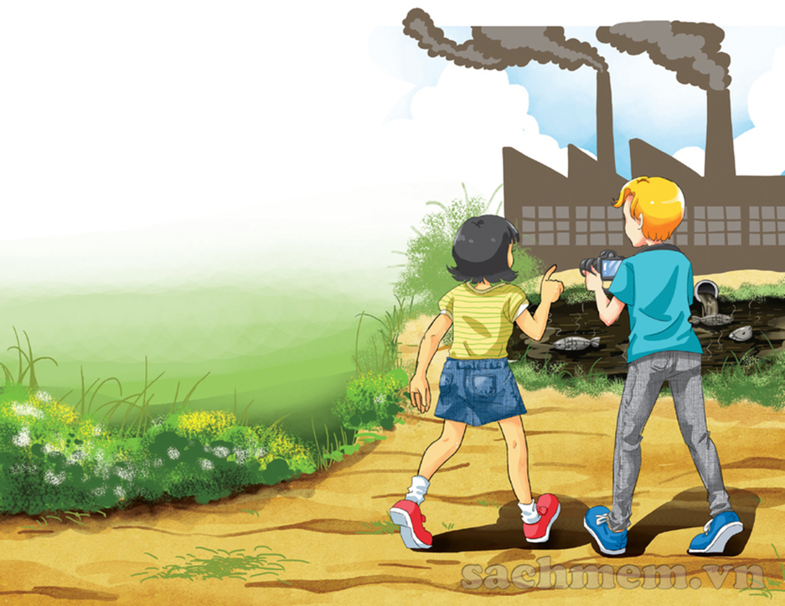
1.Who can you see in the picture?
→ Mi and Nick
2. Where do you think they are?
→ They are in Mi’ s home village.
3. What can you see in the picture ?
smoke from the factory, waste,
poison from the factory, water is
black, the fish are dead.
4. What do you think the people in the picture are talking about?
→ They are talking about their environmental project.

Slide 12
01:00
00:59
00:58
00:57
00:56
00:55
00:54
00:53
00:52
00:51
00:50
00:49
00:48
00:47
00:46
00:45
00:44
00:43
00:42
00:41
00:40
00:39
00:38
00:37
00:36
00:35
00:34
00:33
00:32
00:31
00:30
00:29
00:28
00:27
00:26
00:25
00:24
00:23
00:22
00:21
00:20
00:19
00:18
00:17
00:16
00:15
00:14
00:13
00:12
00:11
00:10
00:09
00:08
00:07
00:06
00:05
00:04
00:03
00:02
00:01
00:00
Ex1a/Find a word / phrase that means :
dead
1. no longer alive
L10
2. growing or living in, on, or near water
aquatic
L16
3. throwing away something you do not want, especially in a place with is not allowed
dump
L14
4. A substance that can make people or animals ill or kill them if they eat or drink it
poison
L15
5. Made unclear or unsafe to use
L13
polluted
6. To think of an idea, or a plan
to come up with
L22

Slide 13
Ex1c/ :
T | F | NI
1. The water in the lake has been polluted by a ship.
2. Water pollution in the lake has made the fish die.
3. Aquatic plants may also die because of the polluted water.
4. Nick wouldn’t sneeze so much if the air was clean.
5.Nick and Mi will give a talk about water and air pollution.
√
√
√
√
√

Slide 14
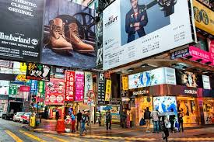
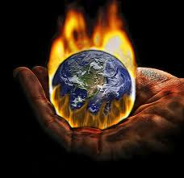
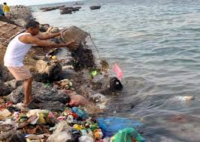
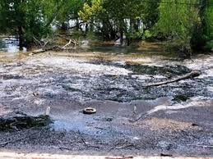
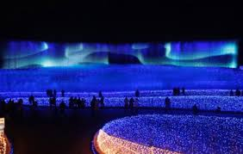
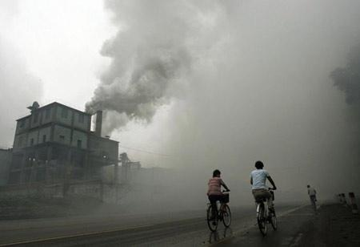
Ex2*Matching:
water pollution land/ soil pollution air pollution noise pollution thermal pollution light pollution radioactive pollution visual pollution
b. noise
pollution
c. visual
pollution
d. thermal
pollution
a. radioactive
pollution
e. water
pollution
f. land/ soil
pollution
g. light
pollution
h. air
pollution

Slide 15
Ex3*Complete the sentences with the types of pollution:
thermal pollution
1. When ……………............. happens, the water temperature in streams, rivers, lakes, or oceans changes.
2. ……………………. occurs when the atmosphere contains gases, dust, or fumes in harmful amounts.
3. When radiation goes into the land, air or water, it is called ………………………
4. Too much use of electric lights in cities may cause …………..
5. ………………….. is the contamination of lakes, rivers, oceans, or groundwater, usually by human activities.
6. ………………………… happens when human activities destroy the Earth’s surface.
7. …………..…… occurs because there are too many loud sounds in the environment.
8. The sight of too many telephone poles, advertising billboards, overhead power lines, or shop signs may case ……………………
Air pollution
radioactive pollution
light pollution
Water pollution
Land/ Soil pollution
Noise pollution
visual pollution

Slide 17
Answer the questions.
1. Where are Nick and Mi ?
2. What does the water in the lake look like ?
3. Why is Mi surprised when they get closer to the lake?
4. What is the factory dumping into the lake?
5. Why is Nick sneezing so much ?
01:30
01:29
01:28
01:27
01:26
01:25
01:24
01:23
01:22
01:21
01:20
01:19
01:18
01:17
01:16
01:15
01:14
01:13
01:12
01:11
01:10
01:09
01:08
01:07
01:06
01:05
01:04
01:03
01:02
01:01
01:00
00:59
00:58
00:57
00:56
00:55
00:54
00:53
00:52
00:51
00:50
00:49
00:48
00:47
00:46
00:45
00:44
00:43
00:42
00:41
00:40
00:39
00:38
00:37
00:36
00:35
00:34
00:33
00:32
00:31
00:30
00:29
00:28
00:27
00:26
00:25
00:24
00:23
00:22
00:21
00:20
00:19
00:18
00:17
00:16
00:15
00:14
00:13
00:12
00:11
00:10
00:09
00:08
00:07
00:06
00:05
00:04
00:03
00:02
00:01
00:00
STOP

Slide 18
LUCKY SPIN
30
20
1
2
3
40
10
50
80
4
5
60
70
SPIN

Slide 19
1.Where are Nick and Mi?
They are in Mi's home village
B. They are in Nick's home village
C. They are in the city
D. They are in a sea village
BACK

Slide 20
2.What does the water in the lake look like?
A.It's almost blue
B.It's almost black
C.It's almost pink
D.It's almost yellow
BACK

Slide 21
3.Why is Mi surprised when they get closer to the lake?
A.Because the lake is beautiful.
B. Because she hasn’t seen this lake before.
C.Because she sees the fish are dead.
D. Because she wants to swim.
BACK

Slide 22
4.What is the factory dumping into the lake?
A. It's dumping water into the lake
B. It's dumping poison into the lake
C. It's dumping food into
the lake
D. It's dumping plastic bags into the lake
BACK

Slide 23
5.Why is Nick sneezing so much?
A. Because the river is not clean.
B. Because the water is not clean.
C. Because the factory is not clean.
D. Because the air is not clean.
BACK

Slide 24
Ex1b/ Answer the questions
1. Where are Nick and Mi ?
→ They are in Mi’s home village.
2. What does the water in the lake look like ?
→ It's almost black .
3. Why is Mi surprised when they get closer to the lake?
→ Because she sees the fish dead.
4. What is the factory dumping into the lake?
→ It's dumping poison into the lake
5. Why is Nick sneezing so much ?
→ Because the air is not clean.

Slide 25
Ex4/Work in groups. Which types of pollution in 3 does your neighbourhood face? Rank them in order of seriousness. Give reasons for your group’s order.
* It’s air pollution, noise pollution and visual pollution.
Air pollution does harm to your health.
Noise pollution can make you stressed.
Visual pollution is not good for sight around.
01:30
01:29
01:28
01:27
01:26
01:25
01:24
01:23
01:22
01:21
01:20
01:19
01:18
01:17
01:16
01:15
01:14
01:13
01:12
01:11
01:10
01:09
01:08
01:07
01:06
01:05
01:04
01:03
01:02
01:01
01:00
00:59
00:58
00:57
00:56
00:55
00:54
00:53
00:52
00:51
00:50
00:49
00:48
00:47
00:46
00:45
00:44
00:43
00:42
00:41
00:40
00:39
00:38
00:37
00:36
00:35
00:34
00:33
00:32
00:31
00:30
00:29
00:28
00:27
00:26
00:25
00:24
00:23
00:22
00:21
00:20
00:19
00:18
00:17
00:16
00:15
00:14
00:13
00:12
00:11
00:10
00:09
00:08
00:07
00:06
00:05
00:04
00:03
00:02
00:01
00:00
STOP

Slide 26
*CONSOLIDATION:

Slide 27
HOMEWORK:
- Learn the new words by heart.​
- Practice the dialogue again.​
- Do exercises B1,2,3 in workbook (page 4).​
- Prepare for Unit 7: A closer look 1. (new words, grammar)​

