Slide 1
Vocabulary
Grammar
Choose the best two options to complete the sentences.
Complete the sentences with the correct possessive pronouns in the box.
Write the words in the box under their pictures.
Read the sentences and correct the underlined words.

Slide 2
Choose the best two options to complete the sentences.
Vocabulary
1.
The city is .
A.
exciting
B.
amazing
C.
long
2.
The weather is .
A.
cold
B.
quiet
C.
sunny
3.
The people are .
B.
C.
helpful
A.
friendly
expensive
4.
The buildings are .
A.
B.
beautiful
C.
fast
tall
5.
The food is .
A.
B.
delicious
C.
good
cute

Slide 3
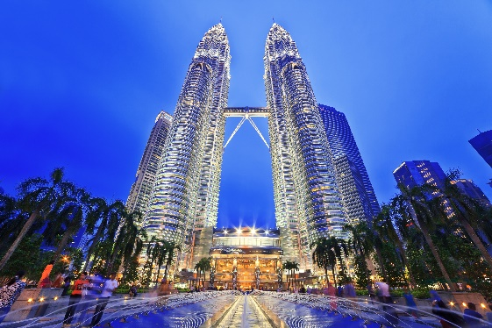
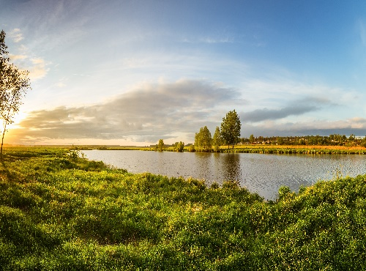
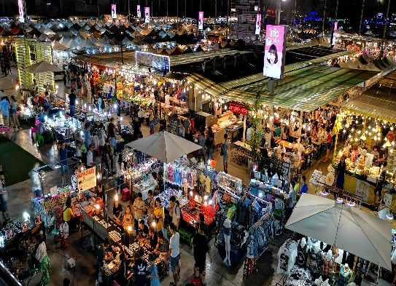
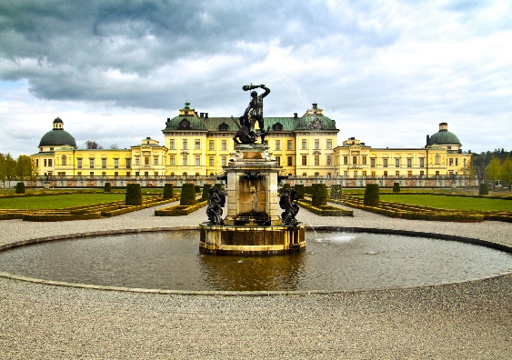
Write the words in the box under their pictures.
towers
beach
river bank
postcard
palace
night market
1.
towers
2.
river bank
3.
beach
4.
night market
5.
palace
6.
postcard

Slide 4
Complete the sentences with the correct possessive pronouns in the box.
Vocabulary
theirs
hers
yours
mine
ours
1.
Hey Phong. You’re wearing my hat. It’s not .
yours
2.
We’re looking for Mr and Mrs Smith’s house. Is that ?
theirs
3.
mine
This is my drawing. It’s .
4.
Ours
This is your room. is next door. So call us if you need anything.
5.
Sue doesn’t need to borrow my pen. She’s got .
hers

Slide 5
Read the sentences and correct the underlined words.
1.
Bangkok is an exciting city. I love it’s people
its
2.
We are watching the sunrise at Angkor Wat with ours local friends.
our
3.
Discover Beijing and Shanghai through theirs food tours.
their
4.
Visit Hue and try your food.
its
5.
Venice is your city and Jakarta is our.
ours

Slide 6
Work in groups.
Choose one city in the world you would like to visit.
Find necessary information for your visit.
Make a report of your findings and present it to the class.

Slide 7
Suggestions:
What city is it?
Where is it?
How can you go there?
What’s the weather like there?
What would you like to see and do there?
Make a report of your findings and present it to the class.

Slide 8
Now I can … |  |  | 
use the words related to cities and landmarks.
pronounce the sounds /əʊ/ and /aʊ/ correctly.
use possessive adjectives and possessive pronouns.
express exclamations with What.
read about a holiday postcard.
talk about a city.
listen to a description of a city.
write a holiday postcard.
✓
✓
✓
✓
✓
✓
✓
✓
✓
✓
✓
✓
✓
✓
✓
✓
✓
✓
✓
✓
✓
✓
✓
✓

