Slide 1
Unit 9 –CITIES IN THE WORLD
Skills 2

Slide 2
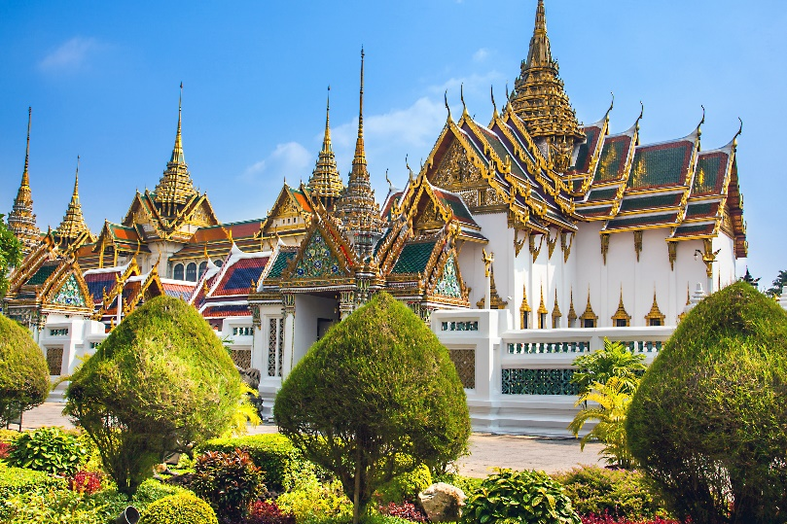
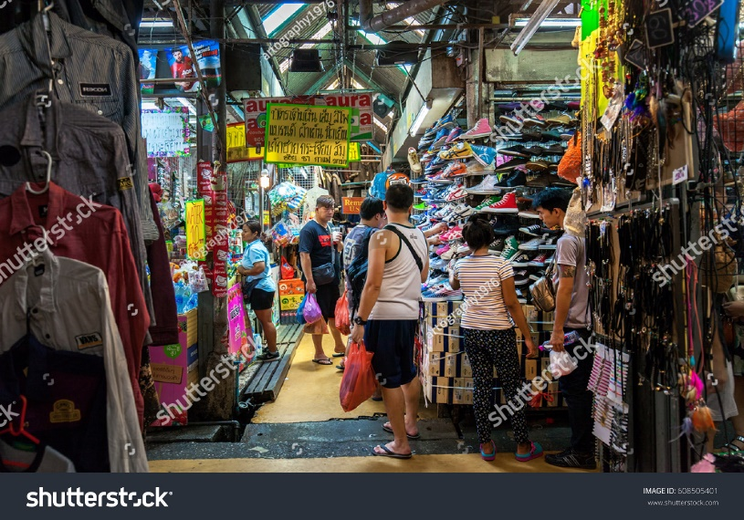
Work in groups. Discuss and answer the questions.
Listening
1.
Where is Bangkok?
2.
What is Bangkok famous for?

Slide 3
Listen and tick () T (True) or F (False).
 |  | T | F
1. | Bangkok is famous for palace.
2. | Things at Chatuchak market are expensive.
3. | The floating market is on the sea.
4. | You can find food stalls all around Bangkok.
✓
?
✓
?
✓
?
✓
?

Slide 4
SUGGEST
Bangkok is famous for its markets and street food. Visit the Chatuchak, the largest weekend market in the world. There are over 15,000 stalls selling nearly everything, at cheap prices. It’s only five minutes’ walk from the station. When you visit this market, you can see part of Thai people’s life.
Another interesting type of market is the floating market on the river. Don’t forget to try street food in Bangkok. It’s easy to find food stalls all around Bangkok, serving different Thai dishes. They are really delicious.

Slide 5
SUGGEST
Bangkok is famous for its markets and street food. Visit the Chatuchak, the largest weekend market in the world. There are over 15,000 stalls selling nearly everything, at cheap prices. It’s only five minutes’ walk from the station. When you visit this market, you can see part of Thai people’s life.
Another interesting type of market is the floating market on the river. Don’t forget to try street food in Bangkok. It’s easy to find food stalls all around Bangkok, serving different Thai dishes. They are really delicious.

Slide 6
SUGGEST
Bangkok is famous for its markets and street food. Visit the Chatuchak, the largest weekend market in the world. There are over 15,000 stalls selling nearly everything, at cheap prices. It’s only five minutes’ walk from the station. When you visit this market, you can see part of Thai people’s life.
Another interesting type of market is the floating market on the river. Don’t forget to try street food in Bangkok. It’s easy to find food stalls all around Bangkok, serving different Thai dishes. They are really delicious.

Slide 7
SUGGEST
Bangkok is famous for its markets and street food. Visit the Chatuchak, the largest weekend market in the world. There are over 15,000 stalls selling nearly everything, at cheap prices. It’s only five minutes’ walk from the station. When you visit this market, you can see part of Thai people’s life.
Another interesting type of market is the floating market on the river. Don’t forget to try street food in Bangkok. It’s easy to find food stalls all around Bangkok, serving different Thai dishes. They are really delicious.

Slide 8
Listen again and fill each gap with one word / number.
1.
15,000
Chatuchak market has over stalls.
?
2.
5
Chatuchak market is about minutes’ walk from the station.
?
3.
life
You can see part of Thai people’s at a market.
?
4.
Street food in Bangkok is .
delicious
?
Audio script

Slide 9
AUDIO SCRIPT
Bangkok is famous for its markets and street food. Visit the Chatuchak, the largest weekend market in the world. There are over 15,000 stalls selling nearly everything, at cheap prices. It’s only five minutes’ walk from the station. When you visit this market, you can see part of Thai people’s life.
Another interesting type of market is the floating market on the river. Don’t forget to try street food in Bangkok. It’s easy to find food stalls all around Bangkok, serving different Thai dishes. They are really delicious.

Slide 10
SUGGEST
Bangkok is famous for its markets and street food. Visit the Chatuchak, the largest weekend market in the world. There are over 15,000 stalls selling nearly everything, at cheap prices. It’s only five minutes’ walk from the station. When you visit this market, you can see part of Thai people’s life.
Another interesting type of market is the floating market on the river. Don’t forget to try street food in Bangkok. It’s easy to find food stalls all around Bangkok, serving different Thai dishes. They are really delicious.

Slide 11
SUGGEST
Bangkok is famous for its markets and street food. Visit the Chatuchak, the largest weekend market in the world. There are over 15,000 stalls selling nearly everything, at cheap prices. It’s only five minutes’ walk from the station. When you visit this market, you can see part of Thai people’s life.
Another interesting type of market is the floating market on the river. Don’t forget to try street food in Bangkok. It’s easy to find food stalls all around Bangkok, serving different Thai dishes. They are really delicious.

Slide 12
SUGGEST
Bangkok is famous for its markets and street food. Visit the Chatuchak, the largest weekend market in the world. There are over 15,000 stalls selling nearly everything, at cheap prices. It’s only five minutes’ walk from the station. When you visit this market, you can see part of Thai people’s life.
Another interesting type of market is the floating market on the river. Don’t forget to try street food in Bangkok. It’s easy to find food stalls all around Bangkok, serving different Thai dishes. They are really delicious.

Slide 13
SUGGEST
Bangkok is famous for its markets and street food. Visit the Chatuchak, the largest weekend market in the world. There are over 15,000 stalls selling nearly everything, at cheap prices. It’s only five minutes’ walk from the station. When you visit this market, you can see part of Thai people’s life.
Another interesting type of market is the floating market on the river. Don’t forget to try street food in Bangkok. It’s easy to find food stalls all around Bangkok, serving different Thai dishes. They are really delicious.

Slide 14
Work in groups. Talk about a city in your country, using the questions below as a guide.
Writing
What city is it?
What is it like? (the weather, the people, the food)
What can you see and do there?

Slide 15
Write a postcard of about 50 words about your holiday in a city. Use the information in 4.
Dear Mum and Dad,
To:
Love,
Trang

Slide 16
