Slide 1

Welcome teachers to class 6.1
Teacher :Châu Trần Kiều Lan
March 2022

Slide 2


Slide 3


UNIT 11 OUR GREENER WORLD
Period 78 : Getting started

Slide 4
Wednesday,March 19th, 2022
UNIT 11 OUR GREENER WORLD
Period 78 : Getting started
I.Vocabulary :
reusable (adj): [,ri:'ju:zəbl]
có thể dùng lại được

Slide 5
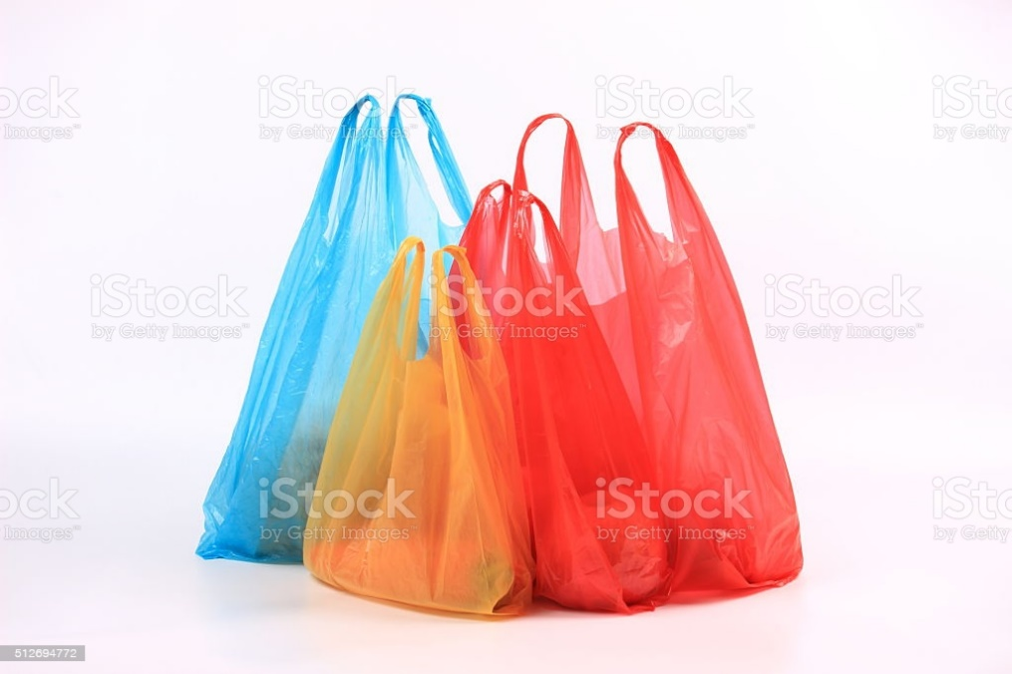
plastic bag (n): ['plæstik bæg]
túi ni lông

Slide 6
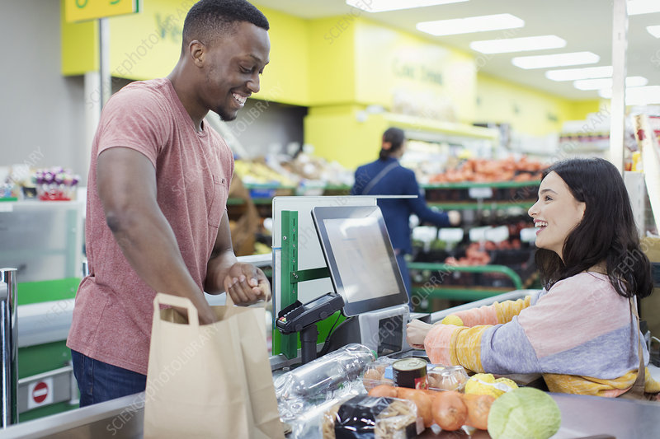
check- out (n): [t∫ek -aut]
quầy tính tiền

Slide 7
môi trường
environment (n): [in'vaiərənmənt]

Slide 8
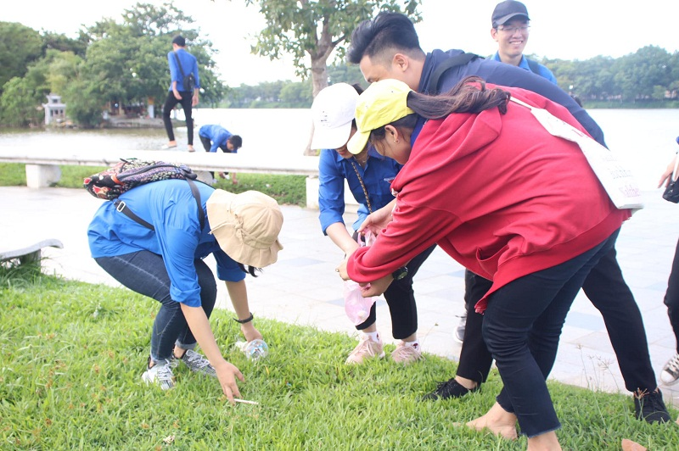
pick up (v): [pik ʌp]
nhặt, lượm

Slide 9
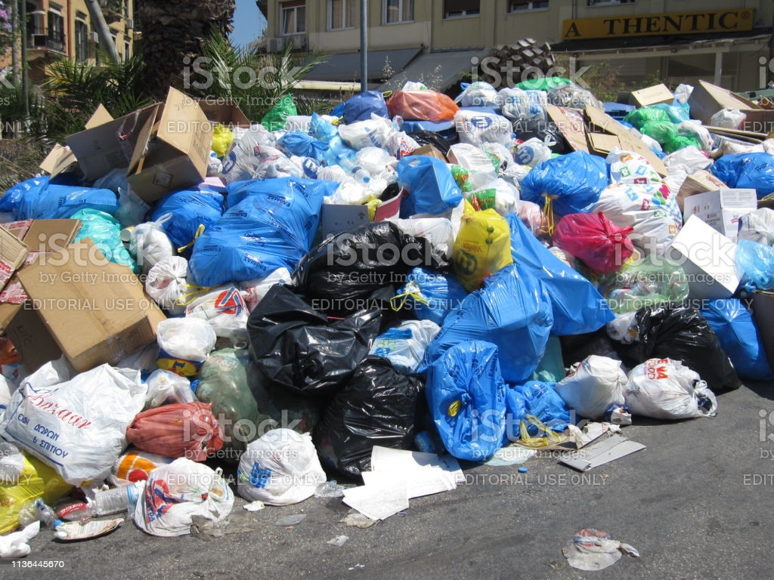
rubbish (n) : ['rʌbi∫]
rác

Slide 10
I.Vocabulary :
có thể dùng lại được
reusable (adj): [,ri:'ju:zəbl]
plastic bag (n): ['plæstik bæg]
check- out (n): [t∫ek -aut]
environment (n): [in'vaiərənmənt]
pick up (v): [pik ʌp]
- rubbish (n) : ['rʌbi∫]
túi ni lông
quầy tính tiền
môi trường
nhặt, lượm
rác

Slide 11



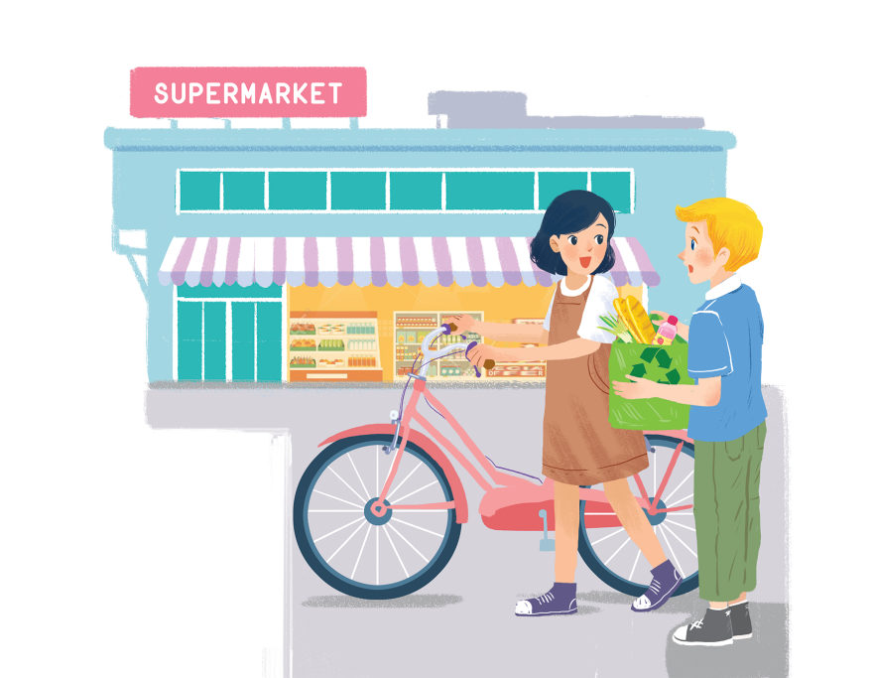
Listen and read.
Let’s go green!

Slide 12


Do you know what does
“ go green” mean?
“ go green” means: to do more to protect nature and the environment

Slide 13
Let’s go green!
Mi: Hi, Nick.
Nick: Hello, Mi.
Mi: You’ve bought a lot of things.
Nick: Yes. We’re going on a picnic tomorrow. What are you doing at the supermarket, Mi?
Mi: I’m buying some eggs. Hey, what’s this?
Nick: It’s a reusable shopping bag.
Mi: Do you always use it?
Nick: Yes. It’s better than a plastic one. If we all use this kind of bag, we will help the environment.
Mi: I see. I’ll buy one for my mum. Where can I buy one?
Nick: At the check-out. By the way, you’re also green. You’re cycling.
Mi: You’re right. If more people cycle, the air will be cleaner. Right?
Nick: Yes. Oh, it’s 5 o’clock already. I have to go now. See you later.
Mi: See you, Nick. Bye.

Slide 14

Read the conversation again. Complete the following sentences. Use no more than three words in each blank.
a picnic
1.
_______ tomorrow.
Nick is going on
plastic one
____________.
2.
The green shopping bag is better than the
______________.
the check-out.
3.
People can buy green bags at
___________ bag for her mum.
4.
Mi wants to buy
a reusable
_______________.
5.
she’s cycling
Nick thinks that Mi is green because

Slide 15

Based on the ideas in the conversation, match the first half of the sentence in column A with its second half in column B.
A
1. Green bags are better
2. The air will be cleaner
3. If people use reusable bags for shopping.
B
B
b. than plastic bags.
c. if more people cycle.
a. they will help the environment.
a. they will help the environment.
b. than plastic bags.
c. if more people cycle.

Slide 16

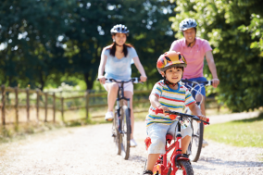
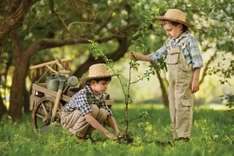
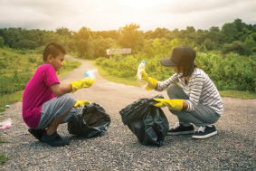
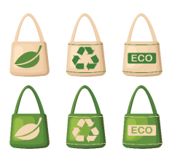
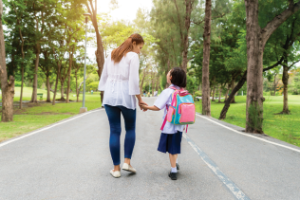
Match the pictures with the ways to help the environment.
1
2
3
4
5

Slide 17



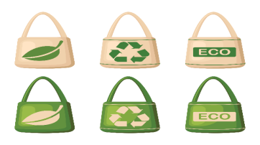
a. planting trees and flower
b. picking up rubbish
c. cycling
e. using reusable bags when shopping
d. walking to school
1
2
3
4
5

Slide 18

Gift box secret game

Slide 19












Slide 20

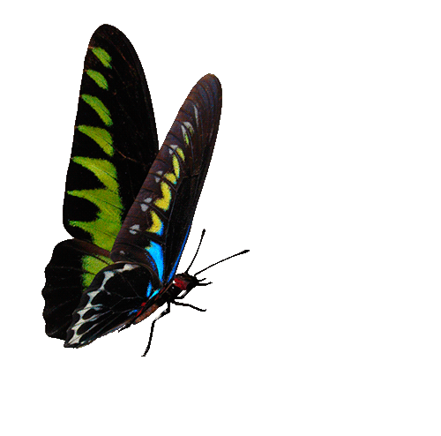






1/Are they walking to school?
Yes,they are.
You are given 3 candies
GO HOME

Slide 21
2/ Where can people buy green bags?
At the check-out.
You are given 4 candies
GO HOME

Slide 22
3/Why does Nick think Mi is green?
Because she’s cycling.
You are given 2 candies
GO HOME

Slide 23
4/What can you do to make our world green?
plant trees and flowers.
use reusable bags when shopping
pick up rubbish
You are given 5 candies
GO HOME

Slide 24
5/Will the air be cleaner if more people cycle?
Yes,it will.
You are given 4 candies
GO HOME

Slide 25
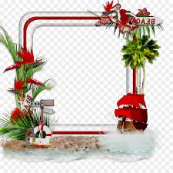
Homework:
Learn lesson.
- Prepare : A closer look 1.

Slide 26



