Slide 1
PERIOD 2nd
Unit 12/ My Future Career
LESSON 2: A CLOSER LOOK 1

Slide 2
opera singer (n): ca sĩ opera
- tourguide (n): hướng dẫn viên du lịch
- craftsman (n): thợ thủ công;
- architect (n): kiến trúc sư
- pharmacist (n): dược sĩ
- physicist (n): nhà vật lý học; - mechanic (n): thợ máy
- businesswoman (n): nữ doanh nhân
- fashion designer (n): nhà thiết kế thời trang.
- career(n): nghề nghiệp (được đào tạo, có trình độ)
- job (n): công việc (bất kì việc gì)
- profession (n): chuyên gia
- career path (n): con đường sự nghiệp
I/ Vocabulary:

Slide 3
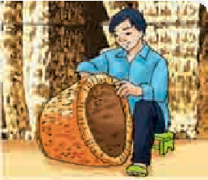
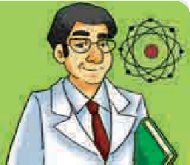
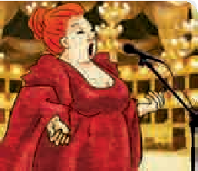

land
1. Put one word/phrase under each picture.
Vocabulary
  opera singer architect mechanic fashion designer tour guide pharmacist businesswoman craftsman physicist
land
train
experience
launch
craftsman
physicist
opera singer
fashion designer
1.
2.
3.
4.

Slide 4
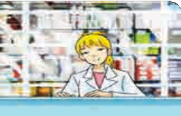
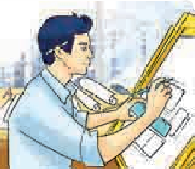
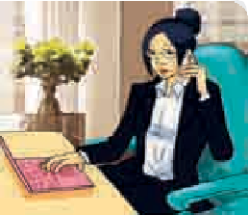
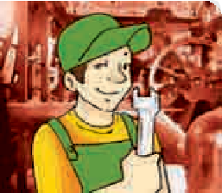
1. Put one word/phrase under each picture.
Vocabulary
  opera singer architect mechanic
  fashion designer tour guide pharmacist
  businesswoman craftsman physicist
land
train
experience
launch
pharmacist
architect
businesswoman
mechanic
5.
6.
7.
8.
Unit 12/ My Future Career

Slide 5
  2. Fill each blank with a suitable job from 1, adapting them where necessary.
1. She dreams of becoming a _ because she really likes physics.
2. He has a talent for fixing things, so he is an excellent
3. My father is running a pharmacy. He is a .
4. He wants to become a . He’s very interested in fashion and design.
5. As a(n) , he has many opportunities to perform in the Grand Theatre.
6. Working as , they design buildings.
7. They have won many big contracts. They are successful ___________________
8. Working with skilled in a pottery village, I learnt a lot about the art form.
physicist
land
train
experience
launch
mechanic
pharmacist
fashion designer
opera singer
architects
businesswomen and businessmen
craftsmen and craftswomen

Slide 6
land
3. a. Match each word/phrase in the left column with its definition in the right one.
Words/Phrases
1. career
2. job
3. profession
4. career path
Definitions
A. a type of job that needs special training or skills, often at a higher educational level
B. work which a person does to earn money
C. the way a person progresses in work in one job or in a series of jobs
D. a series of jobs a person does in a particular work area
land
experience
launch

Slide 7

land
3. b. Fill each gap with a word/phrase in 3a.
land
orbit
train
experience launch
1. Throughout his teaching _______, he worked as a teacher, a researcher and a textbook writer.
2. His _______was becoming boring, so he decided to continue with his studies.
3. If you want to enter the teaching ___________, you need to get a teaching degree.
4. She took a different ____________ when she gave up nursing and became a yoga teacher.
career
land
experience
launch
job
profession
career path
Unit 12/ My Future Career

Slide 8

(Ngữ điệu cao)
Pronunciation: High tones
land
['gɔ:dʒəs]
We use high tones for adjectives like excellent, gorgeous, brilliant, superb, absolutely amazing, etc., to show strong feelings. If we use weaker adjectives like nice, quite pleasant, quite pretty, etc., our voice does not usually go high.
Example:
A: So, how was your trip?
B: Excellent!
A: Good food?
B: Quite pleasant.
  When people use excellent, gorgeous, brilliant, superb, absolutely amazing, etc., with a flat voice, they mean the opposite.
Example:
A: The flight is delayed again.
B: Brilliant.
experience
launch

Slide 9
(Ngữ điệu cao)
Pronunciation: High tones
land
['gɔ:dʒəs]
Chúng ta sử dụng ngữ điệu cao cho các tính từ như: excellent(xuất sắc), gorgeous(tuyệt đẹp), brilliant(rất thông minh), superb(xuất sắc, tuyệt vời), absolutely amazing(vô cùng ngạc nhiên), etc., để thể hiện cảm xúc mạnh mẽ. Nếu chúng ta sử dụng những tính từ yếu hơn như nice, quite pleasant, quite pretty, etc, giọng của chúng ta thường không cao.
experience
launch
- Khi ta sử dụng excellent, gorgeous, brilliant,… với tông ngang, chúng có nghĩa ngược lại.

Slide 10
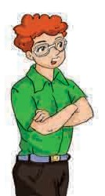


land
Pronunciation
High tones
Listen to the conversations between Jenny and Tom. Notice how Tom uses the tones in his replies. Then practise the conversation with a partner.
4
1. Jenny: The new office is pretty.
Tom: Pretty? It’s amazing!
2. Jenny: My new computer is OK.
Tom: OK? It’s fantastic!
3. Jenny: The canteen is good.
Tom: Good? It’s wonderful!
4. Jenny: My colleagues are OK.
Tom: OK? They are absolutely fantastic!
5. Jenny: The working environment is pleasant.
Tom: Pleasant? It’s superb!
6. Jenny: The view from my office is nice.
Tom: Nice? It’s gorgeous!
land
experience
launch
Unit 12/ My Future Career

Slide 11
land
The responses to the pairs of sentences are the same but the speakers have opposite attitudes. Listen, draw arrows to show the tones, then repeat.
Pronunciation
High tones
5
  a · They offered us Thai food.
    Delicious.
  b · We had some old slices of bread.
    Delicious.
land
launch
1a | They have a new air-conditioner. Brilliant. | 1b | There’s going to be an electricity cut today. Brilliant.
2a | I got the sack. Well done. | 2b | I got a promotion again. Well done.
3a | I got an A in the exam. Excellent. | 3b | I failed the exam again. Excellent.
4a | Her application was turned down. Amazing. | 4b | I’ve been offered two jobs at the same time. Amazing.
5a | We’re having a company holiday in a luxury resort. How awful. | 5b | He has decided to cut down on our wages. How awful.

Slide 12
Homework
Learn by heart the new words.
Speak with your friends
Prepare for the next..

