Slide 1




Unit 1
Local Environment
Lesson 5: Skills 1

Slide 2
I.Vocabulary:
layer (n) /ˈleɪə(r) lớp lá
frame (n) /freɪm/ khung
poem (n) /ˈpəʊɪm/thơ
authenticity /ˌɔːθenˈtɪsəti/ xác thực
string /strɪŋ/ (n): quai (nón)
skillful /ˈskɪlfl/ (adj): khéo léo

Slide 3

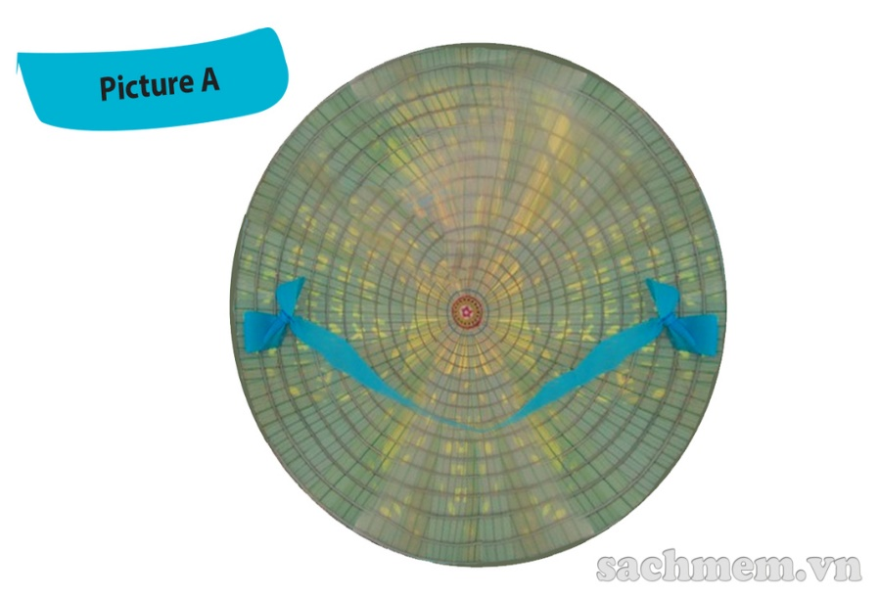
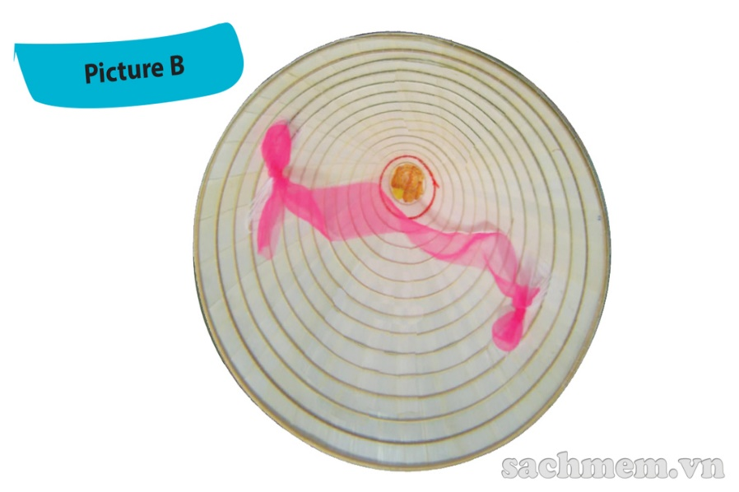
1. Work in pairs. One look at Picture A and other look at picture B. Ask each other question to find out the similarities and differences between your pictures
- Similarities: conical hat, string
Differences
Picture A: light green, pictures between layers, blue string, look lighter
Picture B: white, no decoration, pink string, look heavier

Slide 4

2. Mi visited Tay Ho village in Hue last month. She has decided to present what she knows about this place to the class. Read what she has prepared and match the titles with the paragraphs
Paragraph A:
1. Present status of the craft
Paragraph B:
2. Location and history of conical hat making village
Picture A: light green, pictures between layers, blue string, look lighter
Picture B: white, no decoration, pink string, look heavier
Paragraph C:
3. How the conical hat is made

Slide 5
2. Mi visited Tay Ho village in Hue last month. She has decided to present what she knows about this place to the class. Read what she has prepared and match the titles with the paragraphs
А. When you think about the conical hat, the first thing you think of is the region of Hue. Conical hat making has been a traditional craft there for hundreds of years, and there are many craft villages like Dale, Phu Cam, and Doc So. However, Tay Ho is the most famous because it is the birthplace of the conical hat in Hue. It is a village on the bank of the Nhu Y River, 12 km from Hue City.
B. A conical hat may look simple, but artisans have to follow 15 stages, from going to the forest to collect leaves to ironing the leaves, making the frames, etc. Hue's conical has always have two layers of leaves. Craftsmen must be skillful to make the two layers very thin. What is special is that they then add poems and paintings of Hue between the two layers, creating the famous bai tho or poetic conical has.
C. Conical hat making in the village has been passed down from generation to generation because everybody, young or old, can take part in the process. It is a well-known handicraft, not only in Viet Nam, but all around the world.
Picture A: light green, pictures between layers, blue string, look lighter
Picture B: white, no decoration, pink string, look heavier

Slide 6
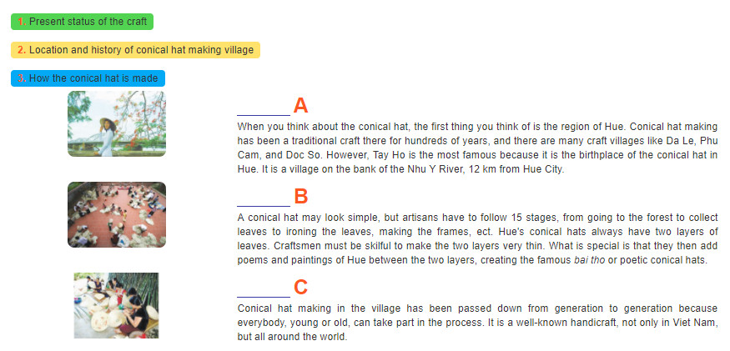
2. Mi visited Tay Ho village in Hue last month. She has decided to present what she knows about this place to the class. Read what she has prepared and match the titles with the paragraphs
Paragraph A:
1. Present status of the craft
2. Location and history of conical hat making village
3. How the conical hat is made
Paragraph B:
Paragraph C:

Slide 7
3. Read the text again and answer the questions
Why is Tay Ho the most well-known conical hat making village?
2. How far is it from Tay Ho to Hue City?
3. What is the first stage of conical hat making?
4. What is special about the hat layers?
5. What is special about the bai tho conical hat?
6. Who can make conical hats?
Because it is the birthplace of the conical hat in Hue.
It’s 12 km from Hue City.
It’s going to the forest to collect leaves.
They’re very thin.
It has poems and paintings of Hue between the two layers.
Everybody can, young or old.

Slide 8
SPEAKING
4. Read the following ideas. Are they about benefits of traditinal crafts (B) or challenges that artisans may face (C). Write B or C
B
1. providing employment
2. losing authenticity
3. providing additional income
4. relying too much on tourism
5. treating waste and pollution
6. preserving cultural heritage
C
B
C
C
B
Can you add some more benefits and challenges

Slide 9
Can you add some more benefits and challenges that artisans may face?
Other benefits: | Other challenges:
Creating national/regional pride helping develop tourism, helping improve local infrastructure and services, Creating cohesion between craft families and communities | limited designs, - natural resources running out, competition from other countries

Slide 10
5. Imagine that your group is responsible for promoting traditional crafts in your area. Propose an action plan to deal with the challenges
Our group want to propose an action plan for promoting conical hat, a well-know traditional crafts of our country.
The first part of the plan, we want to provide young people, especially students like us, with knowledge about this product. Young people should know about conical hat’s history, symbolization, the making process, ect… so they understand why we need to promoting it and keep it alive even in the current modern life. After that, we should organize some fairs or festival for conical hat and even other traditional crafts to increase the sale of these products. Last but not least, we can produce conical hats for different purposes instead of only for wearing. In this days and age, conical hats are no longer a conventional accessory for the majority of our population. However, we can create more unique and artistic conical hats for decorating home or dance and music performance. It can also be a way to increase the sale of this product.
We hope our plan can help to promote conical hats in the future. Thanks for listening!

Slide 11

HOMEWORK
- Learn by heart vocabulary
- Practice reading paragraph
- Speaking
- Prepare: Skills 2

