Slide 2
Unit
4
MUSIC AND ARTS
LESSON 1: GETTING STARTED
A talk at the school gate
Unit
HOBBIES

Slide 3
OBJECTIVES
By the end of the lesson, students will be able to:
get an overview about the topic Music and arts
use the vocabulary to talk about Music and arts

Slide 4
LESSON 1: GETTING STARTED
WARM-UP
Chatting
Aims of the stage:
to create an active atmosphere in the class before the lesson
to introduce the topic

Slide 5
WARM-UP: CHATTING

Slide 6
WARM-UP: CHATTING

Slide 7
WARM-UP: CHATTING
1/ Do you like the piece of music you have listened?
2/ What kind of music do you like?
3/ When do you listen to music?
4/ How do you feel when you listen to music?
5/ Is music important to our life?
Yes, it is. Music helps me relax after a busy day with studying.

Slide 8
LESSON 1: GETTING STARTED
WARM-UP
Chatting
PRESENTATION
Vocabulary
Listen and read.
Aims of the stage:
to provide students with vocabulary
to help students well-prepared for the listening and reading tasks

Slide 9
PRESENTATION
classical (adj)
modern
/ˈklæsɪkəl/
cổ điển

Slide 10
PRESENTATION
spare time (n)
/speər taɪm/
thời gian rảnh rỗi

Slide 11
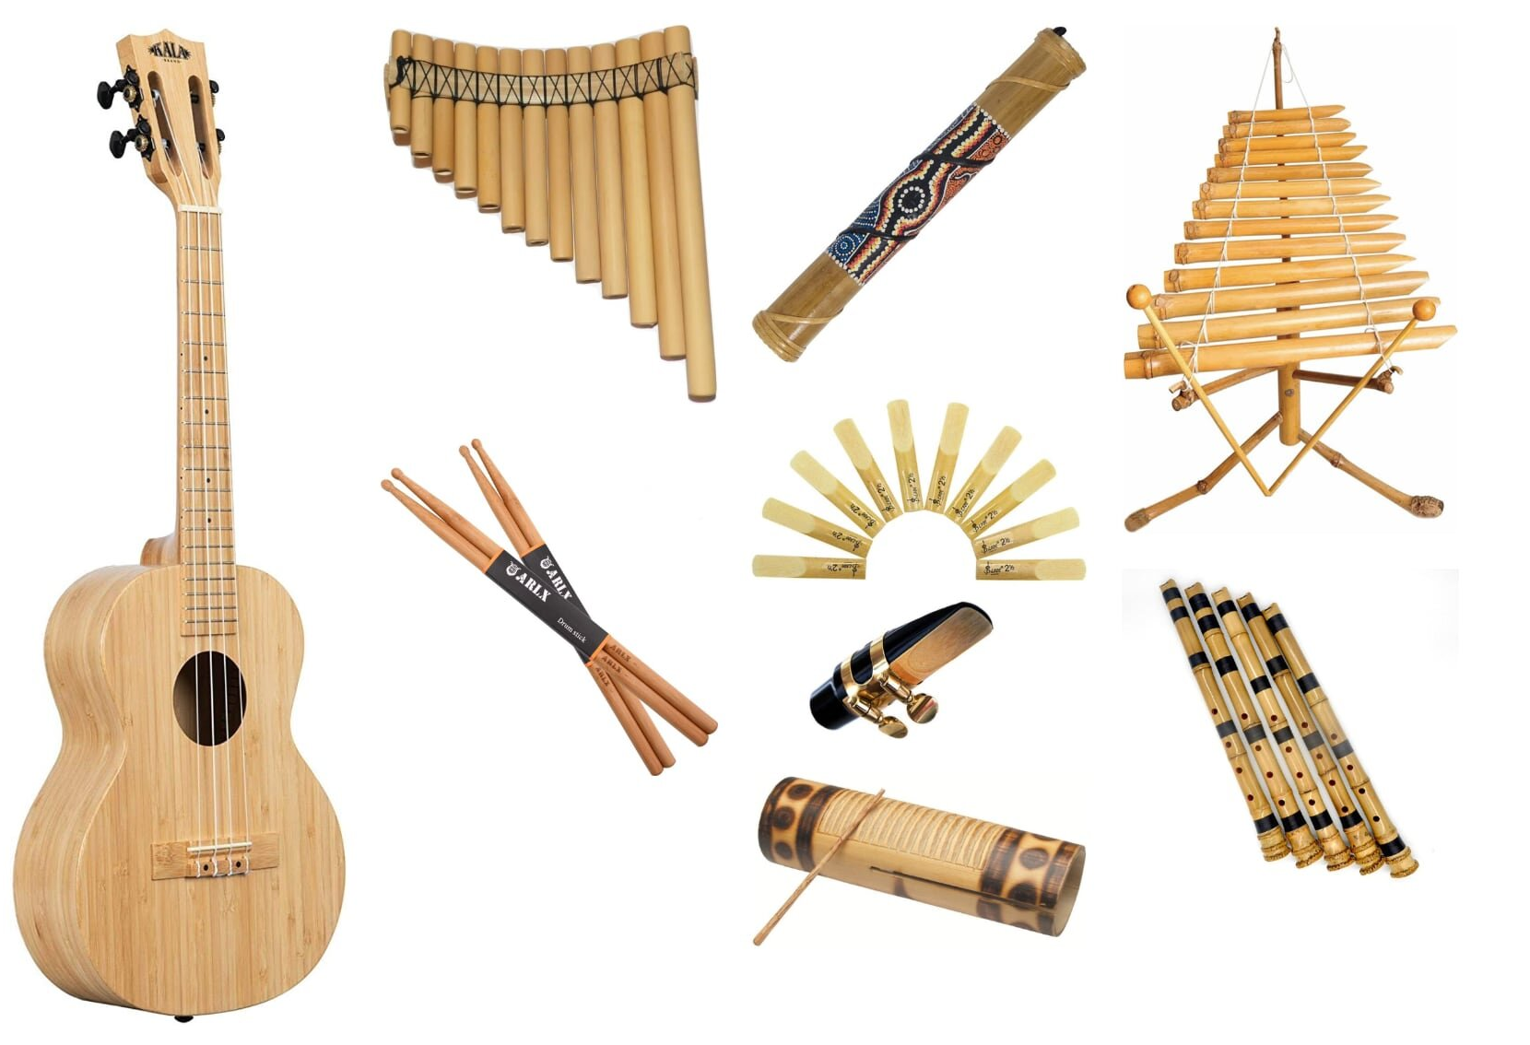
PRESENTATION
musical instruments (n)
/ˈmjuːzɪkəl ˈɪnstrəmənts/
nhạc cụ

Slide 12
PRESENTATION
landscape (n)
/ˈlændskeɪp/
cảnh quan

Slide 13
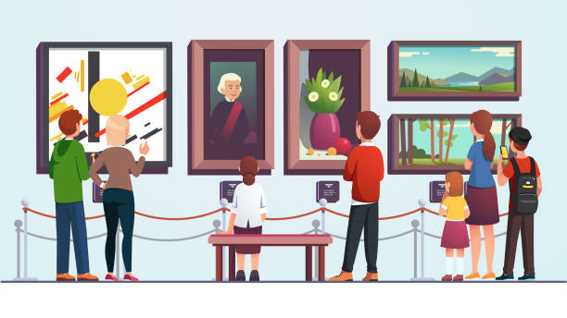
PRESENTATION
art gallery (n)
/ˈɑːt ˌɡæləri/
phòng trưng bày
nghệ thuật

Slide 14
Unit 4: Getting started
- classical music (n): nhạc cổ điển /ˈklæsɪkəl ˈmjuːzɪk/ - musical instruments:(n) nhạc cụ /pleɪ ˈmjuːzɪkəl ˈɪnstrʊmənts/ - different from /ˈdɪfrənt frɒm/: khác nhau - landscapes (n)/ˈlænskeɪps/: phong cảnh - art gallery (n)/ˈɑːt ˌɡæl.ər.i/: triển lãm nghệ thuật - paintbrush (n)/ˈpeɪntbrʌʃ/ : cọ vẽ - talented (adj) /ˈtæləntɪd/: tài năng - artistic (adj) /ɑːˈtɪstɪk/ : nghệ thuật - musician (n) /mjuˈzɪʃn/: nhạc sĩ - engineer (n)/ˌendʒɪˈnɪə(r)/: kĩ sư

Slide 15
New words | Pronunciation | Meaning
- classical (adj) | /ˈklæsɪkəl/ | cổ điển
- spare time (n) | /speər taɪm/ | thời gian rảnh rỗi
- musical instruments (n) | /ˈmjuːzɪkəl ˈɪnstrəmənts/ | nhạc cụ
- landscape (n) | /ˈlændskeɪp/ | cảnh quan
- art gallery (n) | /ˈɑːt ˌɡæləri/ | phòng trưng bày nghệ thuật

Slide 16
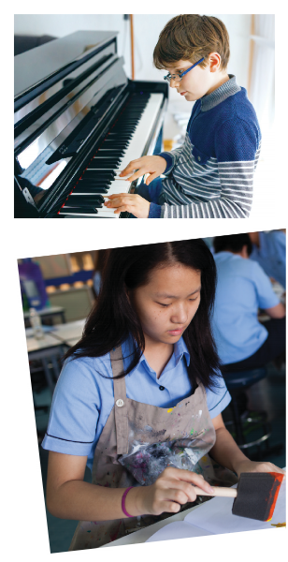
PRESENTATION: LISTEN AND READ
Aim of the task:
to have students get to know the topic

Slide 17
Trang: Hi Nick. What are you listening to?
Nick: I’m listening to music. I like classical music, and I often play the piano in my spare time.
Trang: Wow. I can’t play any instruments.
Nick: And what about you? What’s your hobby?
Trang: I like painting and taking photos.
Nick: Taking photo? I’ve never tried it. Is it fun?
Trang: Yeah, it is, but not as fun as painting.
Nick: Right. They seem quite different from each other. What do you normally paint?
Trang: Landscapes and animals, just for pleasure, you know. I sometimes share them with my friends.
Nick: Really? Um, maybe we should go to an art gallery next weekend?
Trang: Sounds good, but I’d prefer to go to the music festival at my school.
Nick: Well … OK. That’s fine.

Slide 18
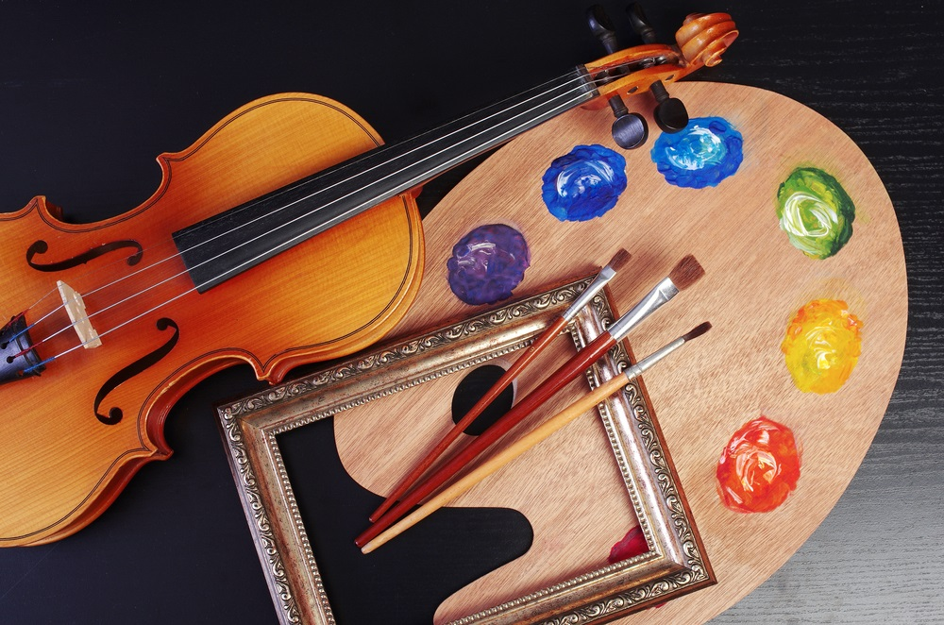
1
Tick the correct answer.
1. What are Trang and Nick talking about? A. Playing the piano. B. Drawing and painting. C. Music and arts.
Trang: Hi Nick. What are you listening to?
Nick: I’m listening to music. I like classical music, and I often play the piano in my spare time.

Slide 19
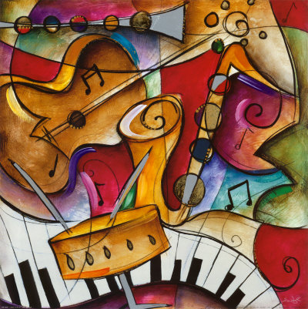
2
Complete each of the sentences with a suitable word or phrase from the box.
photos like different from art gallery musical instruments
Nick wants to go to a(n) _____________ next week.
You can use your smartphone to take ________.
This photo is very bright. It is _____________ that dark one.
Nick and Trang agree that taking photos is not _____ painting.
My friend David is very talented. He plays three _______________________.
art gallery
photos
different from
like
musical instruments

Slide 20
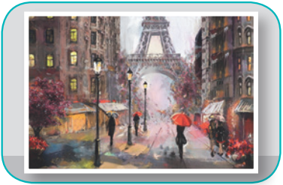
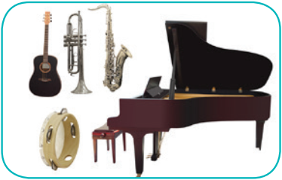
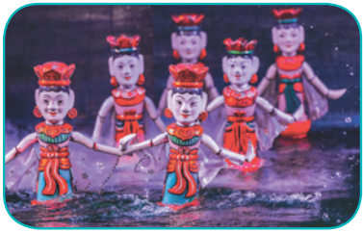
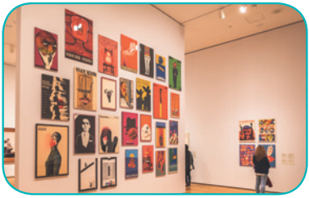
Write the correct word or phrase under each picture. Then listen and repeat.
4
camera water puppet show art gallery
painting paintbrush musical instruments
paintbrush
camera
painting
1. ______________
2. ____________
3. ____________
musical instruments
water puppet show
4. __________________________
5. _________________________
art gallery
6. ____________

Slide 21
PRACTICE
4
Quiz “How artistic are you?”.

Slide 22
CONSOLIDATION
1
WRAP-UP
MUSIC AND ARTS
ABOUT MUSIC
ABOUT ARTS
Topic of the unit
Vocabulary

Slide 23
CONSOLIDATION
2
HOMEWORK
Prepare the vocabulary for the next lesson: A closer look 1.
Prepare for the Project lesson.

Slide 24
Website: sachmem.vn
Fanpage: facebook.com/sachmem.vn/

