Slide 1
*Network
Healthy activities

Slide 2
HEALTHY LIVING
Unit 2:
Lesson 2:
A closer look 1

Slide 3
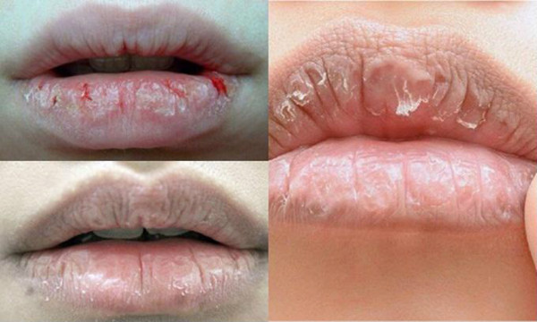
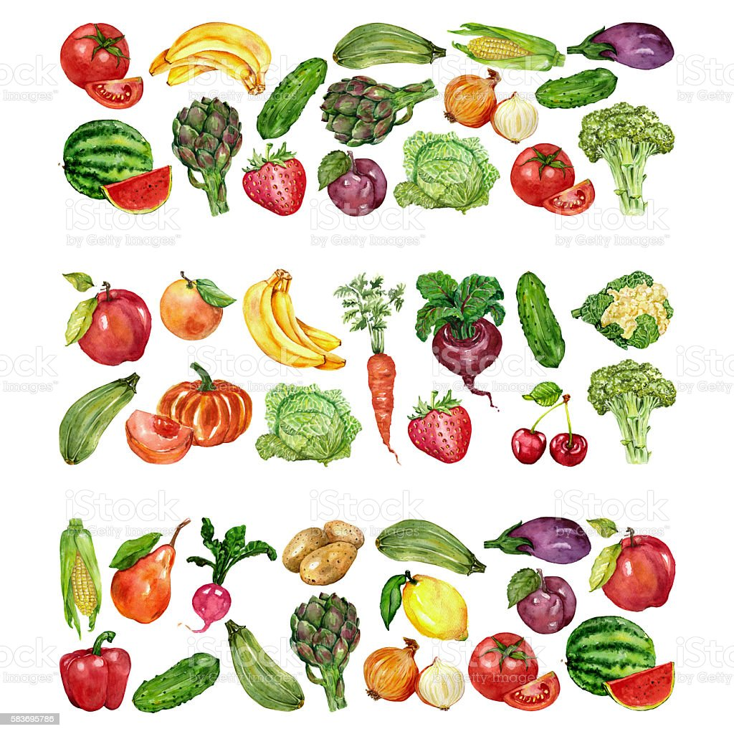
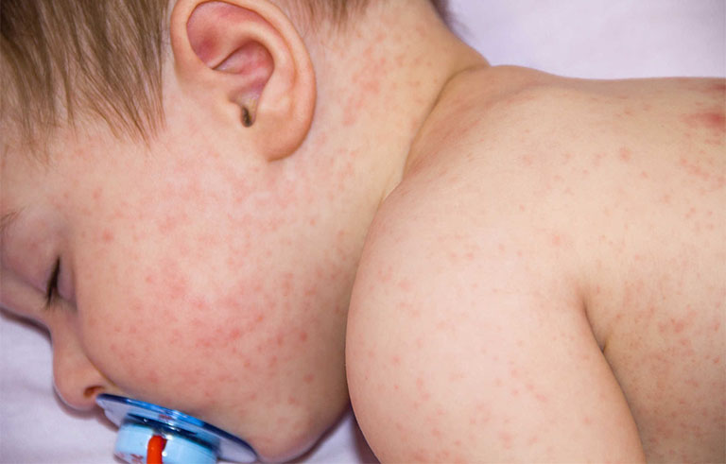
1. Vocabulary:
- chapped lips (n)
môi khô/ nứt nẻ
- lip balm (n)
son dưỡng môi
- red spots (n)
đốm đỏ
- coloured vegetables (n)
rau màu
- dim light (n)
ánh sáng mờ
- skin condition (n)
trạng thái da

Slide 4
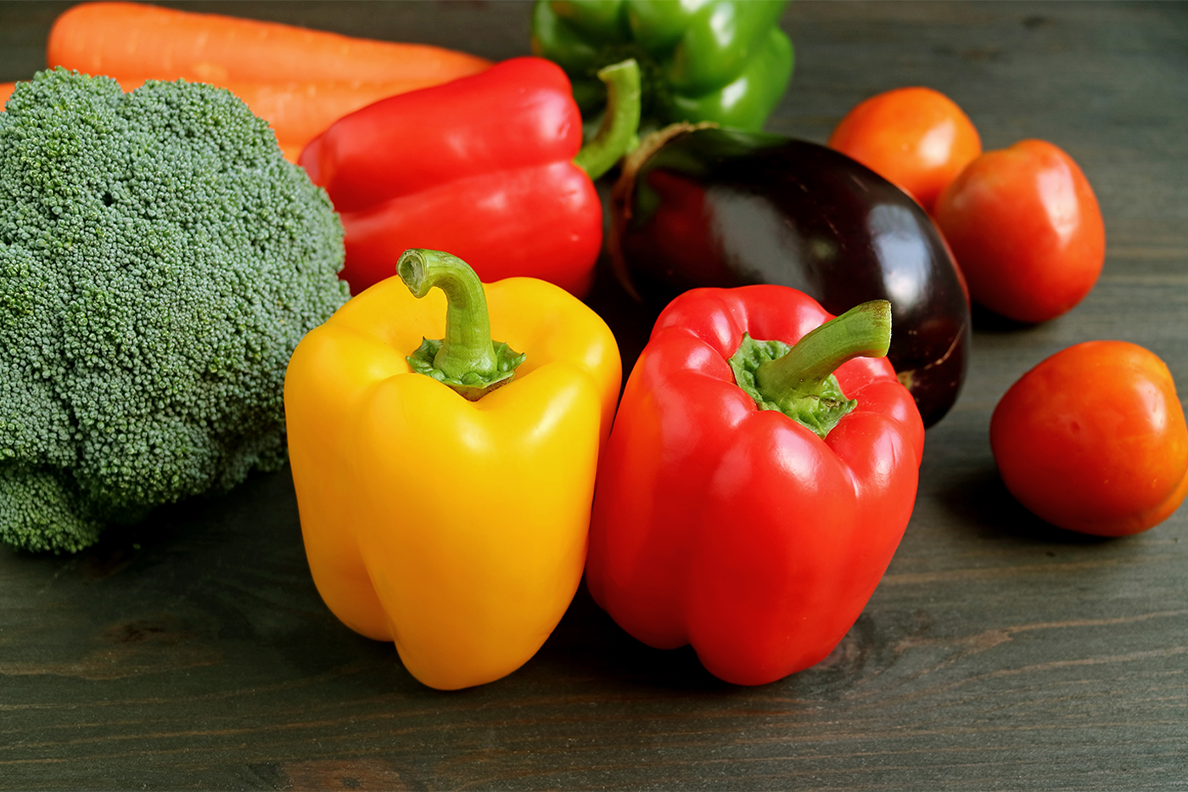
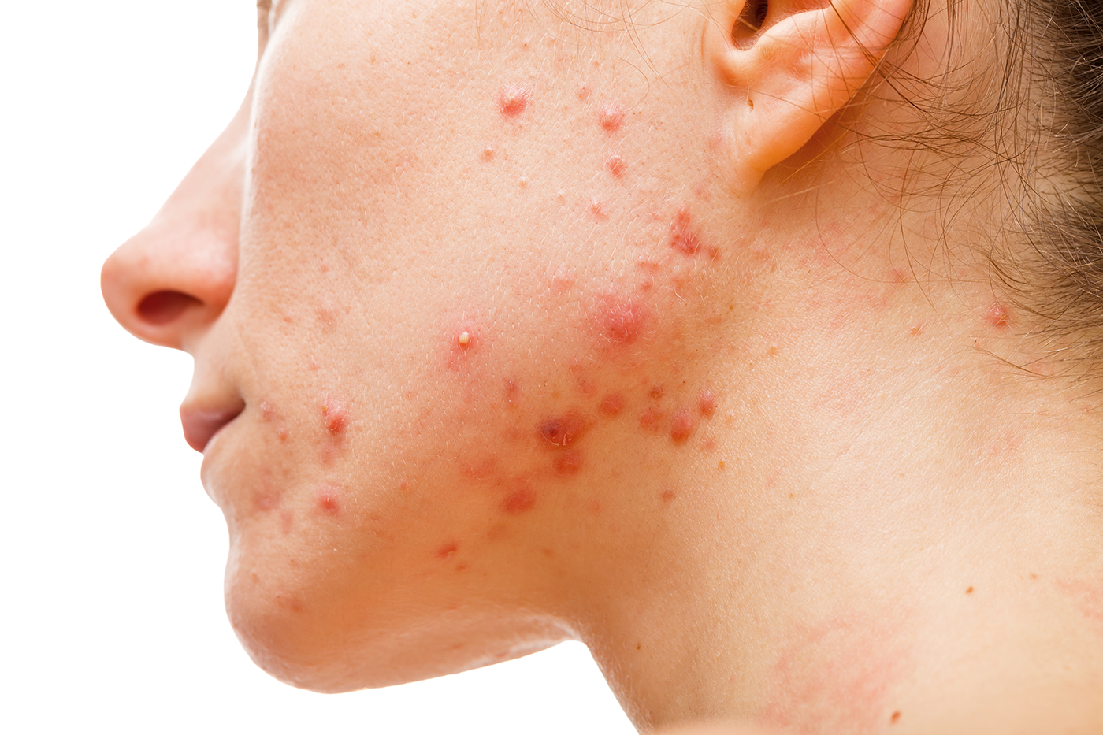
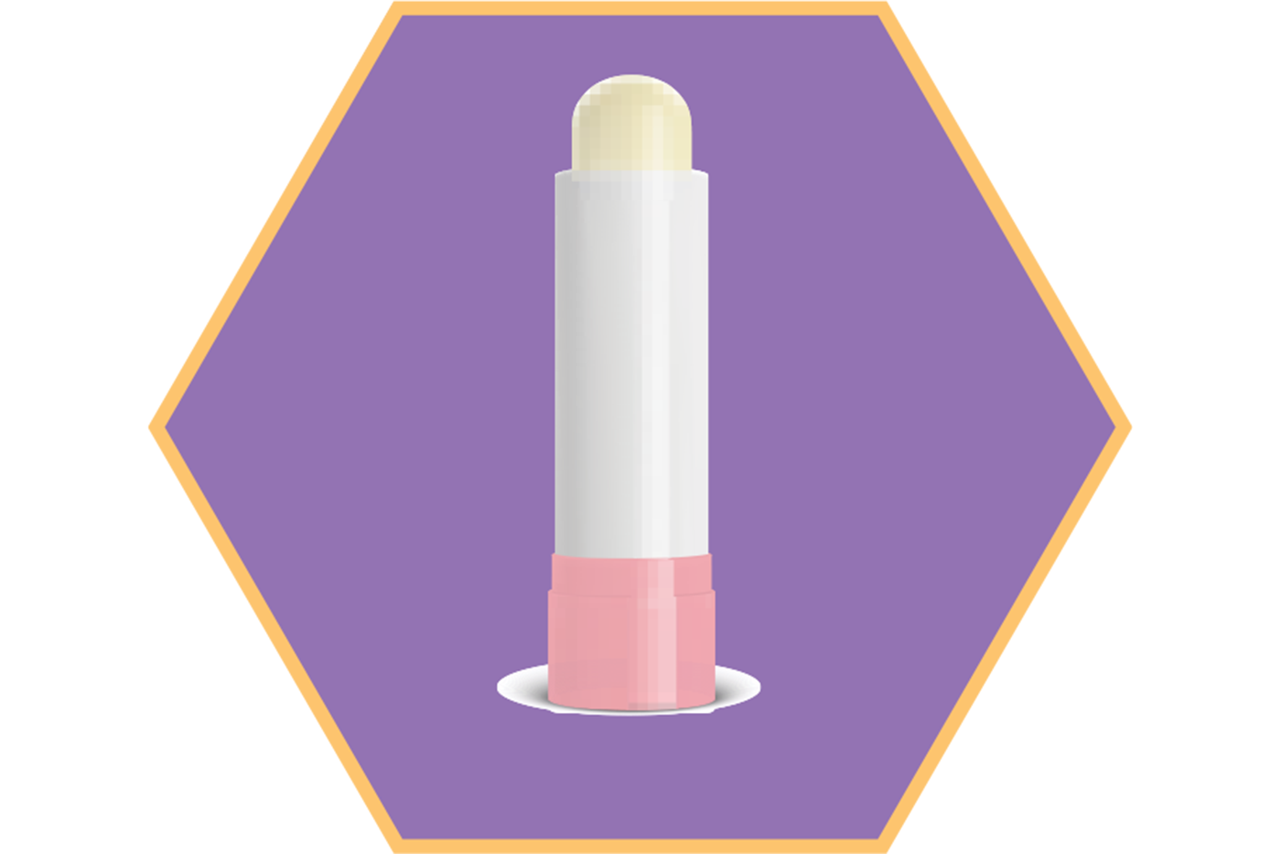
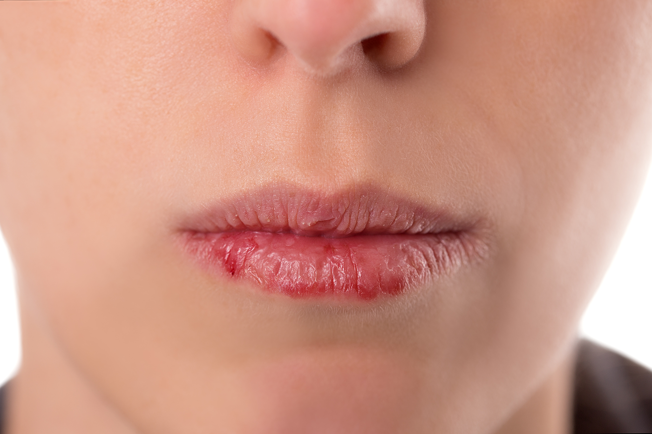
EX 1: MATCH THE PHRASES ON THE LEFT WITH THE CORRECT PICTURES ON THE RIGHT. (Ex 1, p. 20)
a)dim light
b)red spots
c)lip balm
d)chapped lips
e)coloured vegetables
1
3
2
4
5

Slide 5
Ex 2: Complete the sentences with the correct words and phrases below:
skin condition
fit
soft drinks
coloured vegetables
sunburn
1.– Please name some ....................
– Carrots and tomatoes.
2. ......................are not good for your health.
3. My parents go cycling every Sunday. It keeps them .............
4. The weather may affect our ......................
5.- How do we get .........................?
- When we spend a long time in the sun without a hat or suncream

Slide 6
H (HEALTHY)
EX 3: DISCUSS AND TICK EACH ACTIVITY IN THE TABLE AS H (HEALTHY) OR U (UNHEALTHY).
U (UNHEALTHY)

Slide 7
/f/ and /v/
Pronunciation

Slide 9
Task 4. Listen and repeat the words
https://www.sachmem.vn/trial/books/292/exercises/49146/169?type=student
activity
active
vitamin
breakfast
avoid
affect
food
fit

Slide 10
https://www.sachmem.vn/trial/books/292/exercises/49147/169?type=student

Slide 11
Homework:
- Learn words.
- Practice the sound /f/ and /v/ at home.
- Prepare for the new lesson: A closer look 2.

