Slide 1
Welcome to class

Slide 2
WARM-UP
1. books/ I/ science/ read /.
I read science books.
2. games/ children/ love/ outdoor /.
Children love outdoor games.
3. their/ every day/ They/ clean/ house /.
They clean their house every day.
4. night/ watched/ I/ T.V/ last /.
I watched T.V last night.
5. learn/ words/ every day/ You/ should/ the/ new
You should learn the new words every day.

Slide 3
Unit 2: HEALTHY LIVING
Section 3: A closer look 2

Slide 4
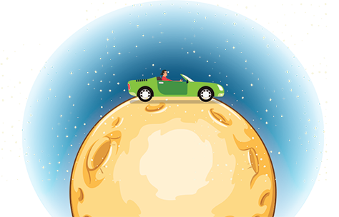
Grammar
Simple sentences
I read
S
V(động từ)
I read science books.
S
V
O(tân ngữ)
I read science books every day.
S
V
O
Adv(Trạng từ)

Slide 5
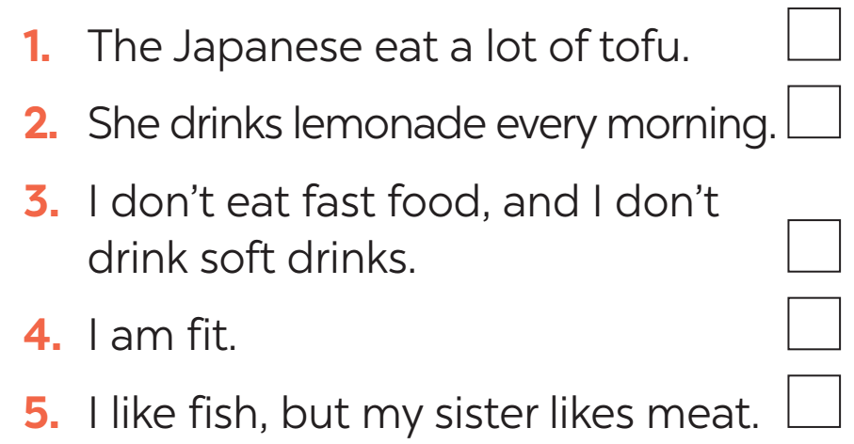
PRACTICE
1
Tick the simple sentences.

Slide 6
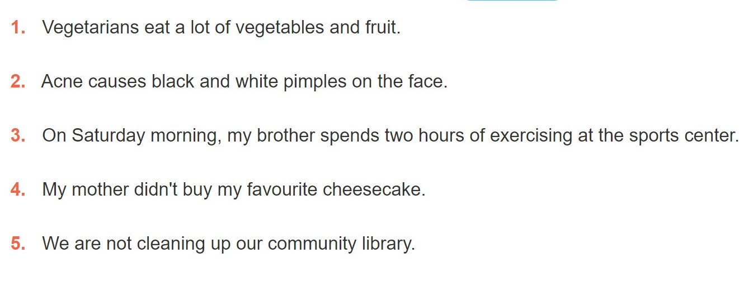
2
Underline and write S for the subject and V for the verb in each simple sentence.
.
S
V
S
V
S
V
S
V
S
V

Slide 7
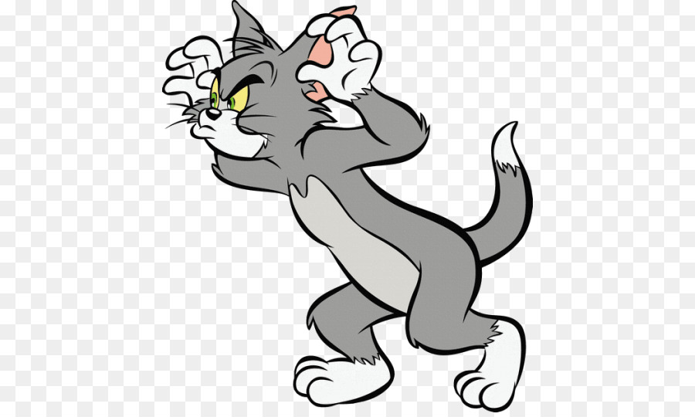
GAME
3
Rearrange the words and phrases to make simple sentences.
PRACTICE
soft drinks/ never/ my sister/ drinks/.
affects/ Acne/ 80% of young people/.
has/ He/ for breakfast/ bread and eggs/.
don’t eat/ We/ much fast food/.
a lot of vitamins/ fruit and vegetables/ have/.

Slide 8
ANSWER
soft drinks/ never/ my sister/ drinks/.
affects/ Acne/ 80% of young people/.
has/ He/ for breakfast/ bread and eggs/.
don’t eat/ We/ much fast food/.
a lot of vitamins/ fruit and vegetables/ have/.
→ My sister never drinks soft drinks.
→ Acne affects 80% of young people.
→ He has bread and eggs for breakfast.
→ We don’t eat much fast food.
→ Fruit and vegetable have a lot of vitamins.

Slide 9
4
Write complete sentences from the prompts. You may have to change the words or add some.
tofu/ be/ healthy
many/ Vietnamese/ drink/ green tea.
she/ not/ use/ suncream.
father/ not/ exercise/ every morning.
most children/ have/ chapped lips and skin/ winter.
→ Tofu is healthy.
→ Many Vietnamese drink green tea.
→ She does not use suncream.
→ My father does not exercise every morning.
→ Most children have chapped lips and skin in winter.

Slide 10
HOMEWORK
Learn the lesson’s today
prepare for new lesson:
Communication

