Slide 1
What is the clip about?

Slide 2
Clip is about the way we do to have a healthy living

Slide 3
Unit 2: HEALTHY LIVING
Period:
Lesson 1:
Getting started

Slide 4
1. Vocabulary:
01
02
03
04
popular (a) /ˈpɒpjələ(r)/
phổ biến, nổi tiếng
fresh (a)
/freʃ/
tươi, mới
join (v)
/dʒɔɪn/
tham gia
energy (n)
/'enədʒi/
năng lượng

Slide 5
Guess:
1. What are Mark and Mi talking about? A. Health problems B. Healthy activities C. Sports and games
2
Circle the correct answer.

Slide 6
1/ LISTEN AND READ.
Mi: This is a nice picture, Mark.
Mark: That’s my dad and I boating at Yen So Park.
Mi: It also see a lot of people exercise there.
Mark: Yes, it’s a popular place for people in my neighbourhood.
Mi: Outdoor activities are good for our health. My family often goes cycling in the countryside. It’s quiet and there’s a lot of fresh air.
Mark: It sounds interesting.
Mi: Yes, it’s lots of fun. We also bring fruit, water, and a lunch box with us.
Mark: I’d love to join you next time.
Mi: Sure. Bring along a hat and suncream.
Mark: Why suncream?
Mi: It’s really hot and sunny at noon so you might get sunburn.
Mark: I see.

Slide 7
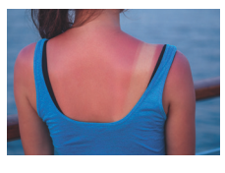
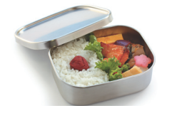
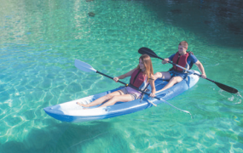
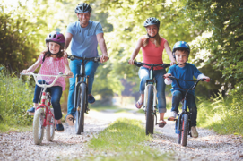
PRACTICE
2
Write a word or phrase from the box under its picture.
boating suncream lunch box sunburn cycling
1.
sunburn
2.
suncream
3.
lunch box
4.
boating
5.
cycling

Slide 8
3
Complete each sentence with a word from the conversation.
1. In the picture, Mark and his father are __________.
2. The people in Mark’s neighbourhood love to go to the _____ .
3. Mi’s family often goes cycling in the ___________.
4. - I don’t want to get sunburn.
- Wear a hat and use __________.
5. Fruit and water are good for our _________ .
GAME: MY FARM

Slide 9
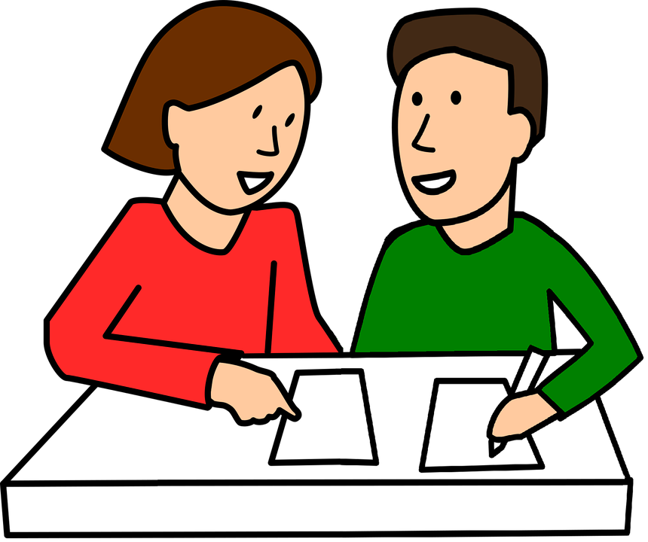
PRODUCTION
4.
Survey: Good or bad for health.
Example: A: I walk to school. B: I think it’s good for your health. A: I rarely eat breakfast. B: It’s not good. Breakfast is very important. It gives us energy for the day.

Slide 10
Survey: Good or bad for health.
Daily activities | How often | Good | Bad
- Walk to school
every day
√
- Play computer games
√
30 minutes
√
a lot of time
after school
.....................
.....................

Slide 11
Project:
Draw or collect pictures to talk about good habits that are good for your health. Write 5 sentences with them.
Step 1
Step 4
R
D
Group foundation
Presentation next period
Step 2
Step 3
A
I
Draw a picture
Prepare for the ideas to present

Slide 12
Homework:
- Do project at home
- Prepare for the new lesson: A closer look 1

