Slide 1
Welcome the teachers to visit our class

Slide 3
Unit 5
FESTIVALS IN VIET NAM
GETTING STARTED
Lesson 1 :
WHICH FESTIVALS SHOULD I SEE?

Slide 4
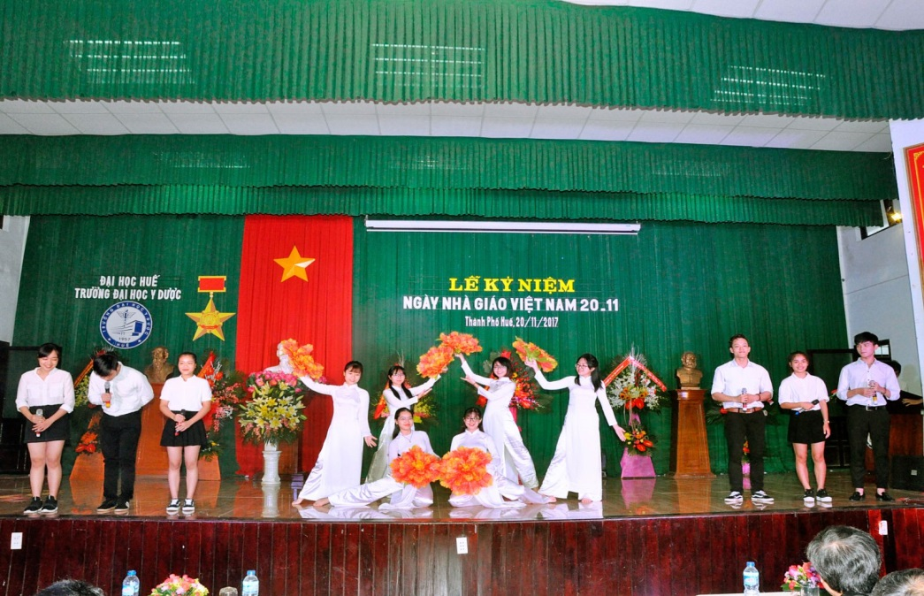
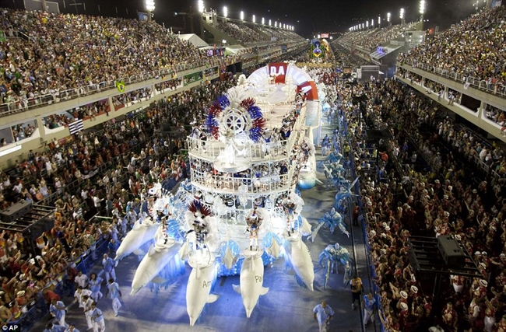
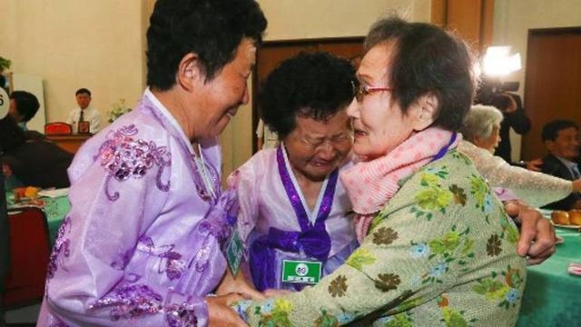
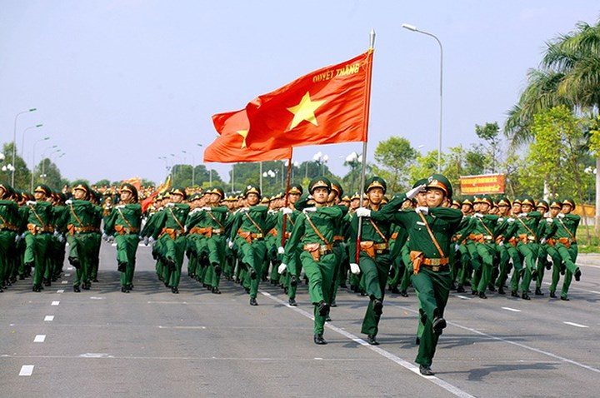
I. Vocabulary
reunion (n) :/ˌriːˈjuːniən/
sự đoàn tụ
carnival ( n) /ˈkɑːnɪvl/ :
lễ hội hóa trang
procession (n): /prəˈseʃn/
đám rước,diễu hành
anniversary (n): /ˌænɪˈvɜːsəri/
lễ kỉ niệm
oriental (adj):/ˌɔːriˈentl/
thuộc phương đông
royal court music (n):
/ˌrɔɪəl kɔːt/
nhã nhạc cung đình Huế

Slide 5
I. Vocabulary
reunion: (n) :
đám rước,diễu hành
carnival: ( n)
lễ hội hóa trang
procession: (n)
thuộc phương đông
anniversary: (n)
nhã nhạc cung đình Huế
oriental: (a)
sự đoàn tụ
royal court music: (n)
lễ kỉ niệm

Slide 6
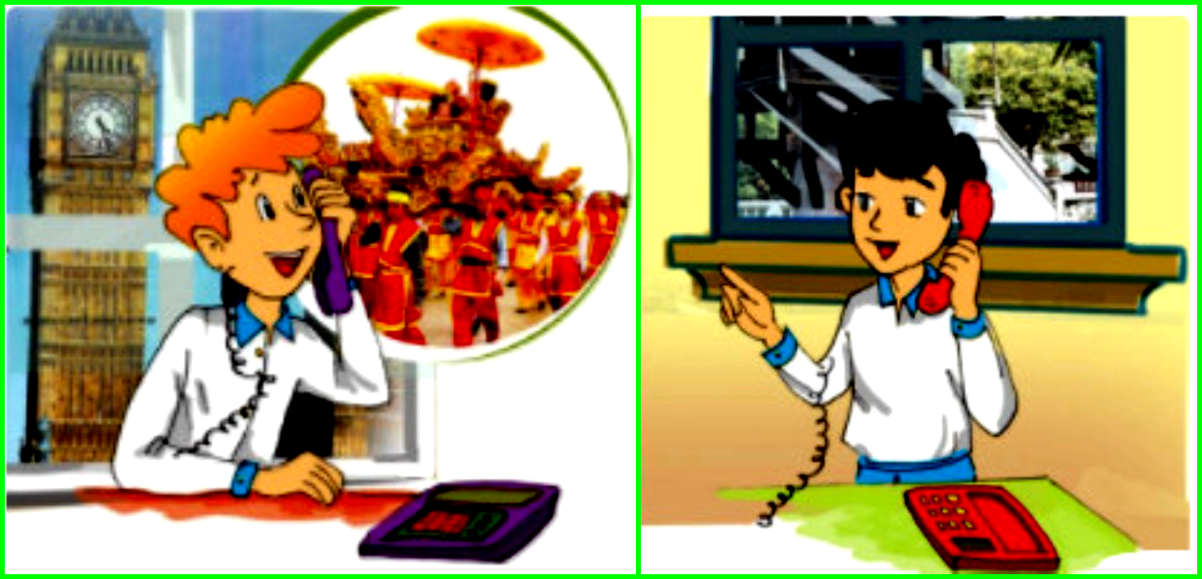
II. GETTING STARTED
What are they doing?
What might they be talking about?
Where are Duong and Peter?
Peter
Duong

Slide 7
P: Hey, I’m visiting Viet Nam this spring. I really want to see a festival there.
D: Really? Well, how about the Hue Festival?
P: What’s that? And when is it?
D: It’s in April. There’s lots to see – a grand opening ceremony, an ao dai fashion show, a Dem Phuong Dong or oriental night show, royal court music performances... And sporting activities like human chess, boat races...
P: Sounds great! How about festivals in February or March?
D: Well, there’s the Tet holiday. Why don’t you come for that?

Slide 8
P: Are you sure? But it’s your family reunion.
D: Sure! Come and join the celebration. To welcome Tet, we prepare a five-fruit tray and make jam and chung cakes. It’s hard to explain on the phone. Just come, you won’t regret it.
P: Thanks, Duong!
D: Yes,... Then on the 12th day of the first lunar month I’ll take you to Bac Ninh Province, which is north of Ha Noi, to see the Lim Festival.
P: Slow down, Duong! The ‘what’ festival?
D: Lim – there’s traditional quan ho singing which is performed on dragon boats, and folk games like swinging on huge bamboo swings, wrestling…

Slide 9
1. Listen and read
a. Tick √ true( T) or false ( F) .
T | F
1. Peter will come to Viet Nam in spring.
√
2. Peter wants Duong to recommend
somewhere to go.
√
3.Duong says that Peter should come to
Hue and Da Nang
Hue and Bac Ninh
√
4. Peter to come to the Hue festival.
wants
doesn’t want
√
5. Duong recommends Peter to see the Hue
Festival, the Lim Festival, and to celebrate the Tet holiday
with his family.
√

Slide 10
c. Can you find the following expressions in the conversation? Try to explain their meaning.
Why don’t you come for that?
2. Sounds great!
3. You won’t regret it.
4. Are you sure?
used as suggestion or to give advice
give your impression of what you hear
= You will love it
to show surprise and to check that something is really OK to do

Slide 11
d. Work in pairs. Make short conversations with the four expressions in c.
Example:
A: Why don’t you come with us to the Lim Festival? You won’t regret it.
B: Sounds great! / Are you sure?
C: The Tet holiday is coming! Why don't you come for that ?
D: sounds great!. I'd like to see some interesting activities on Tet holiday.

Slide 12
A: Why don’t you come with us to the Lim Festival? You won’t regret it.
B: Sounds great! / Are you sure?
C: The Tet holiday is coming! Why don't you come for that ?
D: Sounds great! I'd like to see some interesting activities on Tet holiday.

Slide 13
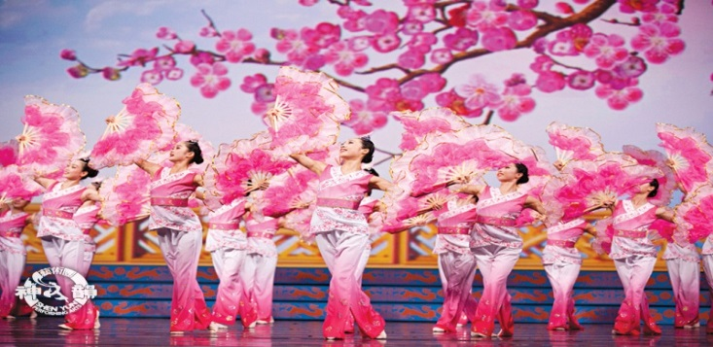
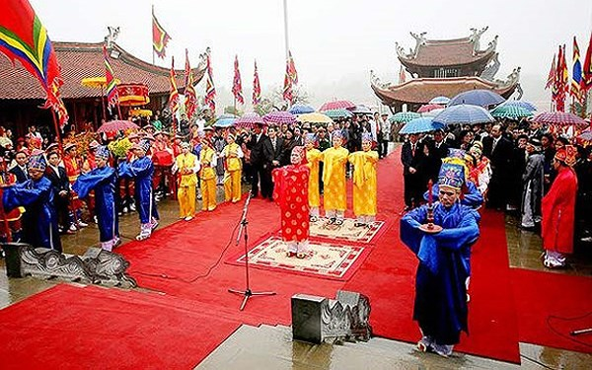
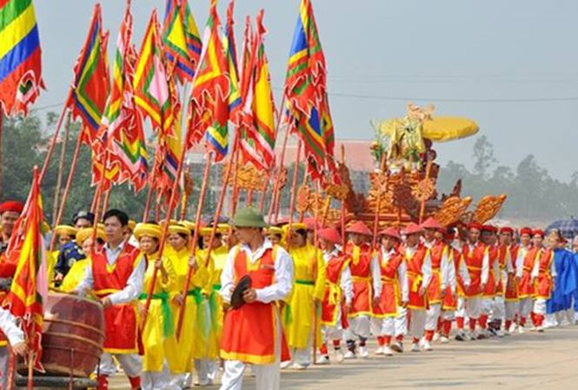
2. Use the words from the box to label the pictures
ceremony performance procession reunion carnival anniversary
a.
reunion
b.
carnival
c.
performance
d.
anniversary
e.
ceremony
f.
procession

Slide 14
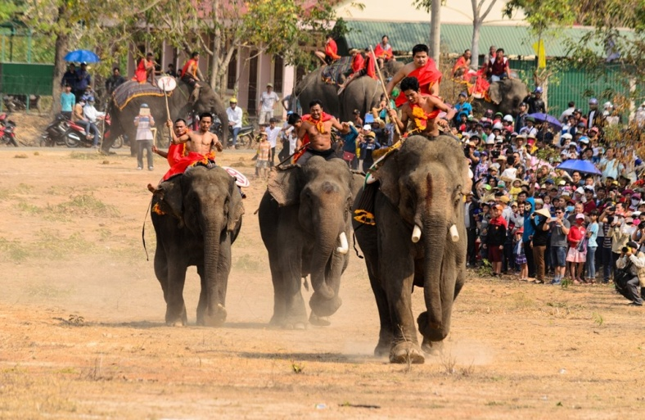
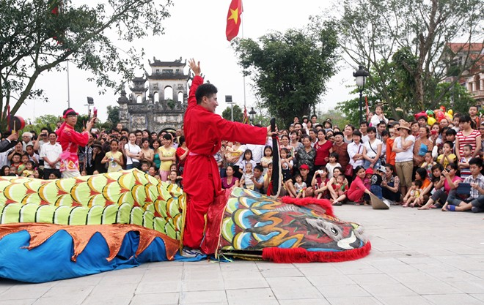
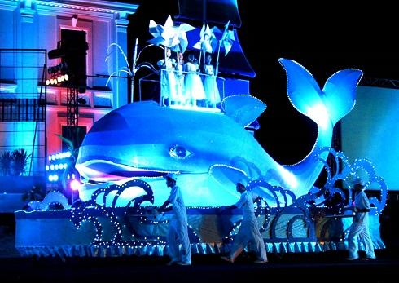
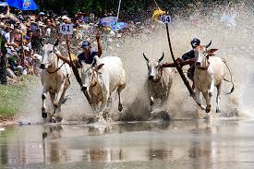
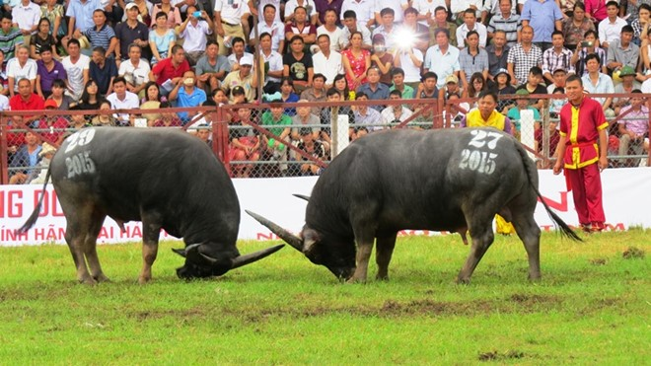
3. Match the words with the pictures of festivals and describe them.
Do Son buffalo- fighting
festival
Elephant race festival
Cow racing festival.
Le Mat snake festival
2.
1.
Whale festival.
3.
4.
5.

Slide 15
3. Match the festivals in 3 with their descriptions.
Festival | Description
1. Do Son Buﬀalo fighting Festival
a. This is held in Don Village, Dak Lak Province. Elephants and their riders race to the sound of drums, gongs and the cheering crowds.
b. This is held in An Giang Province. Each race includes two pairs of cows, and they are controlled by two young men.
2. Cow Racing Festival
3. Le Mat Snake Festival
c. This is a traditional, buﬀalo-fighting ceremony to worship the Water God in Do Son, Hai Phong City.
d. This is a festival to worship the whale and pray for the good fortune of the fishermen in Quang Nam.
4. Whale Festival
5. Elephant Race Festival
e. This festival uses a bamboo snake performance to retell the story of Le Mat Village

Slide 16
3. Match the festivals in 3 with their descriptions.
Festival | Description
5. Elephant Race Festival
a. This is held in Don Village, Dak Lak Province. Elephants and their riders race to the sound of drums, gongs and the cheering crowds.
2. Cow Racing Festival
b. This is held in An Giang Province. Each race includes two pairs of cows, and they are controlled by two young men.
1. Do Son Buﬀalo fighting Festival
c. This is a traditional, buﬀalo-fighting ceremony to worship the Water God in Do Son, Hai Phong City.
d. This is a festival to worship the whale and pray for the good fortune of the fishermen in Quang Nam.
4. Whale Festival
3. Le Mat Snake Festival
e. This festival uses a bamboo snake performance to retell the story of Le Mat Village

Slide 17
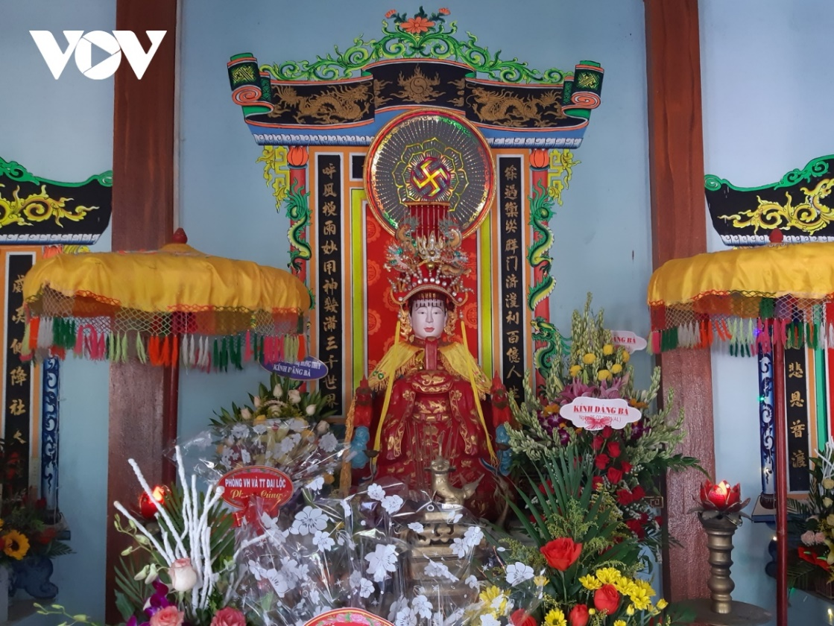
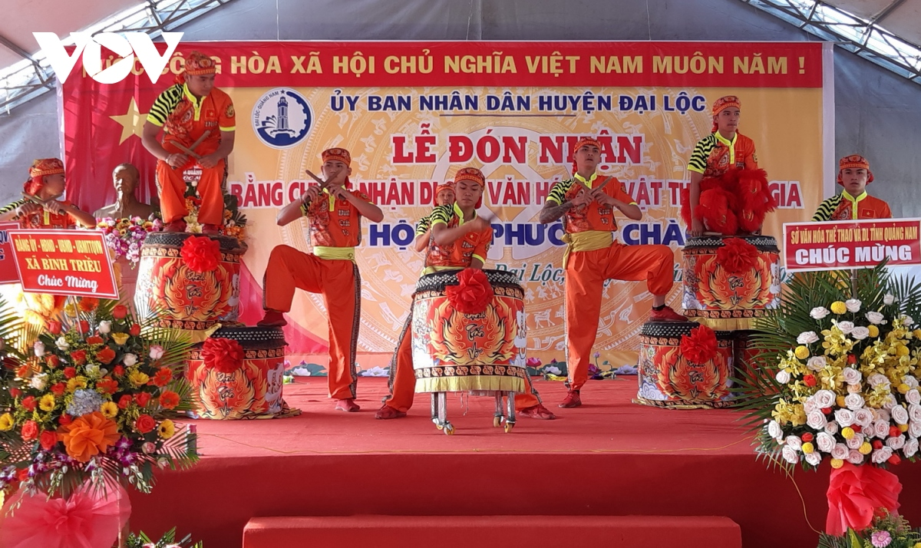
Do you know any festivals in Viet Nam?
Theo truyền thuyết dân gian và gia phả tộc Nguyễn ở Phiếm Ái châu, Bà Phường Chào sinh ngày 25.2 năm Cảnh Thịnh bát niên (1800) tại làng Phường Chào (thuộc châu Phiếm Ái, nay là thôn Khương Mỹ, xã Đại Cường, Đại Lộc).
Lễ hội cầu quốc thái dân an và rước kiệu Bà Phường Chào được nhân dân làng Khương Mỹ tổ chức vào ngày 25.2 âm lịch hằng năm.
Mrs Phuong Chao Festival
National intangible cultural heritage

Slide 18
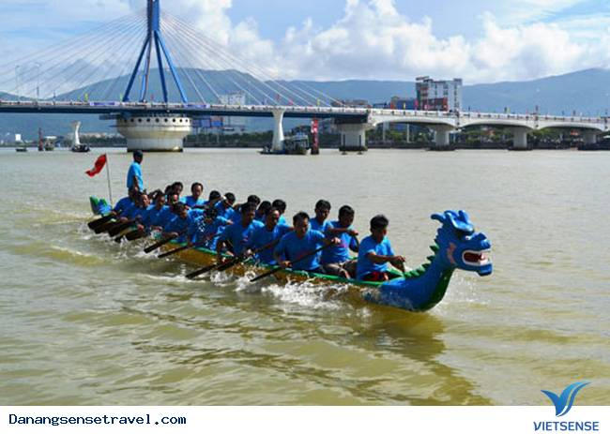
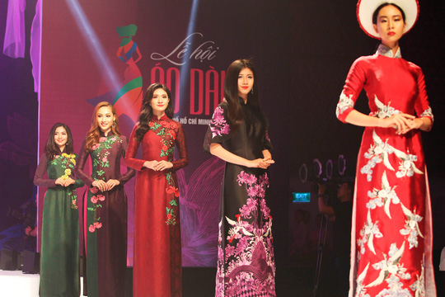
Do you know any festivals in Viet Nam?

Slide 19
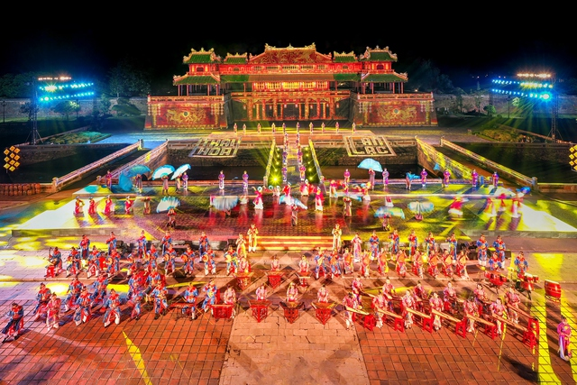
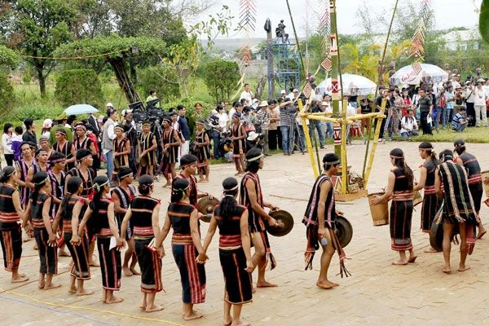
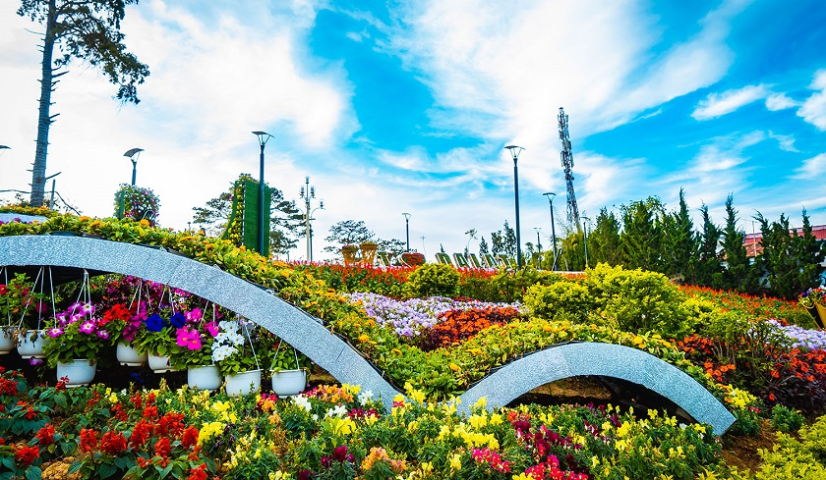

Slide 20
III. Homework
- Learn by heart the new words in context.
- Answer the questions in 1b
- Prepare A closer look 1

Slide 21
Thanks for your attendance!
Goodbye. See you again

Slide 22
Do you know any festivals in Viet Nam?

Slide 23
