Slide 1
HELLO
EVERYONE !!!

Slide 2
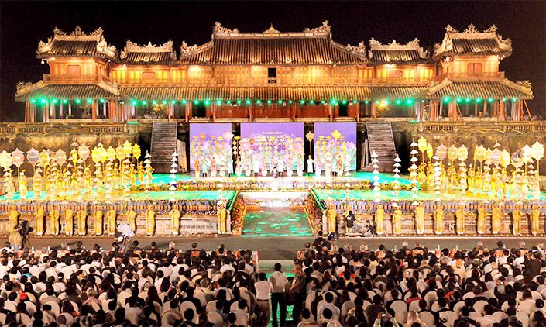
1. When is the Hue Festival held? What can visitors see there?
It is held in April. They can see a grand opening ceremony, an ao dai fashion show, a Dem Phuong Dong or oriental night show, royal court music performances ... and sporting activities.
BACK

Slide 3
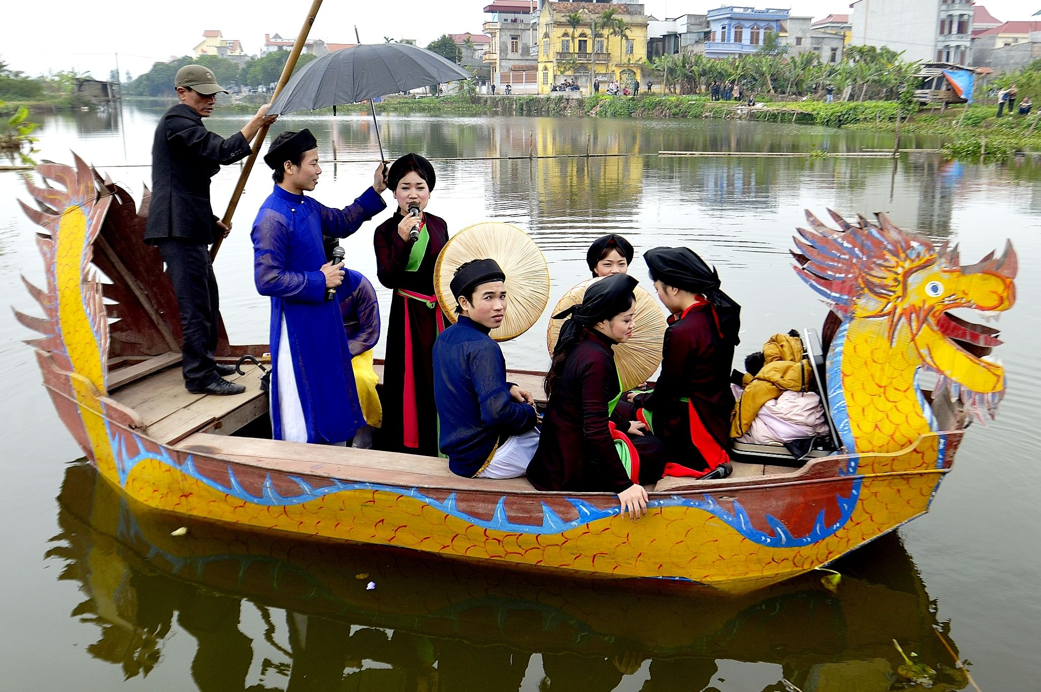
4. Where and when is the Lim Festival held?
It is held in Bac Ninh, on 12th of the first lunar month.
BACK

Slide 4
Game: Brainstorming
Cow - racing
Buffalo - fighting
Le Mat Snake
Names of festivals
in Vietnam
Lim festival
……......
Elephant-racing
Hue festival
Flowers festival

Slide 5
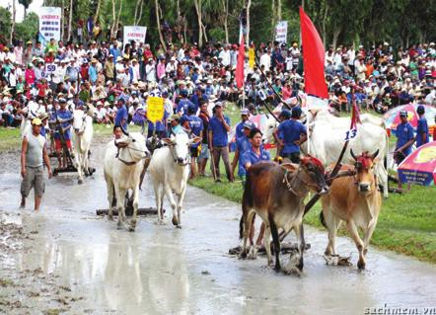
Cow – racing Festival

Slide 6
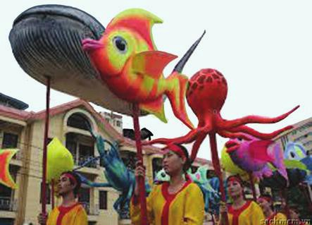
Whale Festival

Slide 7
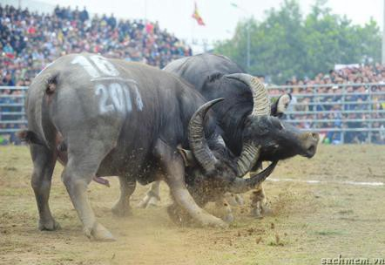
Buffalo-fighting Festival

Slide 8
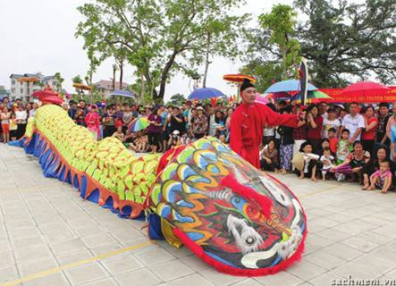
Le Mat Snake Festival

Slide 9
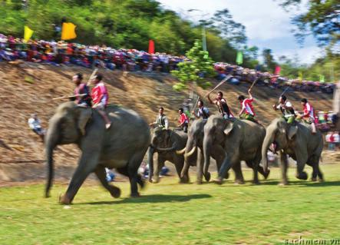
Elephant – racing Festival

Slide 10
Unit 5
FESTIVALS IN VIET NAM
A closer look 1
Lesson 2 :

Slide 11
Match the words with the right meanings:
preserve (v)
ritual (n)
commemorate(v)
saint (n)
incense (n)
fortune (n)
performance
nhang/ hương
vận may
bảo tồn
nghi thức (tôn giáo)
thánh nhân
buổi biểu diễn
tưởng nhớ

Slide 12
vocabulary
preserve: (v) /prɪˈzɜːv/
ritual: (n) /ˈrɪtʃuəl
commemorate:(v) /kəˈmeməreɪt/
saint: (n) /seɪnt/
incense: (n) /ˈɪnsens/
fortune :(n) /ˈfɔːtʃuːn/
performance: (n) /pəˈfɔːməns/
: bảo tồn
: nghi thức (tôn giáo)
: tưởng nhớ
thánh/ thần
nhang
vận may
buổi biểu diễn

Slide 13
vocabulary
1. Match the words to their meanings.
1. to preserve
a. a show
b. an act of special meaning that you do in the same way each time
2. to worship
3. a performance
c. to keep a tradition alive
4. a ritual
d. to remember and celebrate something or someone
5. to commemorate
e. to show respect and love for something or someone

Slide 14
2. Complete the sentences using the words in 1.
The Giong Festival is held every year to _______________ Saint Giong, our traditional hero.
At Huong Pagoda, we offer Buddha a tray of fruit to __________ him.
Thanks to technology, we can now __________ our culture for future generations.
In most festivals in Viet Nam, the __________ often begins with an offering of incense.
The Le Mat Snake _______________ is about the history of the village.
commemorate
worship
preserve
ritual
performance

Slide 15
3. Match the nouns with each verb. A noun can go with more than one verb.
a ceremony a show a celebration
an anniversary a hero good fortune
a ritual a god a reunion
WATCH
HAVE
WORSHIP
PERFORM
a ceremony
a ceremony
a hero
a ceremony
a show
a celebration
a god
a show
a show
an anniversary
a hero
a ritual
good fortune
a ritual
a god
a reunion

Slide 16
pronunciation
4a. Look at the table below. What can you notice about these words?
competition commemoration procession preservation confusion magician
musician vegetarian companion

Slide 17
4b. Now listen and repeat the words.
competition
commemoration
procession
preservation
confusion
magician
musician
vegetarian
companion

Slide 18
5. Listen and stress the words below. Pay attention to the endings.
1. procession | 5. politician
2. companion | 6. musician
3. production | 7. historian
4. competition | 8. librarian

Slide 19
6. Read the following sentences and mark (‘) the stressed syllable in the underline words. Then listen and repeat.
Elephants are good companions of the people in Don Village.
The elephant races need the participation of young riders.
The elephant races get the attention of the crowds.
Vietnamese historians know a lot about festivals in Viet Nam.
It’s a tradition for us to burn incense when we go to the pagoda.

