Slide 1
Welcome to our class

Slide 2
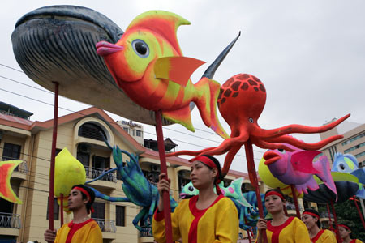
Which festival is this?
Whale festival

Slide 3
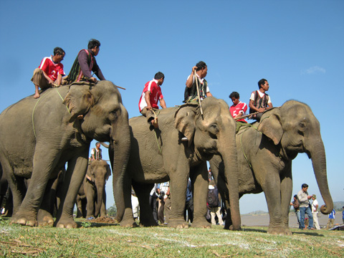
Complete the sentence: “The Elephant race festival is held in ...................., Dak Lak province”
Don village

Slide 4
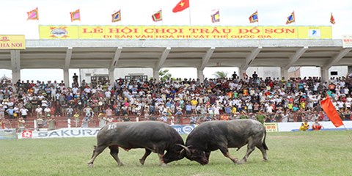
The Buffalo-fighting festival in Do Son, Hai Phong is held to worship ........................
Water God

Slide 5
Quan ho singing is often sung at .................
A.The Lim Festival
B. The Hue festival
C. The Elephant race festival
(held on the 12th
day of the first Lunar month, in Bac Ninh)

Slide 6
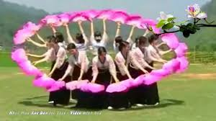
The Xoe dance is a spiritual tradition of ……… ethnic people.
Thai

Slide 7
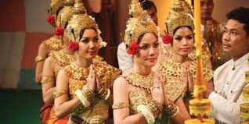
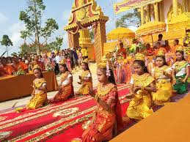
Which ethnic people is this?
The Khmer

Slide 8
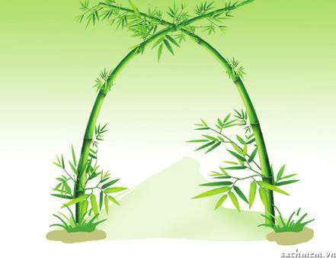
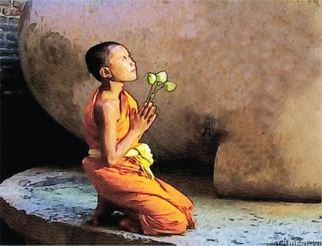
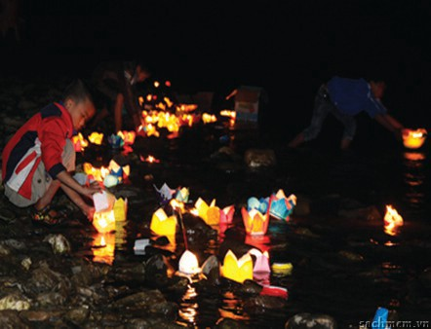
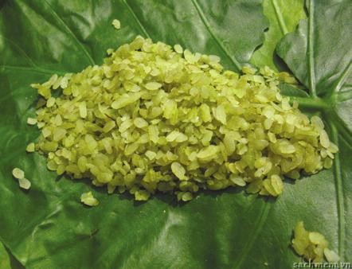
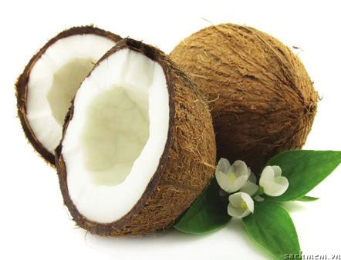
Unit 5: Festivals in Viet Nam
Lesson 4: Communication
I. Vocabulary:
- bamboo archway (n)/ˌbæmˈbuːˈɑːtʃweɪ/
- coconut (n) /ˈkəʊkənʌt/
- green rice flakes (n) /fleɪk/
- floating lanterns (n) /ˈlæntən/
- clasped hands /klɑːspt/

Slide 9
Match the meaning with correct words
A | B
1. Đèn hoa đăng 2. Dừa 3. Cổng vòm tre 4. Cốm 5. Chắp tay | bamboo archway green rice flakes c. floating lanterns d. coconut e. clasped hands

Slide 10
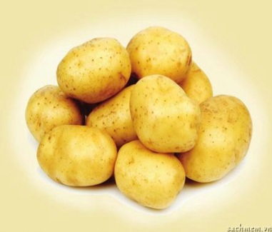
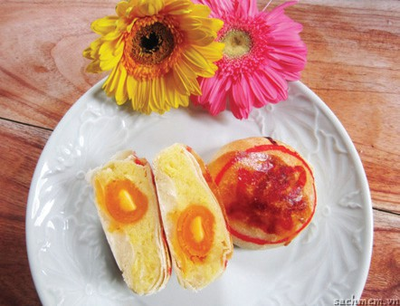
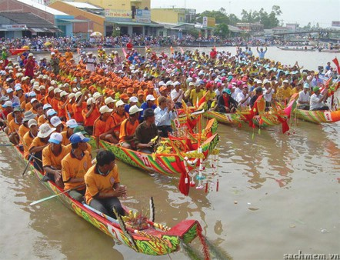
1. Look at the pictures. Discuss the following questions with a partner and then write the right words under the pictures.
a. What are the things in the pictures?
b. Do you know the festivals at which they appear?
bamboo archway
green rice flakes
potatoes
2.
4.
1.
3.
coconuts
6.
Floating lanterns
5.
pia cake
clasped hands
7.
dragon boat race
8.

Slide 11
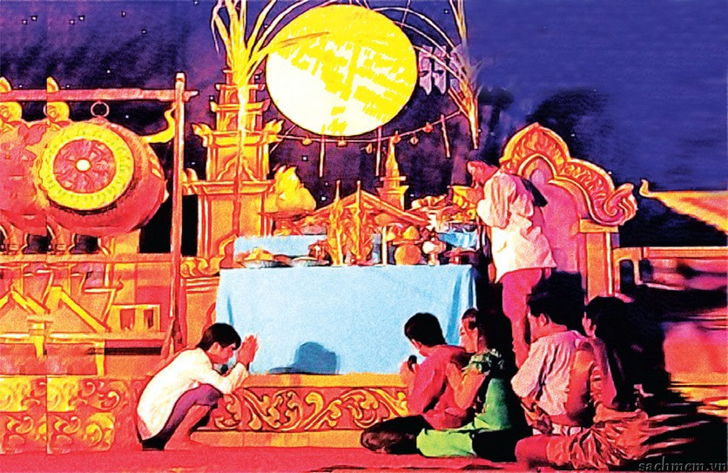
II. Listening
2. Now listen to an interview between a TV reporter and a man about a festival to check your answers.
Ooc bom boc festival
b. Do you know the festivals at which they appear?

Slide 12
3. Listen to the interview again and complete the table below with the answers to the suggested questions.
Questions | Answers
1. Where?
2. When?
3. Who is worshipped?
4. What activities?
1. Where is the festival held?
in Soc Trang
14th , 15th evenings of the 10th lunar month
2. When is the festival held?
3. Who do the people worship at the festival?
the Moon God
4. What activities do people do at the festival?
- have a worshipping ceremony
- float paper lanterns
- hold dragon boat races

Slide 13
III. Practice
4. Role-play in groups of three. One of you is a reporter; two of you are locals. Do an interview about a local festival. It can be a real or an imaginary festival.
Ooc bom boc
Soc Trang on the 14th, 15th
evenings of the 10th lunar month.
Moon God
Example:
A: Good morning. Can I ask you some questions about this festival?
B: Yes, of course.
A: What is the festival called?
B: It's . It's held in
A: Who do you worship at the festival?
C: We worship .
Ooc bom boc
Soc Trang on the 14th, 15th
evenings of the 10th lunar month.
Moon God

Slide 14
A: Good morning. Can I ask you some questions about this festival?
B: Yes, of course.
A: What is the festival called?
B: It's . It's held in ____________
on ___________________
A: Who do you worship at the festival?
C: We worship .

Slide 15
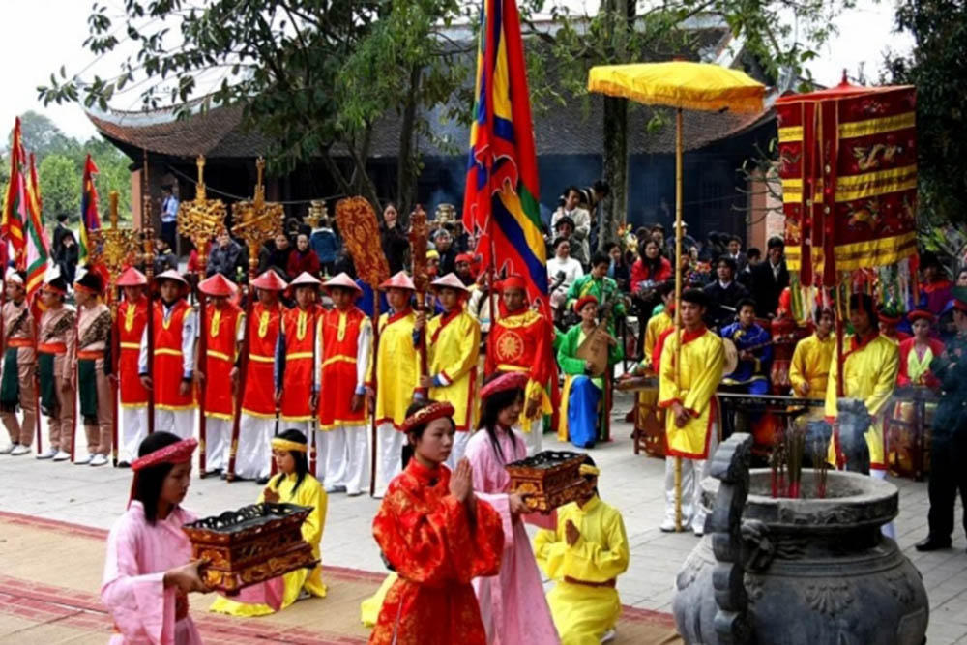
Cuong temple festival:
In Dien Chau, Nghe An
from 12th -16th of February Lunar month
Worship: An Duon Vuong

Slide 16
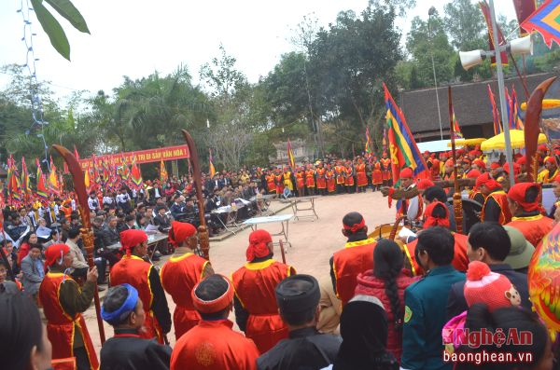
Qua Son temple festival:
In Do Luong, Nghe an
from 18th -20th of January Lunar month
Worship: Uy Minh Vuong Ly Nhat Quang

Slide 17
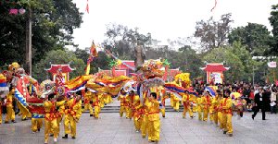
Hoang Muoi temple festival:
Hung Nguyen, Nghe An
from 9th -10th of October Lunar month
Worship: Saint Hoang Muoi

Slide 18
Unit 5: Festivals in Viet Nam
Period: 36 Lesson 4: Communication
Vocabularies about Ooc boom boc festival:
- bamboo archway - green rice flakes
- lanterns - coconut
- clasped hands - dragon boat race
2. Talking about a festival:
The name of the Festival
When and where it is held.
What activities.
3. Homework:
Talk about a festival you like best.
Do exercise in work book
Prepare: Skills 1.

Slide 19
Thank you for your attending!

