Slide 1
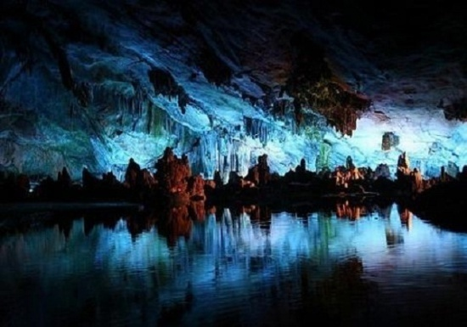
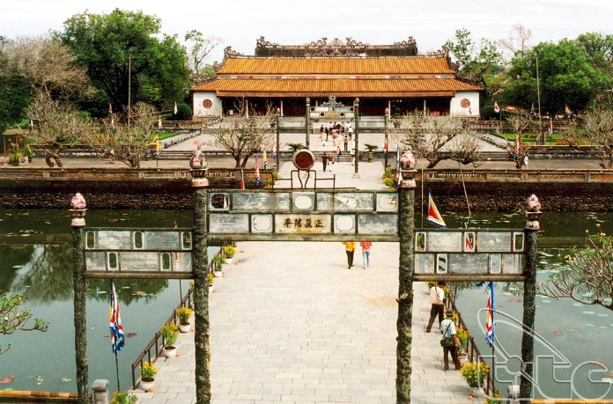
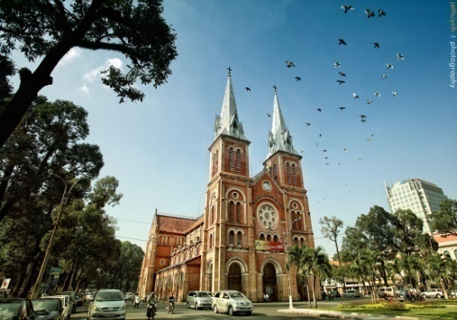
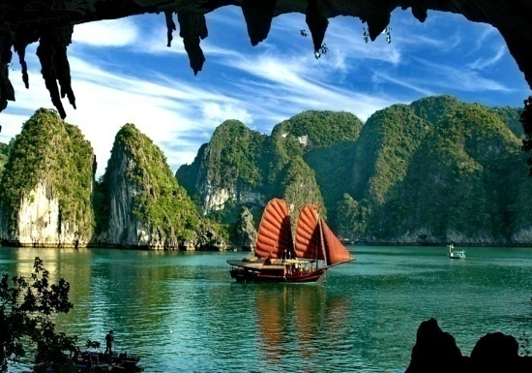
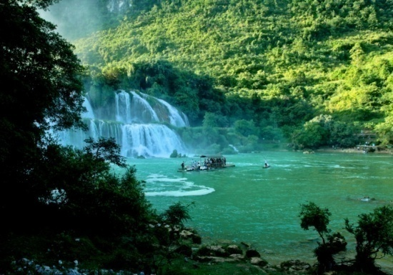
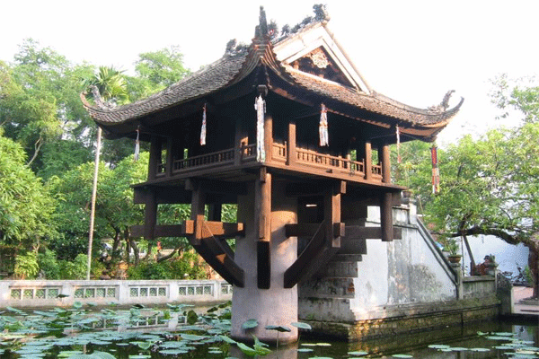
Below are some places of interest in Viet Nam. Match them with the pictures.
Hue Citadel
Ha Long Bay
One Pillar Pagoda
Phong Nha Cave
Wonders of Viet Nam
Cuc Phuong National Park
Saigon Notre-Dame Cathedral
1
2
3
4
5
6

Slide 2

Welcome all of teachers and students
UNIT 5: WONDERS OF VIET NAM
Lesson 1: Getting started
Lesson plan for English 9

Slide 3
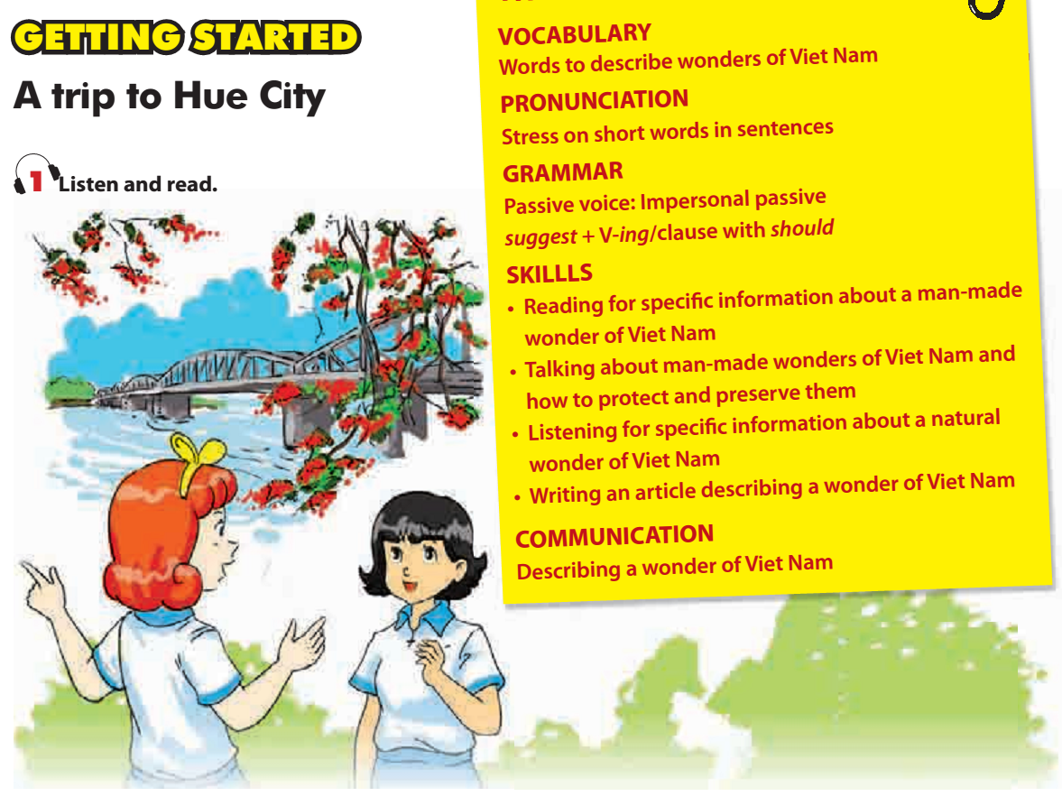
What may they be talking about?
Where are Mi and Veronica?
Have you ever visited a wonder of Viet Nam?
Where is it?
What is special about it?
What is it?

Slide 4
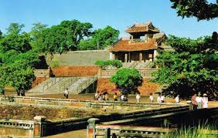
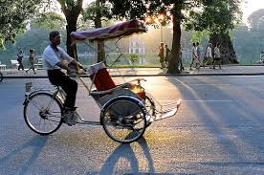
1. New words :
- recommend (v) /ˌrekəˈmend/
giới thiệu
- complex of monuments (n) : /ˈmɒnjumənt/
quần thể di tích
- be worth doing sth (v):
đáng giá để làm gì
- bother (v): /ˈbɒðə(r)/
băn khoăn
- rickshaw (n): /ˈrɪkʃɔː/
xích lô

Slide 5

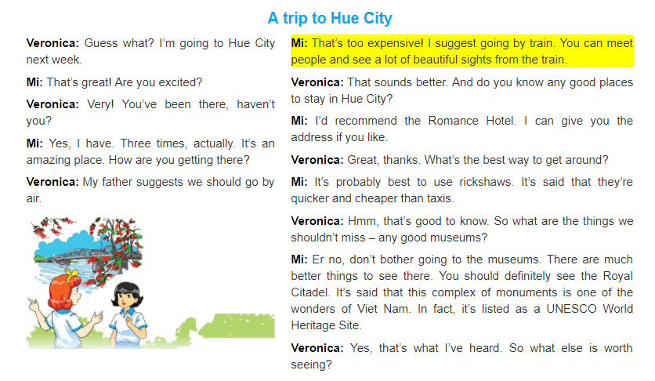

Slide 6
a. Read the conversation again and fill in each gap with no more than three words.
1. Veronica's family is going to ____________ next week.
2. Mi has been to Hue City ____________ times.
3. Veronica's father suggested they should ____________ .
4. Mi suggested going by train because Veronica's family can meet people and see a lot of ____________ .
5. Mi suggested Veronica should ____________ to get around Hue City.
6. In Mi's opinion, Veronica shouldn't go to ____________ .
Hue City
three
go by air
beautiful sights
use rickshaws
the museums

Slide 8
b. Read the conversation and find the expressions Veronica and Mi use to ask for, make, and respond to recommendations.
Asking for recommendations (3) | Making recommendations(3) | Responding to recommendations(3)
Do you know any good
places to stay in Hue City?
-I suggest going by train.
- That sound better.
- It’s probably best to use rickshaws.
- Great, thanks.
- What’s the best way to get around?
- I’d recommend the Romance Hotel.
- That’s good to know.
- What are the things we shouldn’t miss - any good museums?
- That’s what I’ve heard.
- You should definitely see the Royal Citadel.
- What else is worth seeing?

Slide 9
2a. Write the responses below into the correct columns.
1.It's probably best
to go by train.
4.Thanks, that's
really useful.
7. You really must go
to Agra.
5. I wouldn't eat
anything that's sold
in the street.
2.It's well worth
seeing.
8 What about places
outside Hue City?
3. Don't drink the
water.
6. It isn't really
worth seeing.
9. Have you got any
other tips?
Asking for recommendations | Making recommendations |  | Responding to recommendations
 | Recommending things | Not recommending things

Slide 10
2b. Match the sentences (1-4) to the sentences (a-d) to make exchanges. Then the exchanges with a partner.
1. Do you know any good places to eat? | a. Er no, don't bother buying things there. They're too expensive.
2. I wouldn't eat anything that's sold in the street. You can easily get ill. | b. I'd recommend a place called Shanti - the food there is delicious.
3. Is there anything else worth visiting? | c Yes, that's what I've heard.
4. And what about souvenirs? | d. There's Gia Long Tomb. That's well worth a visit.
1-b
1. Do you know
2-c
3-d
4-a

Slide 11
3b. Now put them in the correct columns.
a. Ha Long Bay
d. One Pillar Pagoda
c. Po Nagar Cham Towers
e. Saigon Notre-Dame Cathedral
b. Phong Nha Cave
f. Cuc Phuong National Park
Natural wonders | Man-made wonders

Slide 12

4. Ask and answer questions
about some wonders of Viet Nam.
A: I had a wonderful trip this summer vacation.
B: Where did you visit?
A: Cuc Phuong National Park.
B: Wow! Where is it?
A: It is located in Ninh Binh province.
B: What does it have?
A: Cuc Phuong is home to many kinds of tree and flowers. There are also many animals there. I did learn many things about biology during the trip.
A: Is it a natural wonder?
B: Yes, it is./ No, it isn’t

Slide 13
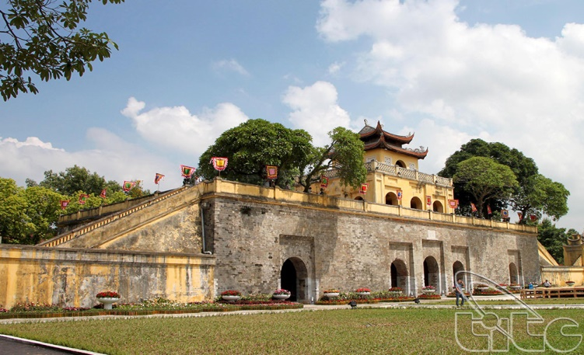
4. Ask and answer questions
about some wonders of Viet Nam.
A: I had a wonderful trip this summer vacation.
B: Where did you visit?
A: Cuc Phuong National Park.
B: Wow! Where is it?
A: It is located in Ninh Binh province.
B: What does it have?
A: Cuc Phuong is home to many kinds of tree and flowers. There are also many animals there. I did learn many things about biology during the trip.
A: Is it a natural wonder?
B: Yes, it is./ No, it isn’t
The central relic area of Hoang Thanh Thang Long - Hanoi has a total area of 18,395 ha, including: archaeological zone of 18 Hoang Dieu and the remaining relics in Hanoi's ancient relics such as Hanoi Flagpole, Doan Mon Gate, Kinh Thien Palace, House D67, Hau Lau, Bac Mon, walls and 8 gates of the Nguyen Dynasty.
Imperial Citadel of Thang Long is a relic complex associated with the history of Thang Long - Hanoi Citadel

Slide 14
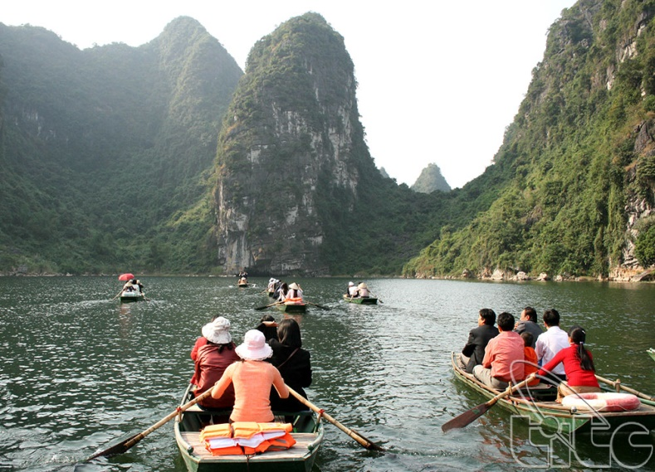
Trang An Landscape Complex This is Vietnam's first mixed-world heritage site recognized by UNESCO. With an area of 6,172 ha located in the area between Hoa Lu district and Gia Vien, Nho Quan districts, Tam Diep town and Ninh Binh city, Trang An scenic complex includes adjacent areas of di Hoa Lu ancient capital, Trang An cave complex, Tam Coc-Bich Dong scenic area and Hoa Lu special-use primeval forest.
4. Ask and answer questions
about some wonders of Viet Nam.
A: I had a wonderful trip this summer vacation.
B: Where did you visit?
A: Cuc Phuong National Park.
B: Wow! Where is it?
A: It is located in Ninh Binh province.
B: What does it have?
A: Cuc Phuong is home to many kinds of tree and flowers. There are also many animals there. I did learn many things about biology during the trip.
A: Is it a natural wonder?
B: Yes, it is./ No, it isn’t

Slide 15
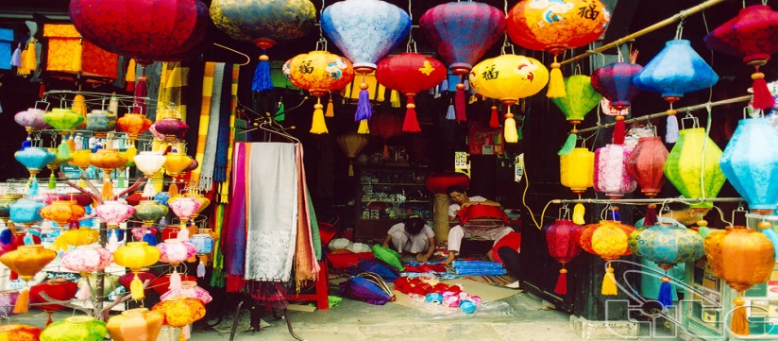
4. Ask and answer questions
about some wonders of Viet Nam.
A: I had a wonderful trip this summer vacation.
B: Where did you visit?
A: Cuc Phuong National Park.
B: Wow! Where is it?
A: It is located in Ninh Binh province.
B: What does it have?
A: Cuc Phuong is home to many kinds of tree and flowers. There are also many animals there. I did learn many things about biology during the trip.
A: Is it a natural wonder?
B: Yes, it is./ No, it isn’t
Hoi An is an ancient town of Vietnamese people, located in the lower section of the Thu Bon river junction in the coastal plain of Quang Nam province. As a unique type of Southeast Asian traditional urban port in Vietnam, rare in the world, Hoi An retains nearly intact over a thousand architectural monuments such as streets, houses, meeting halls, temples, pagodas , temples, ethnic churches, ancient wells, ancient tombs ...

Slide 16
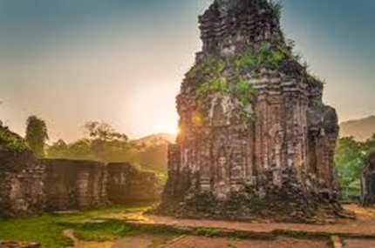
4. Ask and answer questions
about some wonders of Viet Nam.
A: I had a wonderful trip this summer vacation.
B: Where did you visit?
A: Cuc Phuong National Park.
B: Wow! Where is it?
A: It is located in Ninh Binh province.
B: What does it have?
A: Cuc Phuong is home to many kinds of tree and flowers. There are also many animals there. I did learn many things about biology during the trip.
A: Is it a natural wonder?
B: Yes, it is./ No, it isn’t
MY SON TOWER AREA
Located in a valley with a diameter of about 2 km in Duy Phu commune, Duy Xuyen district, Quang Nam province, My Son is a Hindu holy place of the Kingdom of Champa built by King Bhadravarman around the end of the 4th century. to worship the god Siva.

Slide 17
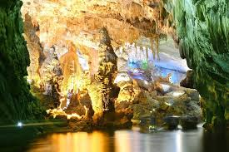
4. Ask and answer questions
about some wonders of Viet Nam.
A: I had a wonderful trip this summer vacation.
B: Where did you visit?
A: Cuc Phuong National Park.
B: Wow! Where is it?
A: It is located in Ninh Binh province.
B: What does it have?
A: Cuc Phuong is home to many kinds of tree and flowers. There are also many animals there. I did learn many things about biology during the trip.
A: Is it a natural wonder?
B: Yes, it is./ No, it isn’t
Phong Nha - Ke Bang National Park is located in Quang Ninh, Bo Trach, Tuyen Hoa and Minh Hoa districts (Quang Binh province) with an area of about 200,000 ha. Phong Nha - Ke Bang is compared to a huge geological museum with global value and significance.

Slide 18

4. Ask and answer questions
about some wonders of Viet Nam.
A: I had a wonderful trip this summer vacation.
B: Where did you visit?
A: Cuc Phuong National Park.
B: Wow! Where is it?
A: It is located in Ninh Binh province.
B: What does it have?
A: Cuc Phuong is home to many kinds of tree and flowers. There are also many animals there. I did learn many things about biology during the trip.
A: Is it a natural wonder?
B: Yes, it is./ No, it isn’t
Hue citadel Located along the banks of the Perfume River and some adjacent areas of Thua Thien - Hue Province, the complex of Hue Monuments is the first heritage site of Vietnam recognized by UNESCO (December 1993). Prominent in the complex of the ancient capital of Hue are three citadels: Imperial Citadel, Imperial Citadel and Forbidden Purple City arranged throughout the south - north axis. The citadel system, the palace is located in an interesting natural setting with Ngu Binh mountain, Huong Giang stream, Gia Vien dunes, Boc Thanh dune ...

Slide 19

HOMEWORK
- Learn by heart new words.
- Do all the exercises again
- Prepare Unit 5 : A closer look 1

