Slide 1
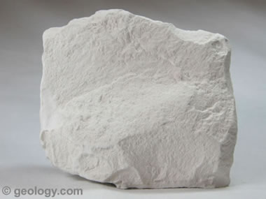
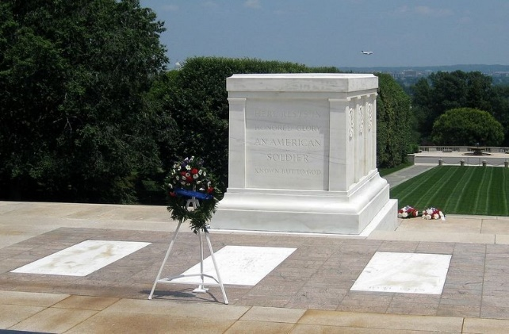
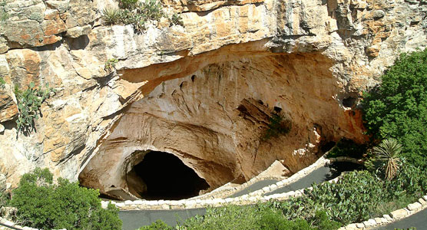
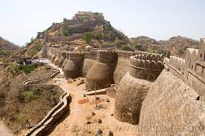
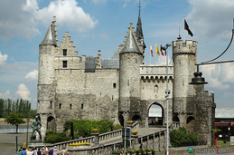
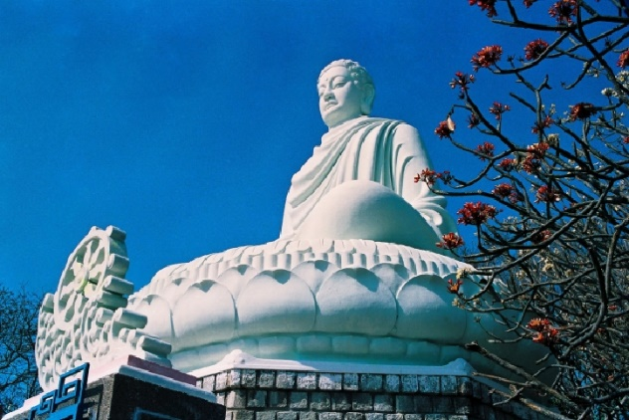
*Write the words with the correct pictures.
limestone
sculpture
cavern
citadel
fortress
tomb
1
2
3
4
5
6

Slide 2

Welcome all of teachers and students
UNIT 5: WONDERS OF VIET NAM
Lesson 2: A closer look 1
Lesson plan for English 9

Slide 3

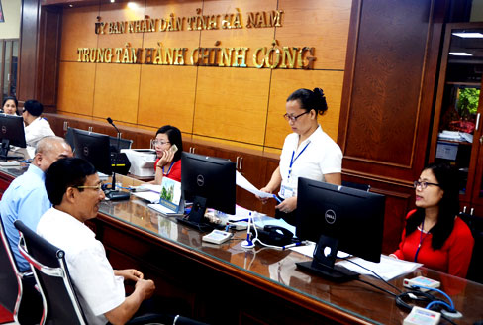
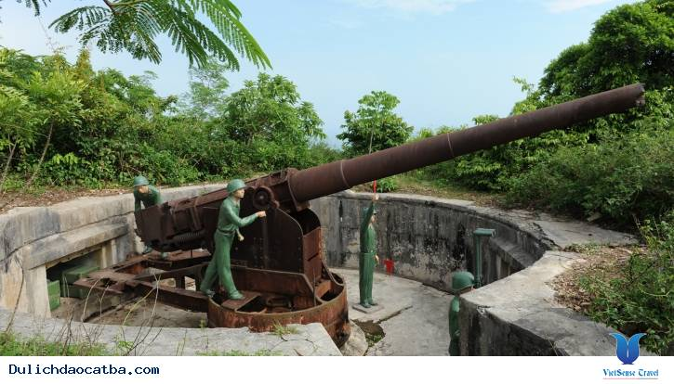
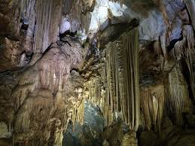
1. VOCABULARY
-fortress (n) /ˈfɔːtrəs/ : pháo đài
-cavern (n) /ˈkævən/ : hang động
-astounding (adj) /əˈstaʊndɪŋ/ : kinh ngạc
-picturesque (adj) /ˌpɪktʃəˈresk/ : đẹp như tranh
-administrative center (n) /ədˈmɪnɪstrətɪv/ : trung tâm hành chính
-geological (a) /ˌdʒiːəˈlɒdʒɪkl/ thuộc địa chất

Slide 4
CHECK VOCAB: Circle the correct answer A, B, C or D
1. An ………………… center is a seat of regional administration or local government, or the place where the central administration of a commune is located.
a. administrative b. regional c. local d. central
2. Inspired by the success of Hugo Gernsback's Amazing Stories, Clayton Publishing Co. released, in January of 1930, the first issue of …………… Stories.
a. sad b. interesting c. boring d. astounding
3. He lives in a very ............... village in Hue.
a. picture b. picturely c. picturesque d. picturesquely
4. It is likely that marine waters intruded directly into this ………… during its formation.
a. cavern b. pond c. pipe d. forest
5. A ............... is a building or place that has been made stronger and protected against attack.
a. citadel b. structure c. fortress d. tower

Slide 5
2. Fill in each blank with a suitable adjective from the box.
geological
located/situated
picturesque
astounding
administrative
1. The hotel is beautifully ______________ in a quiet spot near the river.
2. It is a quiet fishing village with a ______________harbor.
3. The original size of the Forbidden City is ___________________
- it's hard to believe.
4. This book is about _____________features of Viet Nam.
5. Ha Noi is the ____________ center of our country.
located/situated
picturesque
astounding
geological
administrative

Slide 6
3a. Match the nouns in A to the definitions in B.
A
B
1. setting
a general word for a building
of any kind
2. complex
b. the place where something is and
the general environment around it
3. structure
c. an acceptance that something
exists, is true, or is valuable
4. measures
d. a group of connected buildings
that are designed for a particular
purpose
5. recognition
e. official actions that are done in
order to achieve a particular aim

Slide 7
3b. Now use the nouns in a to complete the sentences.
1. setting
4. measures
3. structure
2. complex
5. recognition
structure
1. This has been standing since the 15th ____________
century.
2. The government must take ___________ to preserve historical sites in the area.
3. I like a hotel in a beautiful __________ of landscaped gardens.
4. The Imperial Citadel of Thang Long is a __________
that consists of royal palaces and monuments.
5. There is a growing __________ that protecting natural wonders has financial benefits as well as cultural importance
measures
setting
complex
recognition

Slide 8

PRONUNCIATION
Stress on auxiliary verbs in sentences
4. Listen and repeat, paying attention to the words in red in each pair of sentences.
A: This is a solution, but not the only one.
B: Attempts to find a solution have failed.
2. A: I'm fond of bananas.
B: Bananas are what I'm fond of.
3. A: It's not trick and treat; it's trick or treat.
B: I need Peter and Mary or John and Nick to help me.
4. A: It's good but expensive.
B: You shouldn't put 'but' at the end of the sentence.

Slide 9
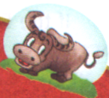
Remember!
Short words like articles (a, an, the), conjunctions (and, or), and prepositions (at, of, to) are usually unstressed or in the weak form. However, we use these short words in the strong form in the following cases:
When the short words are used at the end of sentences.
Example: What are you playing at?
Mary is the person I’m looking for.
When the short words are used for emphasis or contrast.
Example: This is the place to eat.
It’s not a solution, but the solution
When the short words are used for citation.
Example: You should put ‘and’ at the end of the sentence.

Slide 10
5. Read the mini-talks and underline the short words (for, the, from, and, but, at, of, to) you think use the strong form. Then listen and check.
Example:
A: Who are you looking for?
B: Peter is the person I'm looking for.
1. A: Where are you from?
B: I'm from Ha Noi.
2. A: Can you come and check this paragraph for me?
B: It's OK but you shouldn't use 'and' at the beginning of the paragraph.
3. A: Did you ask her to join our group?
B: I've asked her several times but she doesn't want to.
4. A: Is this letter from Peter?
B: No, the letter is to him, not from him.

Slide 11

HOMEWORK
- Learn by heart new words.
- Do all the exercises again
- Prepare Unit 5 : A closer look 2

