Slide 1

Welcome all of teachers and students
UNIT 5: WONDERS OF VIET NAM
Lesson 3: A closer look 2
Lesson plan for English 9

Slide 2
*Match the active to the passive
Active |  | Passive
1. People think he is a great teacher |  | a. It is said that she works 16 hours a day
2. People say she works 16 hours a day |  | b. It was reported that two people had been injured in the accident
3. They reported that two people had been injured in the accident |  | c. It is thought that he is a great teacher
*What kind of passive is it?
-It is impersonal passive (bị động không ngôi)

Slide 3
Welcome all of teachers and students
UNIT 5: WONDERS OF VIET NAM
Lesson 3: A closer look 2
Lesson plan for English 9

Slide 4

The impersonal passive
1a. Read part of the conversation. Pay attention to the underlined part.
Veronica: Great thanks. What’s the best way to get around?
Mi: It’s probably best to use rickshaws. It’s said that they’re quicker and cheaper than taxis.
Form: It + to be + PII + that + S + V
Can you find another example of the impersonal passive in the conversation?
It is said that this complex of monuments is one of the wonders of Viet Nam.
a. When do we use the impersonal passive? Can you think of any rules?

Slide 5
2. Complete the sentences using the correct passive form of the verbs in brackets. The first one has been completed for you.
It is known
1.(know) ........................... that Ha Long Bay was recognized as a World Heritage Site by UNESCO in 1994.
It is believed
2.(believe) .............................. the best time to visit the complex of Hue Monuments is in April.
It is reported
3. (report) ......................... thousands of visitors come to enjoy breathtaking views of Ha Long Bay every year.
It is claimed
4. (claim) ............................. Phong Nha – Ke Bang can be compared to a huge geological museum.
5. (understand) ............................... Binh Dai Fortress was designed to control movement on the perfumed River.
It is understood
It is expected
6. (expect) ............................ The government will have measures to protect and preserve our man-made wonders.

Slide 6
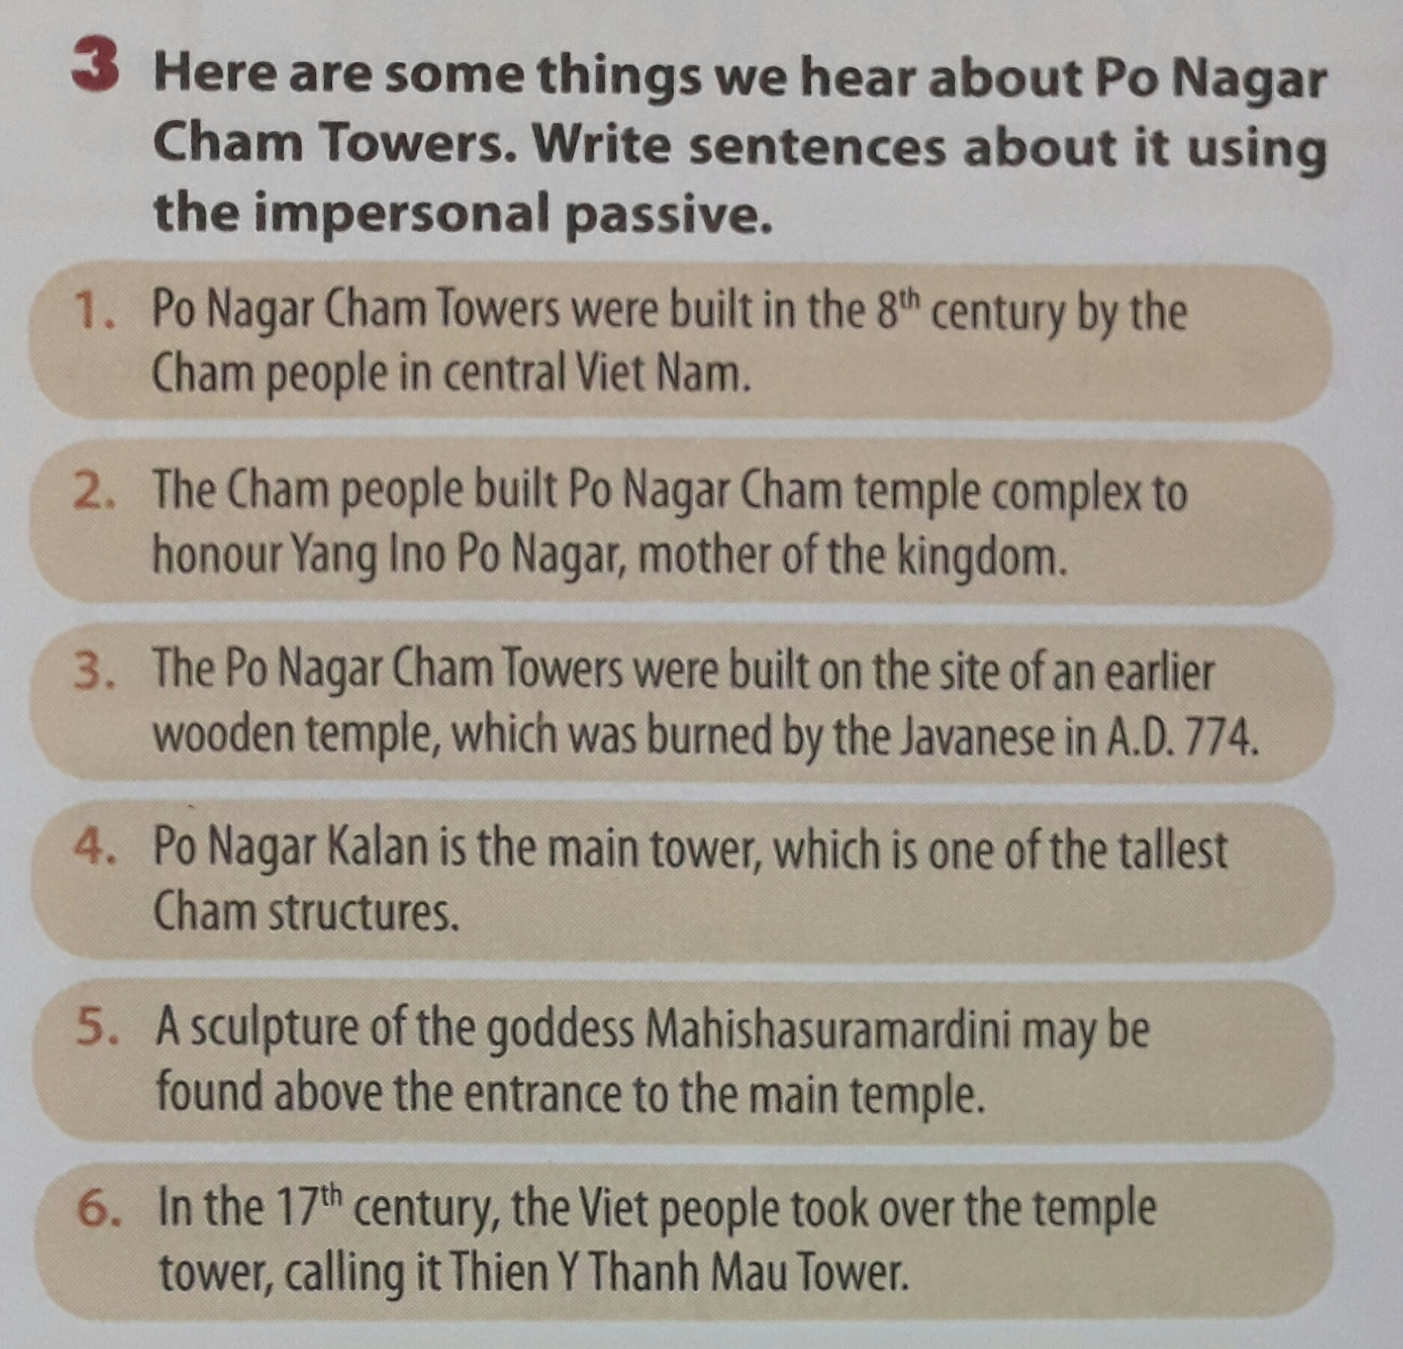
3. Here are some things we hear about Po Nagar Cham Towers. Write sentences about it using the impersonal passive.
-> It is claimed that Po Nagar Cham Towers were built in the 8th century by the Cham people in central Viet Nam.
-> It is said that the Cham people built Po Nagar Cham temple complex to honour Yang Ino Po Nagar mother of the kingdom.
-> It is believed that the Po Nagar Cham Towers were built on the site of an earlier wooden temple which was burned by the Javanese in A.D. 774.
-> It is understood that the Po Nagar Kalan is the main tower, which is one of the tallest Cham structures.
-> It is known that a sculpture of the goddess Mahishasuramardini may be found above the entrance to the main temple.
-> It is thought that in the 17th century, the Viet people took over the temple tower, calling it Thien Y Thanh Mau Tower.

Slide 7
suggest + V-ing/clause with should
4 a. Read part of the conversation. Pay attention to the underlined part.
Veronica: My father suggests we should go by air.
Mi: That’s too expensive! I suggest going by train.
=>After the verb suggest we can use V-ing , a clause with should or V
• S + suggest + V-ing
• S + suggest + that + S + should + V
• S + suggest + that + S + V
b. When do we use suggest + V-ing/clause with should? Can you think of any rules?
We use suggest + V-ing/clause with should to tell someone our ideas about what they should do where they should go, etc.
Eg: I suggest that she should go out to eat.
I suggest that she go out to eat.
I suggested going in my car.

Slide 8
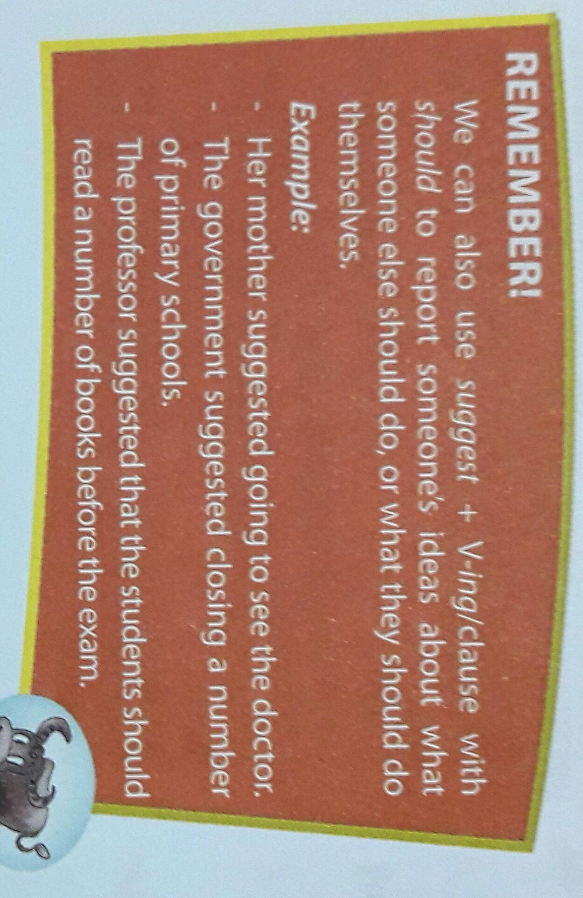

Slide 9
5. Write answers to the following questions using suggest + V-ing/clause with should and the prompts in brackets. Then practice them with your partner. The first one has been completed for you.
1. A: Have you thought of recycling?
B: I suggest …………………………………………………………….
(recycle things such as bags, cans, and bottles)
We should recycle/ recycling things such as bags cans, and bottles
2. A: What should we do to protect and preserve our man-made wonders?
B: I suggest ...........................................
(the government/ limit the number of visitors/ every day.)
the government should limit/ limiting the number of visitors every day
3. A: What should we do to conserve forests? (control/ deforestation)
B: .....................................................................
I suggest the government should control/ controlling the deforestation.
4. A: What should we do to protect valuable things in pagodas and temples?
B: ...................................................................
(put/ these valuable things/ in high-security places).
I suggest we should put/ putting these valuable things in high-security places.
5. A: What should we do to restore our aging man-made wonders? (raise/ money)
B: ....................................................................
I suggest we should raise/ raising some money.
6. A: What should we do to prevent global warming? (reduce/ smoke/ exhaust fumes).
B: ...................................................................
I suggest we should reduce/ reducing smoke and exhaust fumes.
11/26/2020 7:53 AM

Slide 10
6 a. Work in pairs. Tell your partners what they should do in the following situations using suggest + V-ing/ clause with should.
1. Your bicycle has been stolen.
Example:
→ call the police.
A: Oh no! …………………………...
What should I do now?
B: I suggest …………………
I suggest that …………………………...
My bicycle has been stolen
2. You have left your workbook at home.
→ tell the teacher.
calling the police
3. You have lost your way in the city center.
you (should) call the police.
→ buy a map.
4.Your laptop isn’t working.
→ thank someone to fix it.
5. You have forgotten to bring your wallet when going shopping.
→ come back to take the wallet.

Slide 11
6b. Now report your partner’s idea to another partner.
1. Your bicycle has been stolen.
Example:
→ call the police.
2. You have left your workbook at home.
→ tell the teacher.
I asked B what I should do when ………………………….
He suggested ………………………….
3. You have lost your way in the city center.
→ buy a map.
my bicycle had been stolen.
4.Your laptop isn’t working.
calling the police/
that I (should) call the police.
→ thank someone to fix it.
5. You have forgotten to bring your wallet when going shopping.
→ come back to take the wallet.

Slide 12

HOMEWORK
- Learn by heart stuctures
- Do all the exercises again
- Prepare Unit 5 : communication

