Slide 1
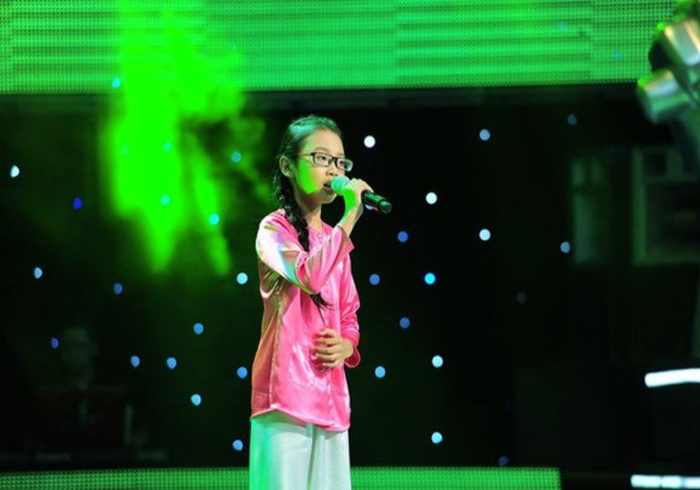





*Match the programme to the pictures
The voice kid
The Price is right
1 VS 100
A miraculous hat
VN got talent
Who is the millionaire?
1
2
3
4
5
6

Slide 2

Welcome all of teachers and students
UNIT 5: WONDERS OF VIET NAM
Lesson 4: Communication
Lesson plan for English 9

Slide 3
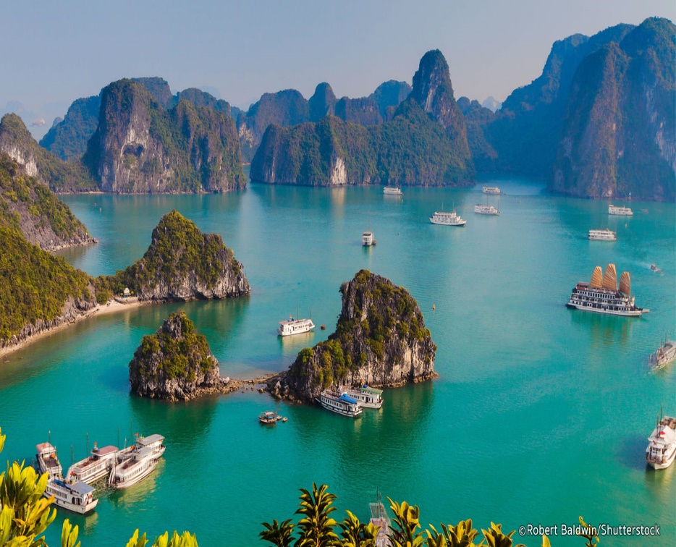

I/ Vocabulary:
:Tên riêng/ danh từ riêng
- proper name: (n) /ˈprɒpə(r)/
= amazing (a)
: Ngoạn mục
- spectacular: (adj) /spekˈtækjələ(r)/
- contestant: /kənˈtestənt/(n)
= competitor (n)
: Người dự thi
- (to) be out of s.t
: Bị loại, ra khỏi
-(to) risk doing s.t
:Liều lĩnh, mạo hiểm
- round (in a game):
- vòng
Ha Long Bay is one of the most beautiful wonders of Viet Nam.

Slide 4



1 Listen to the radio programme from 4Teen. Then decide whether the following statements are true (T) or false (F)
Statements | True | False
1. The MC will read out five sentences that describe one of the wonders of Viet Nam. 2. The MC won’t mention the proper names of any place in her description. 3. The players have to work out where the wonder is and whoever gives the correct answer first wins. 4. If any player can give the correct answer before the MC finishes reading out all the sentences, he/she is the winner and gets a special gift. 5. If any player gives the incorrect answer before the MC finishes reading out all the sentences, he/she is still allowed to continue the game.
six
what
out of

Slide 5
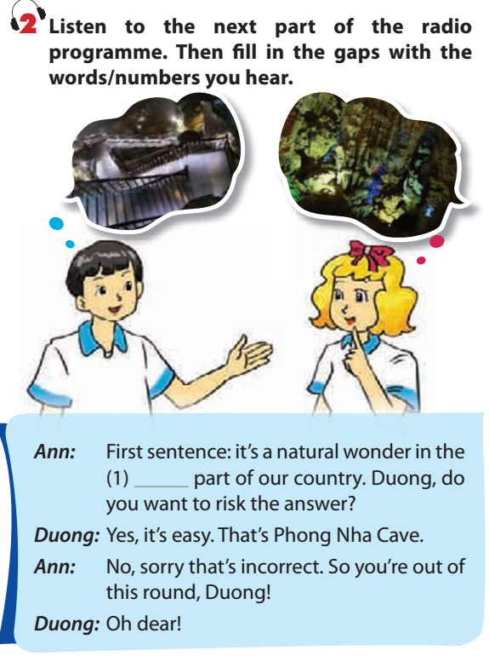
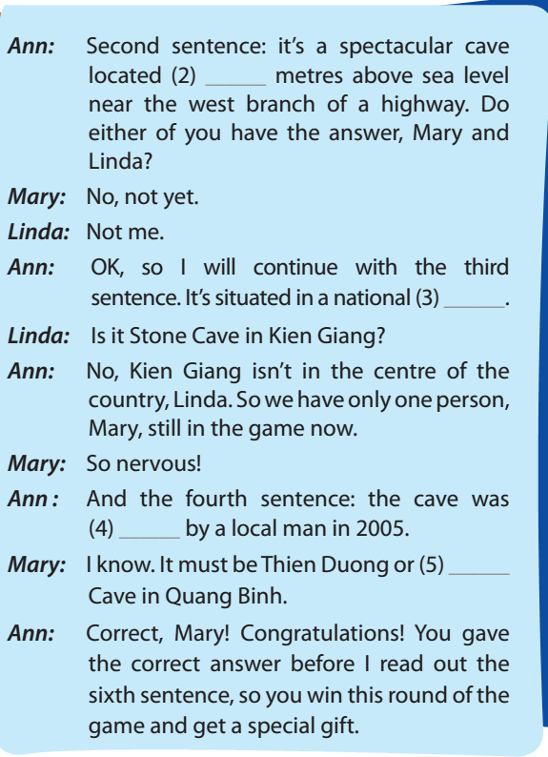
200
park
discovered
central
Paradise

Slide 6
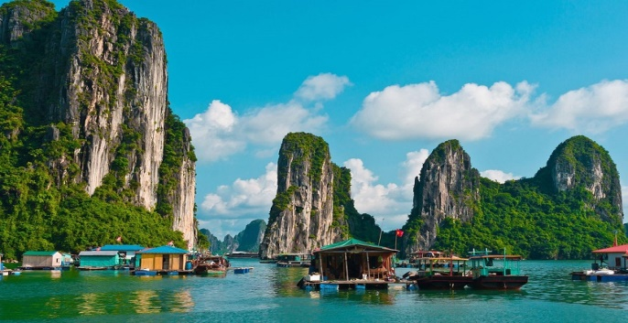
3. Write six sentences that describe one of the wonders of Viet Nam you know.
First sentence: Ha Long Bay is a UNESCO World Heritage Site and popular travel destination in Quảng Ninh Province
Ha Long Bay is a UNESCO World Heritage Site and popular travel destination in Quảng Ninh Province. French tourists visited it in the late 19th century, and named the cave Grotte des Merveilles. There are two bigger islands, Tuan Chau and Cat Ba. The protected area is from the Cai Dam petrol store to Quang Hanh commune, Cam Pha town and the surrounding zone. It has spectacular caves such as Dau Go, Thien cung. It is home to 14 endemic floral species and 60 endemic faunal species.
Second sentence: French tourists visited it in the late 19th century, and named the cave Grotte des Merveilles
Third sentence: There are two bigger islands, Tuan Chau and Cat Ba.
Fourth sentence: The protected area is from the Cai Dam petrol store to Quang Hanh commune, Cam Pha town and the surrounding zone.
Fifth sentence: It has spectacular caves such as Dau Go, Thien cung.
sixth sentence: It is home to 14 endemic floral species and 60 endemic faunal species.

Slide 7
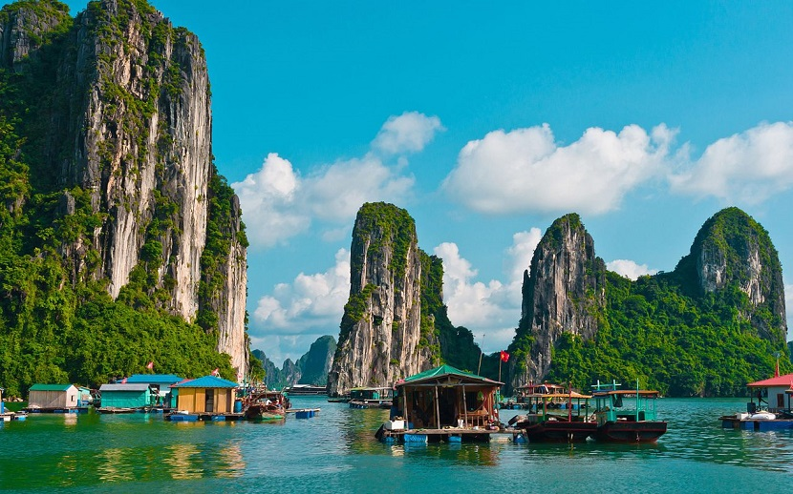
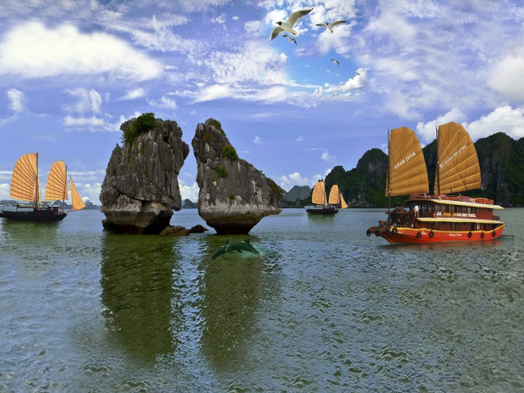
3. Write six sentences that describe one of the wonders of Viet Nam you know.
Ha Long Bay is a UNESCO World Heritage Site and popular travel destination in Quảng Ninh Province. French tourists visited it in the late 19th century, and named the cave Grotte des Merveilles. There are two bigger islands, Tuan Chau and Cat Ba. The protected area is from the Cai Dam petrol store to Quang Hanh commune, Cam Pha town and the surrounding zone. It has spectacular caves such as Dau Go, Thien cung. It is home to 14 endemic floral species and 60 endemic faunal species.
Ha Long Bay / UNESCO World Heritage Site and popular travel destination / Quảng Ninh Province. French tourists visit it / late 19th century, and name/ the cave Grotte des Merveilles. There / two bigger island/, Tuan Chau and Cat Ba. The protected area /from the Cai Dam petrol store / Quang Hanh commune, Cam Pha town and the surrounding zone. It has spectacular cave/such / Dau Go, Thien cung. It / home / 14 endemic floral species and 60 endemic faunal species.

Slide 8
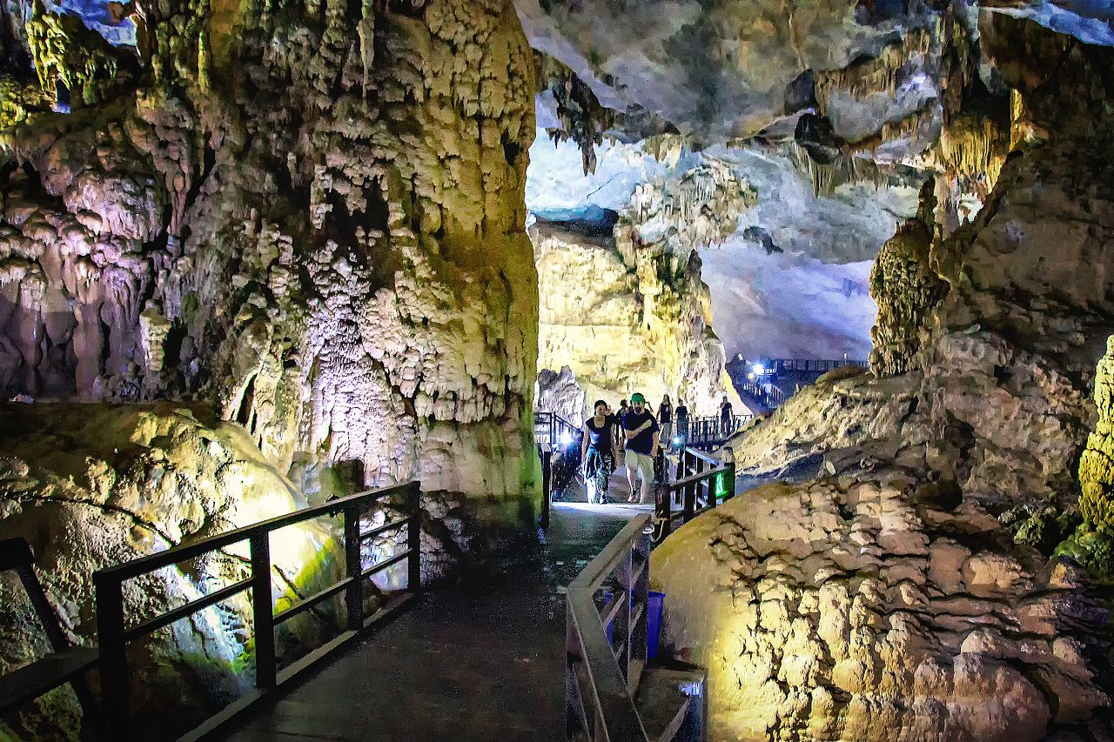
3. Write six sentences that describe one of the wonders of Viet Nam you know.
Phong Nha - Ke Bang National Park is located in Quang Ninh, Bo Trach, Tuyen Hoa and Minh Hoa districts (Quang Binh province) with an area of about 200,000 ha. Phong Nha - Ke Bang is compared to a huge geological museum with global value and significance.
First sentence: It’s a natural wonder in the central part of our country.
Second sentence: It’s a spectacular cave located 200 metres above sea level near the west branch of a highway.
Third sentence: It’s situated in a national park.
Fouth sentence: the cave was discovered by a local man in 2005.
Fifth sentence: ……….

Slide 9





LUCKY
ROUND
30
20
1
2
3
40
10
50
80
4
5
6
60
70
BACK

Slide 10

1. It is an ancient town of Vietnamese people
HOI AN
BACK

Slide 11
2. It has a total area of 18,395 ha,
including: archaeological zone of 18
Hoang Dieu and the remaining relics
in Hanoi's ancient relic
The central relic area of Hoang Thanh Thang Long - Hanoi
BACK

Slide 12
3. It is Located in a valley with a diameter of about 2 km in Duy Phu commune, Duy Xuyen district, Quang Nam province
MY SON TOWER AREA
BACK

Slide 13
4. It is Located along the banks of the Perfume River
Hue citadel
BACK

Slide 14
5. It is located in Quang Binh with an area of about 200,000 ha.
Phong Nha - Ke Bang National Park
BACK

Slide 15
6.This is Vietnam's first mixed-world heritage site recognized by UNESCO. With an area of 6,172 ha
Trang An Landscape Complex
BACK

Slide 16

HOMEWORK
- Do all the exercises again
- Prepare Unit 5 : Skills 1

