Slide 1
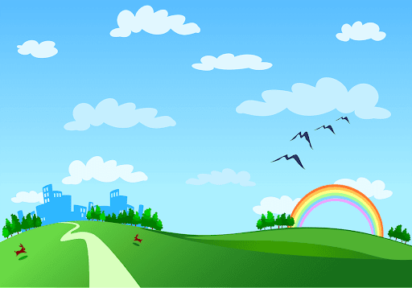
Welcome teachers
to our class!

Slide 2


Slide 3


UNIT 6: A VISIT TO A SCHOOL
LESSON 1: GETTING STARTED

Slide 4
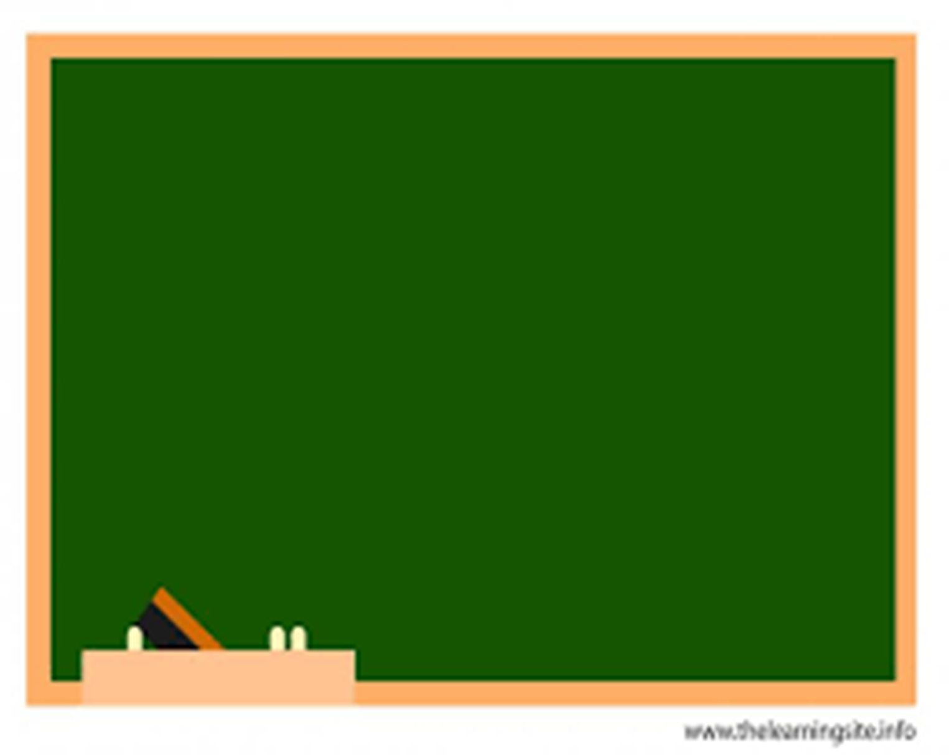
I. Vocabulary
- lower secondary school:
trường trung học cơ sở
- (to) prepare:
chuẩn bị
- member (n):
thành viên
- (to) remind:
gợi nhớ

Slide 5

UNIT 6: A VISIT TO A SCHOOL
* Checking vocab
- lower secondary school
: trường THCS
- (to) prepare
: chuẩn bị
- member (n)
: thành viên
- (to) remind
: gợi nhớ

Slide 6
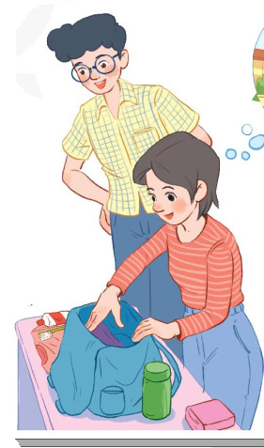
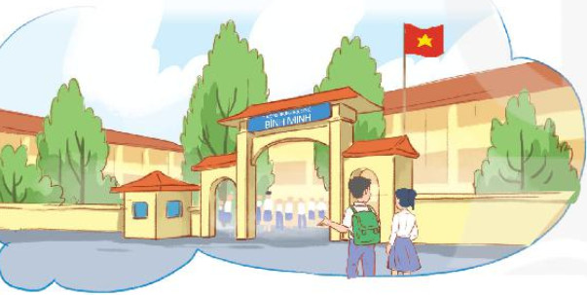
1. Who are they?
2. What is Mi doing?
A visit to Binh Minh
Lower Secondary School
Phong
Mi

Slide 7

Phong: What are you doing, Mi?
Mi: I'm preparing to visit Binh Minh Lower Secondary School.
Phong: Sounds great! I think that's one of the best schools in my neighbourhood. Who is going with you and when?
Mi: My teacher and my classmates. We're going in the afternoon.
Phong: I see. What will you do there?
Mi: Well, I think we'll visit the school library, the computer room, and the gym. We'll meet the students and share ideas for a project in our English class.
Phong: That's interesting. What else will you do there?
Mi: We'll meet the members of their Go Green Club and take photos of the school.
Phong: Fantastic! So don't forget to take your camera.
Mi: I almost forgot. Thanks for reminding me.

Slide 8
2
Read the conversation again and answer the questions by circling A, B or C.
1. What are they talking about?
a. A visit to a computer room.
b. A visit to a school.
c. A visit to a school library.
3. Where is the school?
a. In the city.
b. In the countryside.
c. In Phong’s neighbourhood.
2. Who is going to visit the school?
a. Mi and her teacher.
b. Mi and her classmates.
c. Mi, her teacher and her classmates.
4. When are they going?
a. In the morning.
b. In the afternoon.
c. At noon.

Slide 9




1. What are they talking about?
WHAT A PITY !
A
A visit to a computer room.
PERFECT
A visit to a school.
B
A visit to a school library.
C
SORRY !

Slide 10
2. Who is going to visit the school?
WHAT A PITY !
A
Mi and her teacher .
SORRY !
Mi and her classmates.
B
C
Mi, her teacher and her classmates.
PERFECT

Slide 11
3. Where is the school ?
WHAT A PITY !
A
In the city.
SORRY !
B
In the countryside.
PERFECT
C
In Phong’s neighbourhood.

Slide 12
4. When are they going?
WHAT A PITY !
A
In the morning
In the afternoon
B
PERFECT
C
SORRY !
At noon

Slide 13
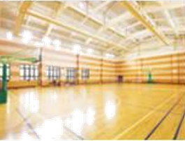
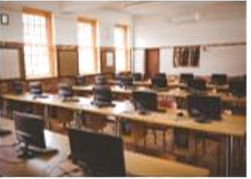
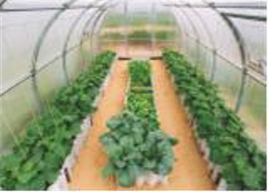
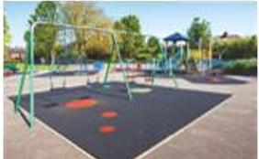
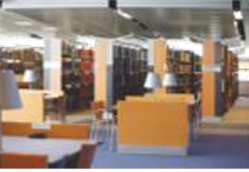
PRACTICE
3
Name these places, using the words and phrases from the box.
computer room
school library
gym
school garden
playground
1.
2.
3.
4.
5.

Slide 14
4
Complete the following sentences with the words in the box.
computer room
school library
school garden
playground
gym
1. The school ____________is very small, so not many children can play in it.
2. We learn how to use the Internet in the ______________ twice a week.
3. They have school meetings in the _______when it rains.
4. There are a lot of books, magazines, and newspapers in the _______________.
5. Our class usually waters the vegetables in the _______________ on Friday afternoon.
playground
computer room
gym
school library
school garden

Slide 15
5
Work in pairs. Ask and answer questions about Nick’s timetable, using when and where.
Subject | Time | Place
Maths | 8 a.m. Monday, Tuesday, Friday | classroom (room 302)
Biology | 9 a.m. Thursday | Science lab
Information Technology | 2 p.m. Wednesday | computer room
Physical Education | 3 p.m. Monday, Thursday | school gym
History | 3:30 p.m. Tuesday | school library
Example:
A: When does Nick have maths?
B: At 8 a.m. on Monday, Tuesday, and Friday.
A: And where does he have it?
B: In his classroom, room 302.

Slide 16
Example:
A: When does Nick have maths?
B: At 8 a.m. on Monday, Tuesday, and Friday.
A: And where does he have it?
B: In his classroom, room 302.
*Notes:
- on Monday ( on-> preposition of time)
- in his class ( in-> preposition of place)

Slide 17
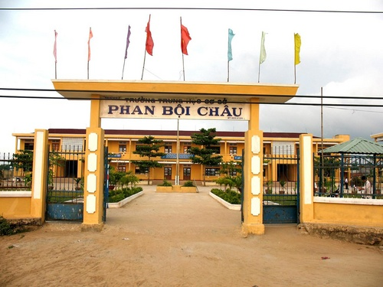

Slide 18
Game: Lucky number
1
2
3
4
5
6

Slide 19

1/ Where is your school?

Slide 20
2/ When do you have English?

Slide 21
Lucky number

Slide 22
3/ Do you like your school?

Slide 23
4/ What do you like the best in your school?

Slide 24
Lucky number

Slide 25

HOMEWORK
Learn the vocabularies by heart.
Do exercises 1, 2 page 45 in workbook.
Prepare for A closer look 1

Slide 26

Thank you for your attention!

