Slide 2
WARM-UP
What did you do last night after finishing your homework?
Do you like watching film?
What kind of film do you watch?

Slide 4
WELCOME  TO  OUR  CLASS
ENGLISH 7
LET’S GO TO THE CINEMA TONIGHT.

Slide 5
Aims of the stage:
to provide students with vocabulary.
to help students well-prepared for the listening and reading tasks.

Slide 6
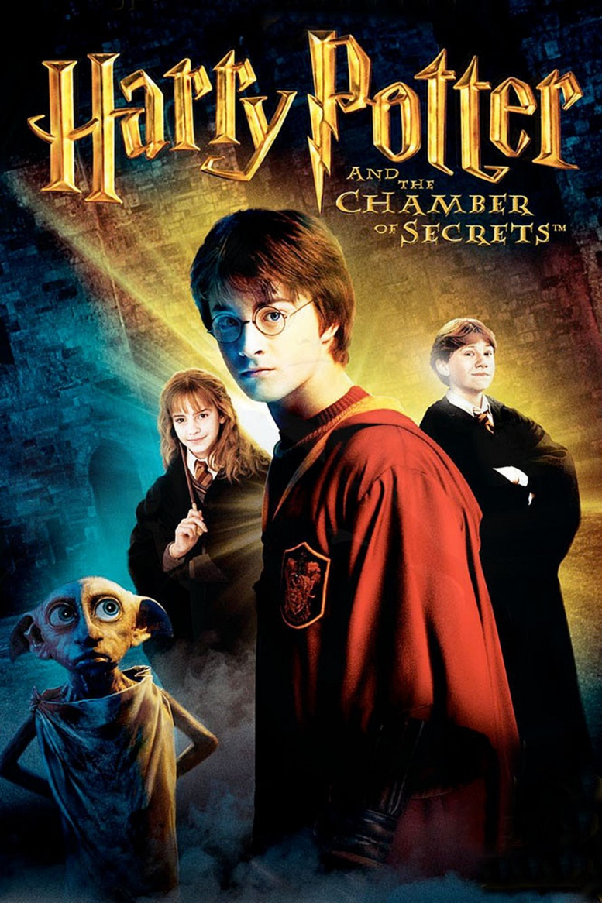
PRESENTATION
fantasy (n)
/ˈfæntəsi /
phim viễn tưởng

Slide 7
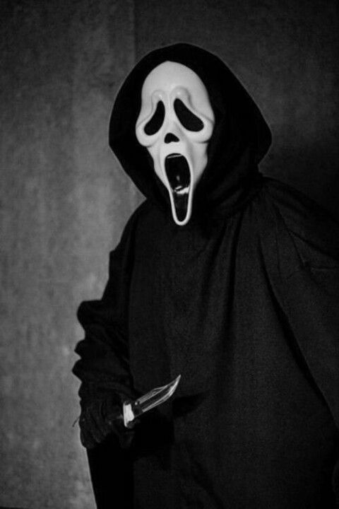
PRESENTATION
horror film (n)
/'hɒrə fɪlm/
phim kinh dị

Slide 8
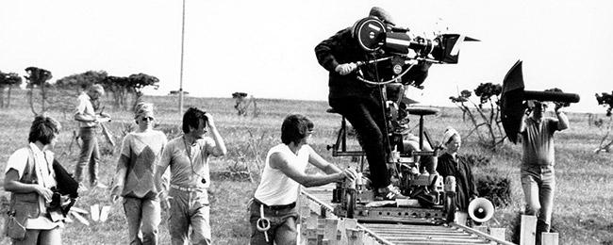
PRESENTATION
documentary (n)
/dɒkjʊˈmentəri/
phim tài liệu

Slide 9
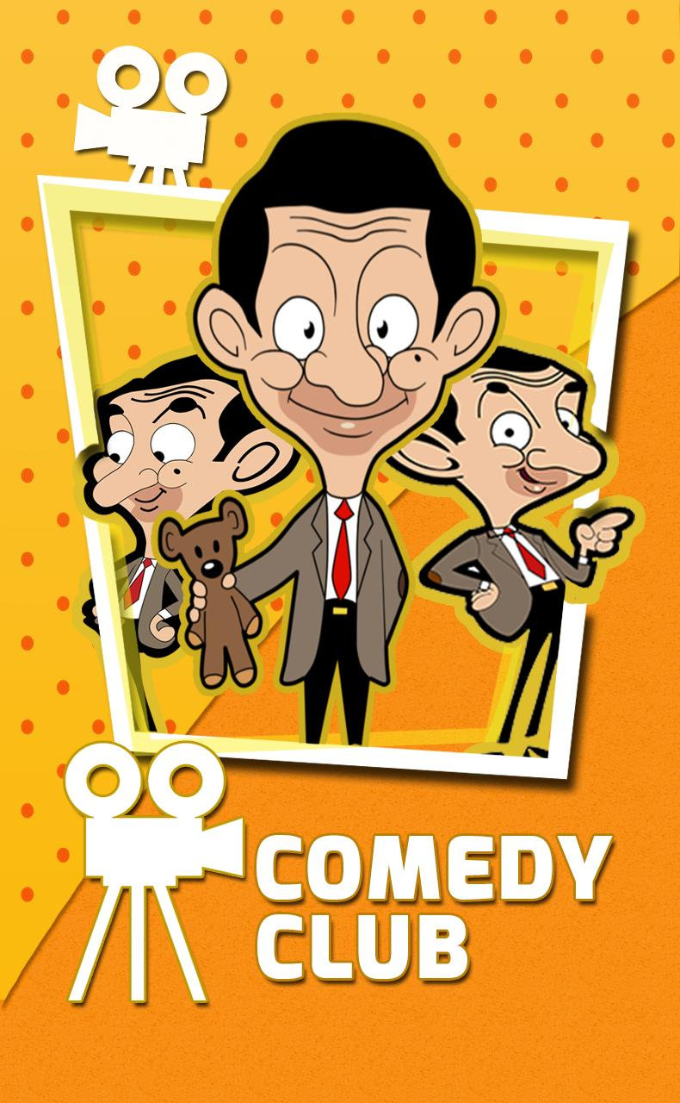
PRESENTATION
comedy (n)
/ˈkɒmədi/
phim hài

Slide 10
PRESENTATION
New words | Pronunciation | Meaning
horror film | /'hɒrə fɪlm/ | phim kinh dị
documentary | /dɒkjuˈmentri/ | phim tài liệu
comedy | /ˈkɒmədi/ | phim hài
fantasy | /ˈfæntəsi / | phim viễn tưởng

Slide 11
LESSON 1: GETTING STARTED
WARM-UP
Chatting
PRESENTATION
Vocabulary
PRACTICE
Task 1: Listen and read.
Task 2: Read the conversation again and choose the correct answer.
Task 3: Choose the correct word or phrase.
Task 4: Complete the sentences.

Slide 12
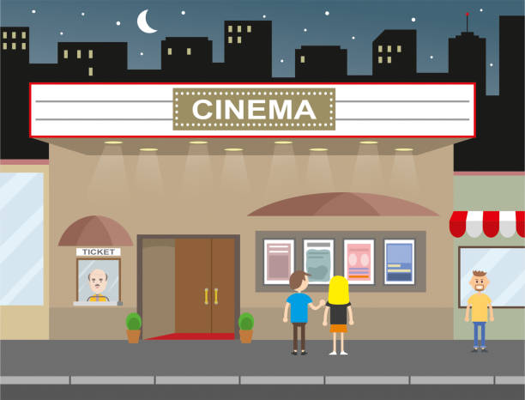
PRACTICE
1
Listen and read.
Aim of the task:
to have students get to know the topic.

Slide 13
Mark: Let’s go to the cinema tonight!
Mi: Good idea! What shall we see?
Mark: A Nightmare is on at Sao Mai Cinema tonight.
Mi: Is it a fantasy?
Mark: No, it’s a horror film.
Mi: That’s too scary for me. Look! An Old Pier is on at Town Cinema. It’s a documentary.
Mark: I don’t really like documentaries. They’re often boring. What about Our Holiday?
Mi: What kind of film is it?
Mark: It’s a comedy.
Mi: And who stars in it?
Mark: Kate Harrison and Lily Collins.
Mi: Um, they're pretty good. What's it about?
Mark: It’s about two women living in different countries and they decide to exchange houses.
Mi: What are the reviews like?
Mark: Well, although a few people say it’s a bit silly, most say it’s funny and interesting. ...

Slide 14
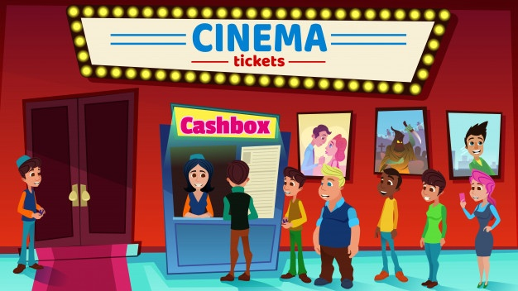
PRACTICE
2
Read the conversation again and choose the correct answer to each question.
Aim of the task:
to have students get specific information of the text.

Slide 15
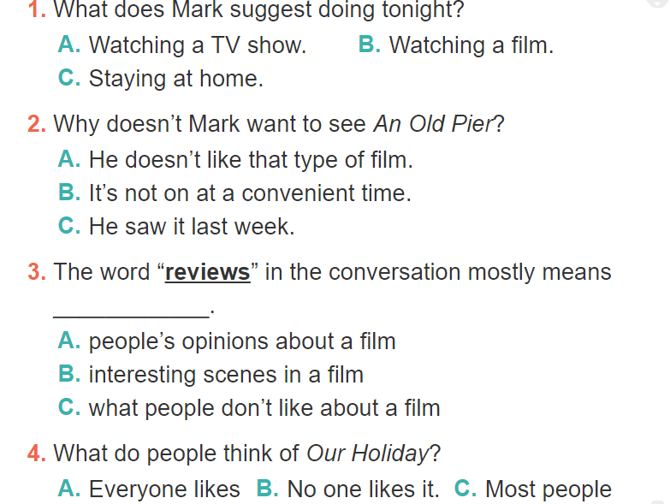
2
Read the conversation again and choose the correct answer to each question.

Slide 16
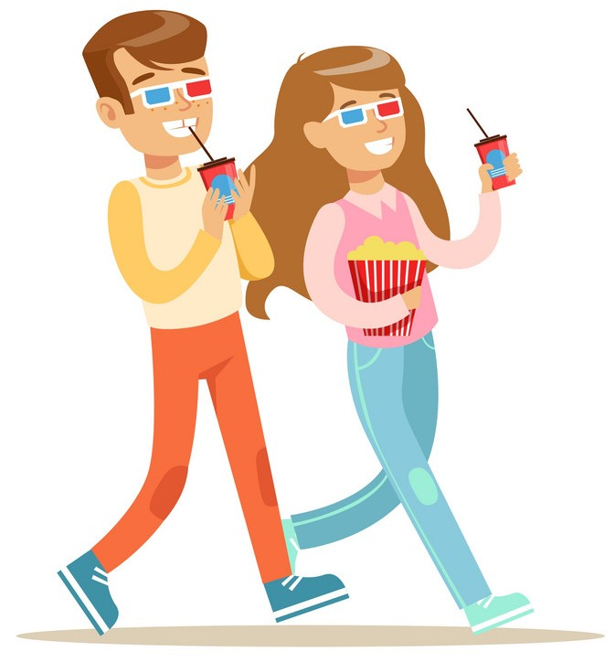
1. What does Mark suggest doing tonight? a. Watching a TV show. b. Watching a film. c. Staying at home.
Mark: Let’s go to the cinema tonight!
Mi: Good idea! What shall we see?
Mark: A Nightmare is on at Sao Mai Cinema tonight.
Mi: Is it a fantasy?
Mark: No, it’s a horror film.
Mi: That’s too scary for me. Look! An Old Pier is on at Town Cinema. It’s a documentary.
Mark: I don’t really like documentaries. They’re often boring. What about Our Holiday?

Slide 17
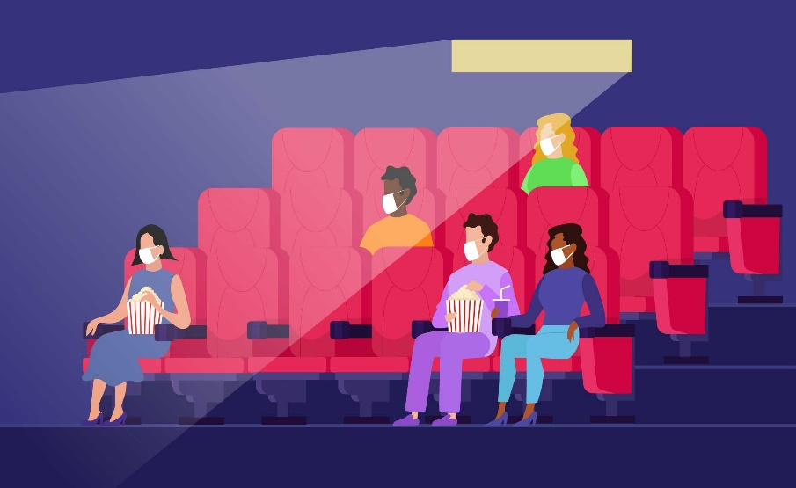
2. Why doesn’t Mark want to see An Old Pier? a. He doesn’t like that type of film. b. It’s not on at a convenient time. c. He saw it last week.
Hoa: That’s too frightening for me. Look! An Old Pier is on at the Town Cinema. It’s a documentary. Mark: I don’t really like documentaries. They’re often boring. What about Our Holiday?

Slide 18
3. The word “reviews” in the conversation mostly means _____. a. people’s opinions about the film b. interesting scenes in the film c. what people don’t like about the film
2
Mi: What are the reviews like?
Mark: Well, although a few people say it’s a bit silly, most say it’s funny and interesting

Slide 19
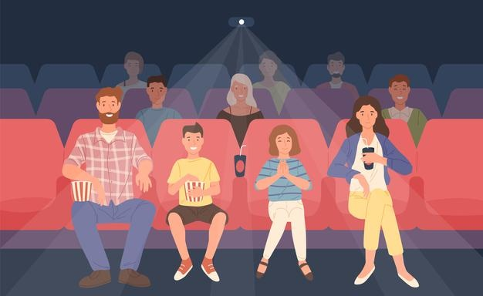
4. What do people think of Our Holiday? a. Everyone likes it. b. No one likes it. c. Most people like it.
2
Mi: What are the reviews like?
Mark: Well, although a few people say it’s a bit silly, most say it’s funny and interesting

Slide 20
PRACTICE
3
Choose the correct word or phrase to complete each of
the following sentences.
comedy
Aim of the task:
to introduce more types of films.
fantasy
science fiction film
Types of films
horror film
docu-mentary
cartoon

Slide 21
1. A film that tries to make the audience laugh is a (comedy / documentary).
2. A film that is based only on imagination, not on real facts, is a (comedy / fantasy).
3. A film that shows real life events or stories is a (documentary / horror film).
4. A film that is set in the future, often about science, is a (cartoon / science fiction film).
5. A film in which strange and frightening things happen is a (horror film / comedy).

Slide 22
WHO’S FASTER?
CHOOSE THE BEST ANSWER

Slide 23
WHO’S FASTER
1. A film that tries to make the audience
laugh is a ………………
1
comedy
A
2
13
8
0
1
3
6
7
9
10
11
12
14
15
5
4
docu-mentary
b
Time’s up
horror film
c

Slide 24
WHO’S FASTER
A film that is based only on imagination,
not on real facts, is a ……
2
fantasy
A
2
13
8
0
1
3
6
7
9
10
11
12
14
15
5
4
comedy
b
Time’s up
horror film
s
c

Slide 25
WHO’S FASTER
A film that shows real life events or stories
is a ……………..
3
fantasy
A
2
13
8
0
1
3
6
7
9
10
11
12
14
15
5
4
docu-mentary
b
Time’s up
horror film
c

Slide 26
WHO’S FASTER
A film that is set in the future, often about
science, is a …………..
4
cartoon
A
2
13
8
0
1
3
6
7
9
10
11
12
14
15
5
4
science fiction film
b
Time’s up
fantasy
c

Slide 27
WHO’S FASTER
A film in which strange and frightening things
happen is a ………..
5
comedy
A
2
13
8
0
1
3
6
7
9
10
11
12
14
15
5
4
science fiction film
b
Time’s up
c
horror film

Slide 28
Key:
1. comedy
2. fantasy
3. documentary
4. science fiction film
5. horror film

Slide 29
PRACTICE
4
Complete the following sentences with the words in the box.
Aim of the task:
to introduce adjectives describing films.
funny
boring
frightening
moving
interesting

Slide 30
4
Complete the following sentences with the words in the box.
funny
interesting
frightening
moving
boring
1. Going to the hospital can be _____________ for a child. 2. The film was so _________ that the audience couldn’t stop laughing. 3. Many people cried when they saw the __________ scenes of the film. 4. The film last night was so _________ that we fell asleep. 5. This book is _________. I got a lot of useful information from it.

Slide 31
funny
moving
interesting
frightening
boring
4
1. Going to the hospital can be ____________for a child. 2. The film was so _______________ that the audience couldn’t stop laughing. 3. Many people cried when they saw the _____________ scenes of the film. 4. The film last night was so _______________ that we fell asleep. 5. This book is ________________. I got a lot of useful information from it.

Slide 32
4. Complete the following sentences with the words in the box.
1. frightening
2. funny
3. moving
4. boring
5. interesting

Slide 33
1. comedy
2. fantasy
3. documentary
4. science fiction film
5. horror film
a. frightening
b. funny
c. moving
d. boring
e. interesting

Slide 34
LESSON 1: GETTING STARTED
WARM-UP
Chatting
PRESENTATION
Vocabulary
Task 1: Listen and read.
Task 2: Read the conversation again and choose the correct answer.
Task 3: Choose the correct word or phrase.
Task 4: Complete the sentences.
PRACTICE
PRODUCTION
Task 5: Work in pairs. Ask and answer about a type of film.

Slide 35
PRODUCTION
Work in pairs. ask and answer about a type of film. Use some of the adjectives in Task 4.
5
Example: A: Do you like documentaries? B: No, I don’t. A: Why not? B: I think they’re boring.

Slide 36
Example: A: Do you like documentaries? B: No, I don’t. A: Why not? B: I think they’re boring.
1. comedy
2. fantasy
3. documentary
4. horror film
a. frightening
b. funny
c. boring
d. interesting

Slide 37
LESSON 1: GETTING STARTED
WARM-UP
Chatting
PRESENTATION
Vocabulary
Task 1: Listen and read.
Task 2: Read the conversation again and choose the correct answer.
Task 3: Choose the correct word or phrase.
Task 4: Complete the sentences.
PRACTICE
PRODUCTION
Task 5: Work in pairs. Ask and answer about a type of film.
CONSOLIDATION
Wrap-up
Homework

Slide 38
CONSOLIDATION
1
Wrap-up
Topic of the unit
FILMS
Vocabulary
Types of films
Adjectives describing films

Slide 39
CONSOLIDATION
2
Homework
Think about your favourite film.
Use at least 3 adjectives to describe it.

Slide 40
HOMEWORK
- Learn the new words by heart.
- Practice the dialogue again.
- Do exercises B1,2,3,4 in workbook (page 11,12).
- Prepare for Unit 8: Closer look 1.
+

Slide 41
Website: sachmem.vn
Fanpage: facebook.com/sachmem.vn/

