Slide 2
Unit
8
FILMS
LESSON 3: A CLOSER LOOK 2
Grammar: Connectors of contrast
however
although/ though
Unit
HOBBIES

Slide 3
OBJECTIVES
By the end of the lesson, students will be able to:
understand the use of the connectors: although/ though and however
practise using the connectors: although/ though and however in contexts

Slide 4
LESSON 3: A CLOSER LOOK 2
WARM-UP
Sentence puzzling.
PRESENTATION
Connectors of contrast: although/ though and however.
Task 1: Combine the two sentences, using although/ though.
Task 2: Complete the sentences, using although/ though or however.
PRACTICE
Task 3: Use your own ideas to complete the sentences.
Task 4: Choose the correct answer A, B or C to complete each sentence.
Task 5: Game – Chain story
PRODUCTION
CONSOLIDATION
Wrap-up
Homework

Slide 5
LESSON 3: A CLOSER LOOK 2
WARM-UP
Sentence puzzling
Aims of the stage:
To activate students’ prior knowledge related to the targeted grammar: connectors of contrast.
To increase students’ interest.
To enhance students’ skills of cooperating with team mates.

Slide 6
WARM-UP
Set 1:
He goes out although it is raining.
Set 2:
She gets good marks though she is lazy.
Set 3:
He is an amateur actor. However, he acts very well.
Set 4:
He studied hard. However, he failed the exam.

Slide 7
LESSON 3: A CLOSER LOOK 2
WARM-UP
Sentence puzzling.
PRESENTATION
Connectors of contrast: although/ though and however.
however
although/ though

Slide 8
PRESENTATION
We use although/ though or however to connect 2 contrasting ideas.
although/ though
connect 2
contrasting ideas
in the same sentence
however
connect 2 contrasting ideas
in 2 sentences
Although / Though John Peters is an amateur actor, he gave a great performance in his film.
John Peters is an amateur actor. However, he gave a great performance in his film.

Slide 9
I/ Grammar:
- Ta sử dụng “although/though”(dù, mặc dù, cho dù) hoặc “however”(tuy nhiên) để kết nối 2 ý tưởng tương phản.
1/Ta dùng: “although/though"trước một mệnh đề (clause) Although + Clause (S + V+ …), Main + Clause
Ex: Although / Though John Peters is an amateur actor, he gave a great performance in his film.
2/ Main clause (S + V+ …). However, Main clause (S + V …)
Ex: John Peters is an amateur actor. However, he gave a great performance in his film.

Slide 10
Ngữ pháp: although/ though và however Unit 8 Tiếng Anh 7 Global Success
1. Although/ Though (mặc dù)
Chúng ta sử dụng although/ though trước một mệnh đề để kết nối hai ý kiến trái ngược nhau trong cùng một câu.
Ví dụ: Although/ Though John Peter is an amateur actor, he gave a great performance in his latest film.
= John Peter gave a great performance in his latest film although/ though he is an amateur actor.
(John Peter đã diễn xuất tuyệt vời trong bộ phim mới nhất của mình mặc dù anh ấy là diễn viên nghiệp dư.)
2. However (tuy nhiên)
Chúng ta sử dụng however để thể hiện sự tương phản ý kiến trong hai câu. Chúng ta thường sử dụng dấu phẩy sau however.
Ví dụ:
John Peter is an amateur actor. However, he gave a great performance in his latest film.

Slide 11
PRACTICE
1
Combine the two sentences, using although/ though.
Aim of the task:
To check students’ understanding of the connectors although/ though.

Slide 12
PRACTICE
1
Combine the two sentences, using although/ though.
1. The questions were very difficult. He solved them easily.
2. He was a great actor. He never played a leading role in a film.
3. They spent a lot of money on the film. The film wasn’t a big success.
4. The film was a comedy. I didn’t find it funny at all.
5. We played well. We couldn’t win the match.

Slide 13
1
Combine the two sentences, using although/ though.
1.The questions were very difficult. He solved them easily.
Although/ Though the questions were very difficult, he solved them easily.
or He solved the questions easily although/though they were very difficult.

Slide 14
1
Combine the two sentences, using although/ though.
2. He was a great actor. He never played a leading role in a film.
Although/ Though he was a great actor, he never played a leading role in a film.
or He never played a leading role in a film although/though he was a great actor.

Slide 15
1
Combine the two sentences, using although/ though.
3. They spent a lot of money on the film. The film wasn’t a big success.
Although/ Though they spent a lot of money on the film, it wasn’t a big success.
or The film wasn’t a big success although/though they spent a lot of money on it.

Slide 16
1
Combine the two sentences, using although/ though.
4. The film was a comedy. I didn’t find it funny at all.
Although/ Though the film was a comedy, I didn’t find it funny at all.
or I didn’t find the film funny at all although/though it was a comedy.

Slide 17
1
Combine the two sentences, using although/ though.
5. We played well. We couldn’t win the match.
Although/ Though we played well, we couldn’t win the match.
or We couldn’t win the match although/though we played well.

Slide 18
1
Combine the two sentences, using although/ though.
1. Although/ Though the questions were very difficult, he solved them easily.
or He solved the questions easily although/though they were very difficult.
2. Although/ Though he was a great actor, he never played a leading role in a film.
or He never played a leading role in a film although/though he was a great actor.
3. Although/ Though they spent a lot of money on the film, it wasn’t a big success.
or The film wasn’t a big success although/though they spent a lot of money on it.
4. Although/ Though the film was a comedy, I didn’t find it funny at all.
or I didn’t find the film funny at all although/though it was a comedy.
5. Although/ Though we played well, we couldn’t win the match.
or We couldn’t win the match although/though we played well.

Slide 19
PRACTICE
2
Complete the sentences, using although/ though or however.
Aim of the task:
To check students’ understanding of the connectors although/ though or however.

Slide 20
PRACTICE
2
Complete the sentences, using although/ though or however.
1. _________________ the acting in the film was good, I didn’t like its story. 2. I felt really tired. _____________, I went to see the film. 3. I really enjoyed the new film ________________ most of my friends didn’t like it. 4. He studied hard for the exam. ______________, he failed it. 5. Mai speaks English very well _______________ her native language is Vietnamese.
Notes:
Wordwall game: https://wordwall.net/resource/27225435

Slide 21
1. _________________ the acting in the film was good, I didn’t like its story. 2. I felt really tired. _____________, I went to see the film. 3. I really enjoyed the new film ________________ most of my friends didn’t like it. 4. He studied hard for the exam. ______________, he failed it. 5. Mai speaks English very well _______________ her native language is Vietnamese.
Although/ Though
However
although/ though
However
although/ though
Notes:
Wordwall game: https://wordwall.net/resource/27225435

Slide 22
3
Use your own ideas to complete the following sentences.
1. I don’t really like the film though ______. 2. He felt very well. However, ______. 3. The film was a great success. However, ______. 4. Although it rained all day, ______. 5. The music in the film was terrible. However, ______.

Slide 23
4
Choose the correct answer (A, B, or C) to complete each sentence.
1. Mary overslept this morning ______ she went to bed early last night. A. although B. because C. so 2. ______ the sun is shining, it isn’t very warm. A. Because B. However C. Though 3. I don’t like running, ______ I like swimming. A. but B. so C. however 4. ______ the film was exciting, Jim fell asleep in the cinema. A. However B. Because C. Although 5. The story of the film is silly. ______, many people still enjoyed it. A. However B. Though C. But
Notes:
Wordwall game https://wordwall.net/resource/27224858

Slide 24
10
Gift
10
1
5
15
4
2
5
15
20
20
Gift
3
6
5
15
10

Slide 25
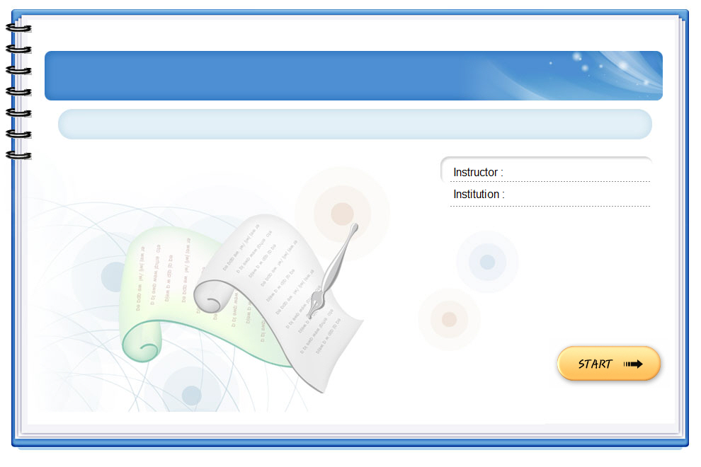
Mary overslept this morning ______
she went to bed early last night
A. although B. because C. so

Slide 26
2. ______ the sun is shining, it isn’t very warm.
A. Because B. However C. Though

Slide 27
3. I don’t like running, ______ I like swimming.
A. but B. so C. however

Slide 28
LUCKY NUMBER

Slide 29
4. ______ the film was exciting, Jim fell asleep in the cinema.
A. However B. Because C. Although

Slide 30
5. The story of the film is silly. ______, many people still enjoyed it.
A. However B. Though C. But

Slide 31
1. Mary overslept this morning ______ she went to bed early last night. A. although B. because C. so 2. ______ the sun is shining, it isn’t very warm. A. Because B. However C. Though 3. I don’t like running, ______ I like swimming. A. but B. so C. however 4. ___ the film was exciting, Jim fell asleep in the cinema. A. However B. Because C. Although 5. The story of the film is silly. ______, many people still enjoyed it. A. However B. Though C. But
4
Notes:
Wordwall game https://wordwall.net/resource/27224858

Slide 32
LESSON 3: A CLOSER LOOK 2
WARM-UP
Sentence puzzling.
PRESENTATION
Connectors of contrast: although/ though and however.
Task 1: Combine the two sentences, using although/ though.
Task 2: Complete the sentences, using although/ though or however.
Task 3: Use your own ideas to complete the sentences.
Task 4: Choose the correct answer A, B or C to complete each sentence.
PRACTICE
PRODUCTION
Task 5: Game – Chain story

Slide 33
PRODUCTION
5
Game – Chain story with although/ though
A: Although/ Though it rained yesterday, we went shopping. B: Although/ Though we went shopping, we didn’t buy anything.
C: ________________

Slide 34
LESSON 3: A CLOSER LOOK 2
WARM-UP
Sentence puzzling
PRESENTATION
Connectors of contrast: although/ though and however.
Task 1: Combine the two sentences, using although/ though.
Task 2: Complete the sentences, using although/ though or however.
PRACTICE
Task 3: Use your own ideas to complete the sentences.
Task 4: Choose the correct answer A, B or C to complete each sentence.
Task 5: Game – Chain story.
PRODUCTION
CONSOLIDATION
Wrap-up
Home work

Slide 35
CONSOLIDATION
1
Wrap-up
Grammar: Connectors of contrast
however
although/ though

Slide 36
CONSOLIDATION
2
Homework
Complete the following exercises in the Workbook.
Part B: Ex.6 & Ex.7 (page 62)
Part E: Ex. 1 (page 65)

Slide 37
Website: sachmem.vn
Fanpage: facebook.com/sachmem.vn/

