Slide 2
Unit
8
FILMS
LESSON 4: COMMUNICATION
Unit
HOBBIES

Slide 3
OBJECTIVES
By the end of the lesson, students will be able to:
accept and decline suggestions;
do a survey about group members’ favourite film;
report the survey’s result to class.

Slide 4
LESSON 4: COMMUNICATION
WARM-UP
Game: Conversation rearranging
Suggestions - Accepting & Declining suggestions
Everyday English
Task 1: Listen and read the conversations. Pay attention to the highlighted sentences.
Task 2: Work in pairs. Make similar conversations with the following situations.
EVERYDAY ENGLISH
A survey about films
Task 3: Listen to the conversation and fill in the blanks with the words you hear.
Task 4: Work in groups. Do a survey about your group members’ favourite films.
A SURVEY ABOUT FILMS
FURTHER PRACTICE
Task 5: Report you results to the class.
CONSOLIDATION
Wrap-up
Homework

Slide 5
LESSON 4: COMMUNICATION
WARM-UP
MATCHING
Aims of the stage:
To activate students’ prior knowledge and vocabulary related to the targeted grammar of giving suggestions and ways to accept/ decline them.

Slide 6
MATCHING
Let’s
How about
Why don’t we
go to the cinema?
go for a picnic.
playing badminton after school?

Slide 7
LESSON 4: COMMUNICATION
WARM-UP
Game: Conversation rearranging
Suggestions - Accepting & Declining suggestions
Everyday English
Task 1: Listen and read the conversations. Pay attention to the highlighted sentences.
Task 2: Work in pairs. Make similar conversations with the following situations.
EVERYDAY ENGLISH
Aims of the stage:
To introduce ways to :
make suggestions
accept/decline suggestions.

Slide 8
EVERYDAY ENGLISH
1
Everyday English
Aim of the stage:
To give students opportunities to use ways to accept and decline suggestions correctly in context.

Slide 9
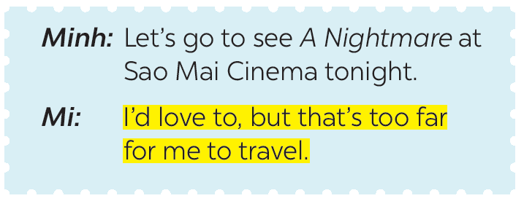
EVERYDAY ENGLISH
1
Listen and read the conversations. Pay attention to the highlighted sentences.

Slide 10
Notes:
Cách chấp nhận và từ chối lời đề nghị
1. Make suggestions (Đưa ra lời đề nghị)
- How about + V-ing?
Ex: How about going to the cinema tonight?
- Let’s + V(inf)
Ex: Let’s go to see A Nightmare at Sao Mai Cinema tonight.
2. Accept suggestions (Chấp nhận lời đề nghị)
- That’s a great idea.
- It sounds good/ interesting.
- Sure. Let do it.
3. Decline suggestions (Từ chối lời đề nghị)
- No, thanks.
- I’ d love to, but I’m very busy.
- That’s not my cup of tea.

Slide 11
EVERYDAY ENGLISH
It sounds good/ interesting/ great to me.
I’m up for it./ I’m on it./
I’m in./ Count me in.
I can’t agree more./ Sure, let’s do it.
No, thanks./ Thanks but I can’t…
That’s not my type/ cup of tea/ interest/ thing/ favourite…
I would rather/ had better not/
am busy/ am not interested…

Slide 12
EVERYDAY ENGLISH
2
Work in pairs. Make similar conversations with the following situations.
Student A suggests going to the cinema and student B accepts.
Student A: Hey, let’s go to the cinema this weekend!
Student B: Good idea! I like action movie.
Student A: So do I. I’ll see you at 6 p.m. this Sunday.
Student B: Great. See you.

Slide 13
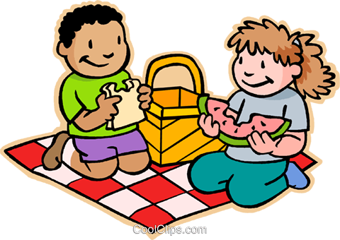
EVERYDAY ENGLISH
2
2.
Work in pairs. Make similar conversations with the following situations.
Student A suggests going for a picnic but student B declines.
Student A: It’s sunny today. How about going for a picnic?
Student B: Oh sorry, I can’t. I have a lot of homework to do.
Student A: That’s a pity. Maybe next time.
Student B: Sure.

Slide 14
EVERYDAY ENGLISH
2.
Work in pairs. Make similar conversations with the following situations.
Student A suggests playing badminton after school, student B accepts.
Student A: Let’s play badminton after class!
Student B: It sounds nice. Where should we play?
Student A: How about the park behind school?
Student B: Good idea.

Slide 15
LESSON 4: COMMUNICATION
WARM-UP
Game: Conversation rearranging
Suggestions - Accepting & Declining suggestions
Everyday English
Task 1: Listen and read the conversations. Pay attention to the highlighted sentences.
Task 2: Work in pairs. Make similar conversations with the following situations.
EVERYDAY ENGLISH
A survey about films
Task 3: Listen to the conversation and fill in the blanks with the words you hear.
Task 4: Work in groups. Do a survey about your group members’ favourite films.
A SURVEY ABOUT FILMS

Slide 16
A SURVEY ABOUT FILMS
A survey about films
Aims of the stage:
To recall students’ knowledge about the concept of a survey and prepare needed language material for the next task.
To let students have some time to brainstorm the ideas and do the survey.

Slide 17
A SURVEY ABOUT FILMS
3
Listen to the conversation and fill in the blanks with the words you hear.
Tom: Hi Lan. I’m doing a survey about films. Can I ask you some questions? Lan: Sure. Go ahead. Tom: What kind of films do you like (1) ____? Lan: I love (2) ___________. Tom: What’s the name of your (3) _________ comedy? Lan: It’s Dr Johnny. Tom: Who (4) _________in it? Lan: Bill Harris. Tom: What do you think of it? Lan: It’s very (5) _______. Tom: Thank you.
best
comedies
favourite
stars
funny

Slide 18
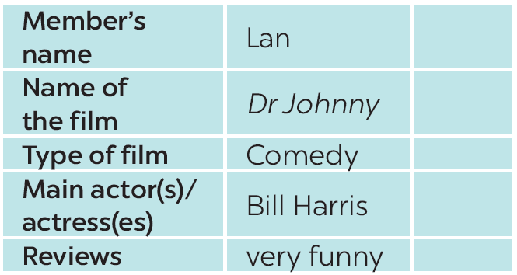
A SURVEY ABOUT FILMS
4
Work in groups. Do a survey about your group members’ favourite films.
Minh
The love story

Slide 19
LESSON 4: COMMUNICATION
WARM-UP
Game: Conversation rearranging
Suggestions - Accepting & Declining suggestions
Everyday English
Task 1: Listen and read the conversations. Pay attention to the highlighted sentences.
Task 2: Work in pairs. Make similar conversations with the following situations.
EVERYDAY ENGLISH
A survey about films
Task 3: Listen to the conversation and fill in the blanks with the words you hear.
Task 4: Work in groups. Do a survey about your group members’ favourite films.
A SURVEY ABOUT FILMS
FURTHER PRACTICE
Task 5: Report you results to the class.

Slide 20
FURTHER PRACTICE
Aims of the stage:
To let students practise talking about others’ favourite films.

Slide 21
FURTHER PRACTICE
5
Report your results to the class.
My friend's name is Steve. His favourite film is Finding Nemo because he loves animated films from Disney. The main character "Nemo" was voiced by Albert Brooks. This animated film is both educational, moving and funny.

Slide 22
LESSON 4: COMMUNICATION
WARM-UP
Game: Conversation rearranging
Suggestions - Accepting & Declining suggestions
Everyday English
Task 1: Listen and read the conversations. Pay attention to the highlighted sentences.
Task 2: Work in pairs. Make similar conversations with the following situations.
EVERYDAY ENGLISH
A survey about films
Task 3: Listen to the conversation and fill in the blanks with the words you hear.
Task 4: Work in groups. Do a survey about your group members’ favourite films.
A SURVEY ABOUT FILMS
FURTHER PRACTICE
Task 5: Report you results to the class.
CONSOLIDATION
Wrap-up
Homework

Slide 23
CONSOLIDATION
1
Wrap-up
In this lesson, we have learnt to:
accept and decline suggestions.
do a survey about group members’ favorite film.
report the survey’s result to class.

Slide 24
CONSOLIDATION
2
Homework
Do exercises in the workbook.

