Slide 2
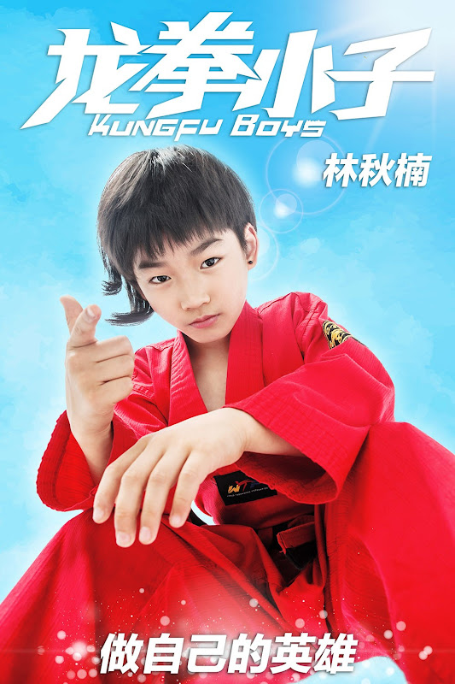
Unit
8
FILMS
LESSON 5: SKILLS 1
Unit
READING
SPEAKING

Slide 3
OBJECTIVES
By the end of the lesson, students will be able to:
develop reading skill about one’s favourite film;
develop speaking skill: Talking about a film.

Slide 4
LESSON 5: SKILLS 1
WARM-UP
Game: Who is faster?
Task 1: Work in pairs. Discuss the following questions.
* Vocabulary
Task 2: Match the words or phrases with their meanings.
Task 3: Read Mark’s blog and answer the questions.
READING
Task 4: Look at the table. Work in pairs. Ask and answer questions about the film Kungfu Boy.
Task 5: Work in groups. Take turns to talk about the film Kungfu Boy.
SPEAKING
POST-READING & SPEAKING
Evaluation
CONSOLIDATION
Wrap-up
Homework

Slide 5
LESSON 5: SKILLS 1
WARM-UP
Game: Who is faster?
Aims of the stage:
To introduce the topic of reading.
To enhance students’ skills of cooperating with team mates.

Slide 6
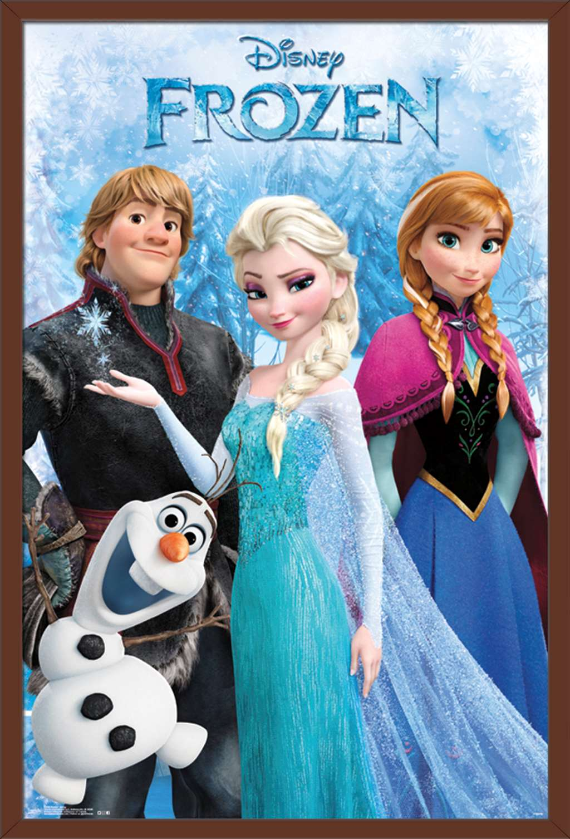
WHO’S FASTER
1
Time’s up
A
animation
2
13
8
0
1
3
6
7
9
10
11
12
14
15
5
4
fantasy
b
horror film
c

Slide 7
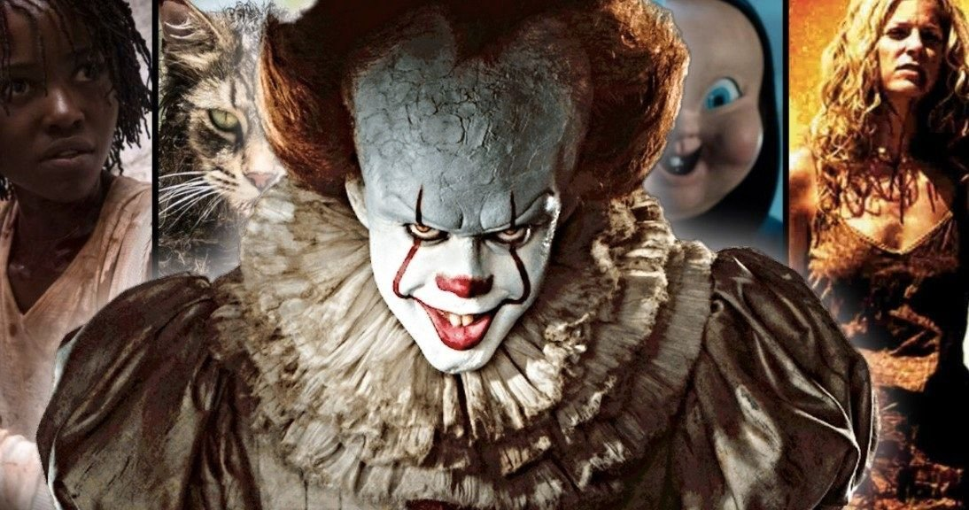
WHO’S FASTER
1
Time’s up
fantasy
A
2
13
8
0
1
3
6
7
9
10
11
12
14
15
5
4
animation
b
horror film
c

Slide 8
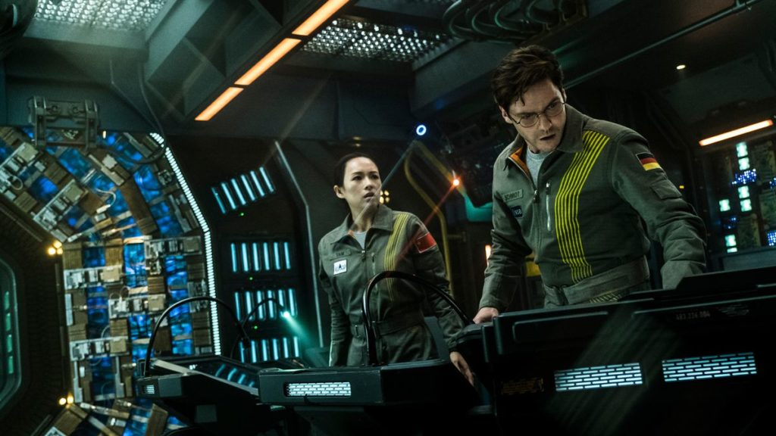
WHO’S FASTER
1
Time’s up
fantasy
A
2
13
8
0
1
3
6
7
9
10
11
12
14
15
5
4
b
action film
science fiction film
c

Slide 9
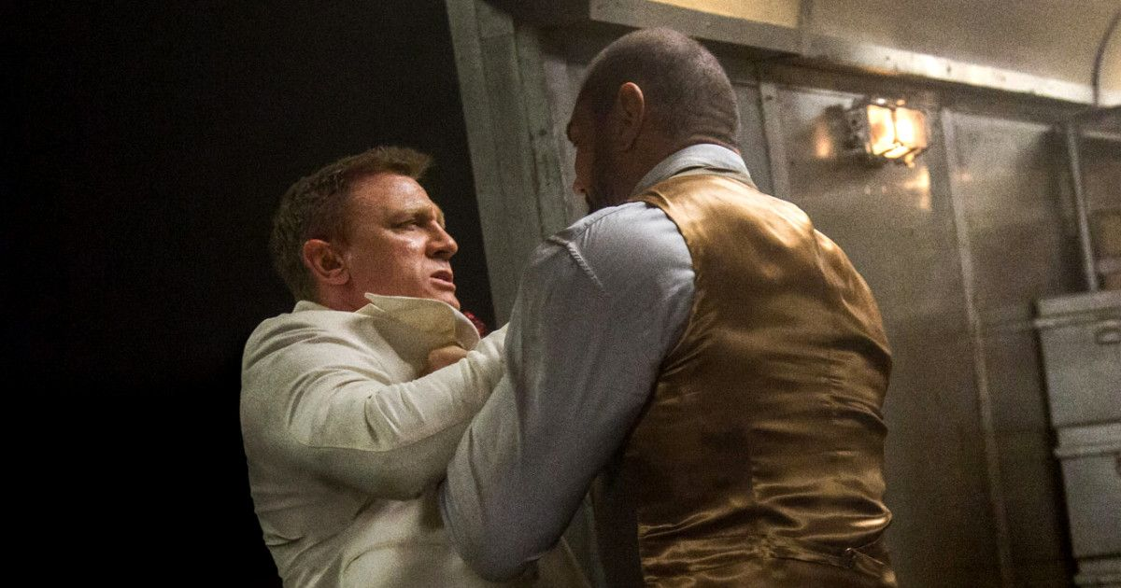
WHO’S FASTER
1
Time’s up
A
action film
2
13
8
0
1
3
6
7
9
10
11
12
14
15
5
4
fantasy
b
comedy
c

Slide 10
animation
horror film
science fiction film
action film

Slide 11
LESSON 5: SKILLS 1
WARM-UP
Game: Who is faster?
* Pre-Reading:
Vocabulary
Task 1: Work in pairs. Discuss the following questions.
Task 2: Match the words or phrases with their meanings.
READING
Aims of the stage:
To provide students with some lexical items before reading the text.

Slide 12
PRE-READING
1
Work in pairs. Discuss the following questions.
Do you like fantasies?
Why or why not?
- Yes, I do
- Because they’re surprising and shocking.
fantasy

Slide 13
PRE-READING
1
Work in pairs. Discuss the following questions.
Do you like fantasies?
Why or why not?
Yes, I do
/ No, I don’t
- Because they’re surprising and shocking.
- I don't like fantasies because it is very boring and not on real facts.
fantasy

Slide 14
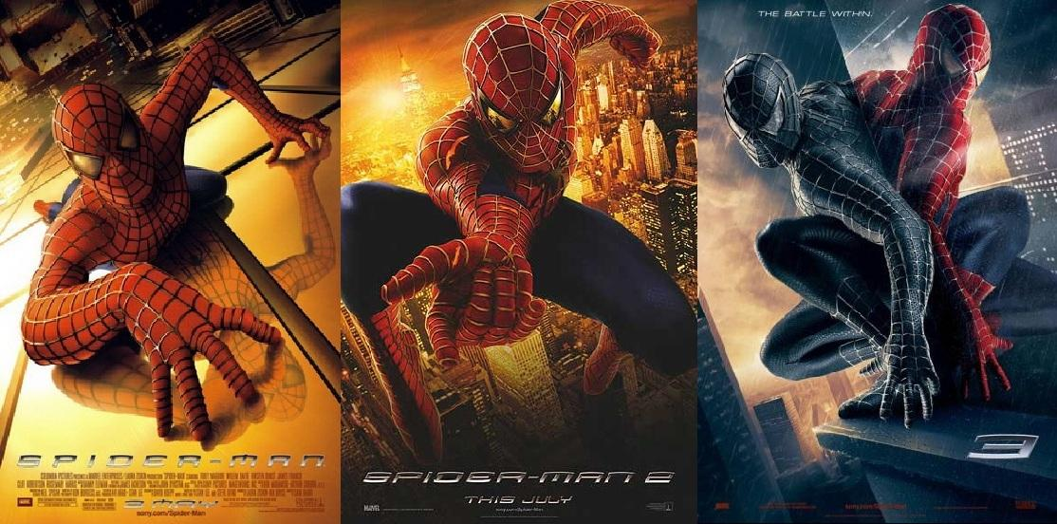
PRE-READING - VOCABULARY
series (n)
/'siəri:z/
chuỗi, loạt (phim dài tập)

Slide 15
PRE-READING - VOCABULARY
wizard (n)
/'wizəd/
phù thủy, người có tài phi thường

Slide 16
PRE-READING - VOCABULARY
must-see (n)
/ˈmʌstˈsiː/
bộ phim đáng xem, nên xem

Slide 17
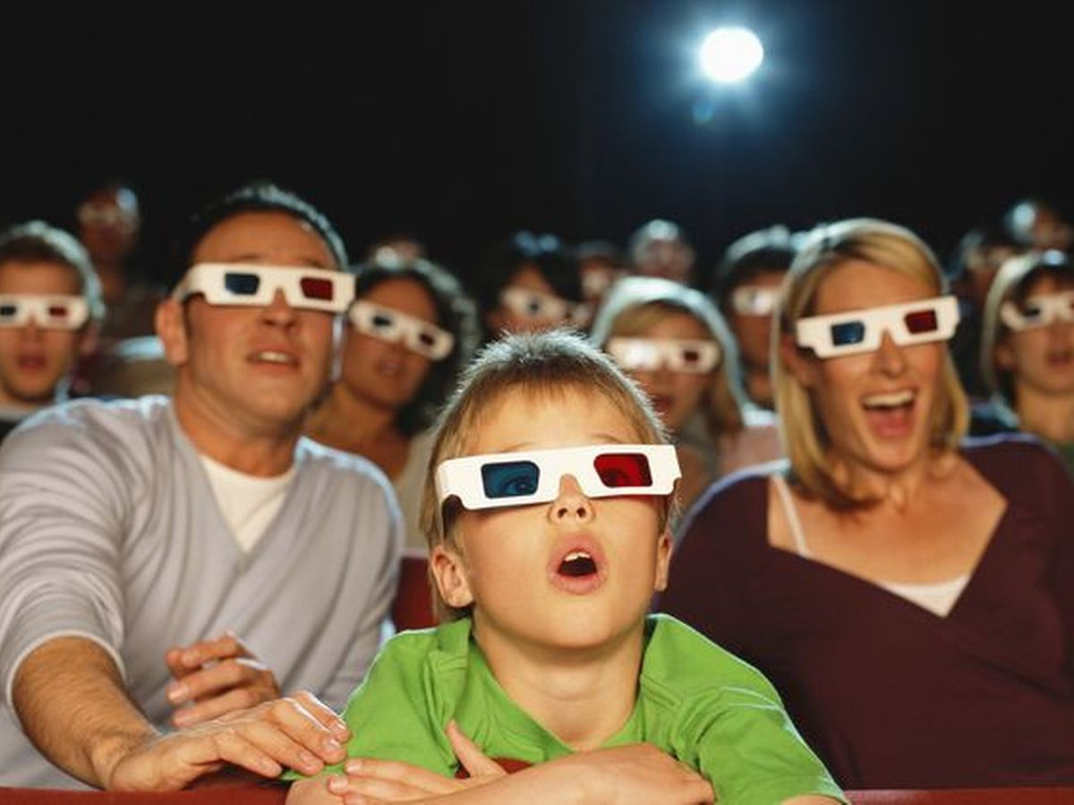
PRE-READING - VOCABULARY
gripping (adj)
/'gripiη/
cuốn hút, hấp dẫn

Slide 18
PRE-READING - VOCABULARY
New words | Pronunciation | Meaning
- series | /'siəri:z/ | chuỗi, loạt (phim dài tập)
- wizard | /'wizəd/ | phù thủy, người có tài phi thường
- must-see | /ˈmʌstˈsiː/ | bộ phim đáng xem, nên xem
- gripping | /'gripiη/ | cuốn hút, hấp dẫn

Slide 19
Mon, Apr 20th
Harry Potter and the Sorcerer's Stone is a fantasy. Its director is Chris Columbus. It is the first of the Harry Potter film series.
Daniel Radcliffe is one of the stars in the film.
The film tells the story of Harry Potter. He's a powerful wizard. He is a student at a school for wizards and learns about himself, his family, and the bad things happening around him.
The film received a lot of good reviews. People say it's a must-see for teens. I agree because the story is gripping and the acting is excellent. The music is also amazing.
Although Harry Potter and the Sorcerer's Stone is a little frightening at times, it is very interesting and full of action. Go and see it if you can.
Posted by Mark at 5.30 p.m.

Slide 20
2
Match the words or phrases with their meanings.
Words | Meanings
1. series | a. something that is so good that you think others should see it
2. wizard | b. related films that tell stories about the same characters
3. must-see | c. very exciting or interesting
4. gripping | d. a man who has magical powers
1. b
2. d
3. a
4. c

Slide 21
LESSON 5: SKILLS 1
WARM-UP
Game: Who is faster?
* Pre-Reading:
Vocabulary
Task 1: Work in pairs. Discuss the following questions.
Task 2: Match the words or phrases with their meanings.
* While-Reading:
Task 3: Read Mark’s blog again and answer the questions.
READING

Slide 22
WHILE-READING
3
Read Mark’s blog and answer the questions.
Aim of the task:
To develop reading skill for specific information.

Slide 23
Mon, Apr 20th
Harry Potter and the Sorcerer's Stone is a fantasy. Its director is Chris Columbus. It is the first of the Harry Potter film series.
Daniel Radcliffe is one of the stars in the film.
The film tells the story of Harry Potter. He's a powerful wizard. He is a student at a school for wizards and learns about himself, his family, and the bad things happening around him.
The film received a lot of good reviews. People say it's a must-see for teens. I agree because the story is gripping and the acting is excellent. The music is also amazing.
Although Harry Potter and the Sorcerer's Stone is a little frightening at times, it is very interesting and full of action. Go and see it if you can.
Posted by Mark at 5.30 p.m.

Slide 24
3
Read Mark’s blog and answer the questions.
1. What kind of film is Harry Potter and the Sorcerer’s Stone?
Harry Potter and the Sorcerer’s Stone is a fantasy.
2. Who is Daniel Radcliffe?
Daniel Radcliffe is one of the stars in the film.
3. What is the film about?
The film tells the story of Harry Potter. He’s a powerful wizard. He is a student at a school for wizards and learns about himself, his family, and the bad things happening around him.
4. What do people say about the film?
People say it’s a must-see for teens.

Slide 25
LESSON 5: SKILLS 1
LESSON 5: SKILLS 1
WARM-UP
Game: Who is faster?
* Pre-Reading:
Vocabulary
Task 1: Work in pairs. Discuss the following questions.
Task 2: Match the words or phrases with their meanings.
* While-Reading:
Task 3: Read Mark’s blog and answer the questions.
READING
Task 4: Look at the table. Work in pairs. Ask and answer questions about the film Kungfu Boy.
Task 5: Work in groups. Take turns to talk about the film Kungfu Boy.
SPEAKING

Slide 26
SPEAKING
4
Look at the table. Work in pairs. Ask and answer questions about the film Kungfu Boy.
Example: A: How about seeing a film this evening? B: That’s a great idea. What film shall we see? A: Kungfu Boy. B: What kind of film is it?
A: __________________
Film’s name | Kungfu Boy
Director | John Stevenson
Type of film | Comedy
Main actor / actress | Bruce Wane
Main content | About a very big boy who saves his town and becomes a hero
Reviews | Funny and interesting
Time | 4.30 p.m and 8.30 p.m daily
Place | Ngoc Khanh Cinema

Slide 27
4
Look at the table. Work in pairs. Ask and answer questions about the film Kungfu Boy.
Example: A: How about seeing a film this evening? B: That’s a great idea. What film shall we see? A: Kungfu Boy. B: What kind of film is it?
A: __________________
Film’s name | Kungfu Boy
Director | John Stevenson
Type of film | Comedy
Main actor / actress | Bruce Wane
Main content | About a very big boy who saves his town and becomes a hero
Reviews | Funny and interesting
Time | 4.30 p.m and 8.30 p.m daily
Place | Ngoc Khanh Cinema
It’s a comedy .
B: Who stars in the film?
A: It stars Bruce Wane.
B: What is it about?
A: It’s about a very big boy who saves his town and becomes a hero.
B: What do people say about it?
A: People say that it is very funny and interesting.
B: So, when and where we can watch it?
A: We can watch it daily from 4.30 p.m. to 8.30 p.m. at Ngoc Khanh Cinema.

Slide 28
B: Who stars in it?
A: Bruce Wane.
B: What’s it about?
A: It’s about a very big boy who saves his town and becomes a hero.
B: What are the reviews like?
A: People say that it’s funny and interesting.
B: What time is the film on?
A: 4.30 p.m and 8.30 p.m daily.
B: Where shall we see?
A: Ngoc Khanh Cinema.

Slide 29
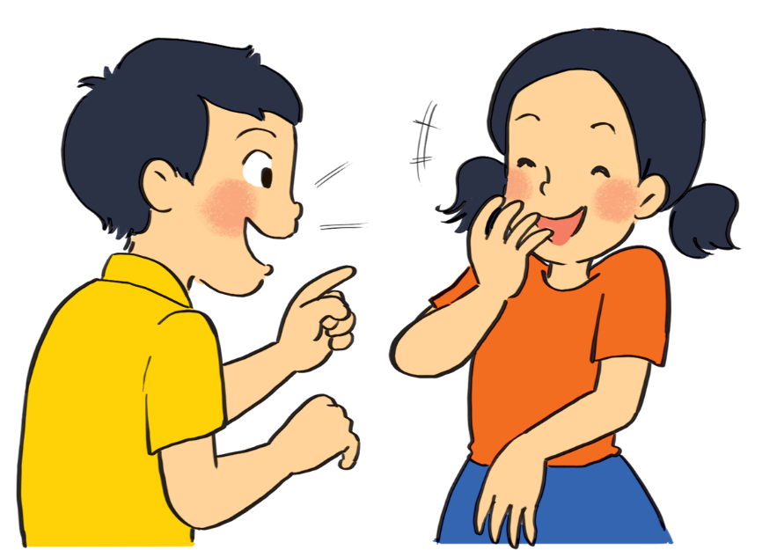
PRODUCTION (Post-Read & Speak)
5
Work in groups. Take turns to talk about the film Kungfu Boy.
Example: Kungfu Boy is on at … at … p.m.
It’s (an) … about …
Suggestion:
Kungfu Boy is a comedy directed by John Stevenson. Bruce Wane is the main actor in this film. It's about a very big boy who saves his town and becomes a hero. People say that it's a must-see because it's very funny and interesting. It's at 4.30 p.m. and 8.30 p.m. daily at Ngoc Khanh Cinema. Let's go to see it!

Slide 30
LESSON 5: SKILLS 1
WARM-UP
Game: Who is faster?
* Pre-Reading:
Vocabulary
Task 1: Work in pairs. Discuss the following questions.
Task 2: Match the words or phrases with their meanings.
* While-Reading:
Task 3: Read Mark’s blog and answer the questions.
READING
Task 4: Look at the table. Work in pairs. Ask and answer questions about the film Kungfu Boy.
Task 5: Work in groups. Take turns to talk about the film Kungfu Boy.
SPEAKING
PRODUCTION
(Post-Read & Speak)
Evaluation
CONSOLIDATION
Wrap-up
Homework

Slide 31
CONSOLIDATION
1
Wrap-up
Unit
READING
SPEAKING

Slide 32
CONSOLIDATION
2
Homework
Prepare for the lesson: Looking back & Project
Choose one of your favourite films:
– name of the film – type of film – its director and main actors / actresses – a short summary – your overall opinion about the film – the showtime and cinema – pictures or photos to illustrate the film

