Slide 2
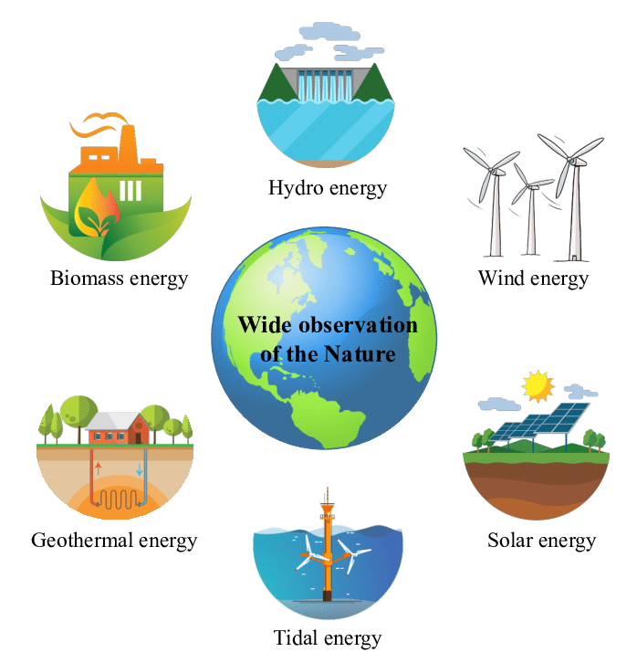
Unit
10
ENERGY SOURCES
LESSON 5: SKILLS 1
Unit

Slide 3
OBJECTIVES
By the end of the lesson, students will be able to:
+ Reading:
read for specific information about renewable and non-renewable sources of energy.
+ Speaking:
talk about advantages and disadvantages of different sources of energy

Slide 4
LESSON 5: SKILLS 1
WARM-UP
Game: Hangman
* Vocabulary
* Discussion
* Practice
Task 1: Read the text and choose the best option to complete the sentences.
Task 2: Read the text again and answer the questions
READING
Task 3: Work in groups. Discuss and put the following words or phrases in the appropriate columns.
Task 4: Work in pairs. Ask and answer questions about the advantages and disadvantages of different energy sources.
SPEAKING
PRODUCTION
Task 5: Presentation
CONSOLIDATION
Wrap-up
Home work

Slide 5
LESSON 1: GETTING STARTED
WARM-UP
Game:Hangman
Aims of the stage:
To introduce the topic of reading.

Slide 6
WARM-UP
R E N E W A B L E

Slide 7
LESSON 5: SKILLS 1
WARM-UP
Game: Hangman
* Vocabulary
* Discussion
* Practice
Task 1: Read the text and choose the best option to complete the sentences.
Task 2: Read the text again and answer the questions
READING
Aims of the stage:
To provide students with some lexical items before reading the text.

Slide 8
I/ Vocabulary
- type (n) loại /taɪp/ - disadvantage(n): bất lợi /ˌdɪsədˈvɑːntɪdʒ/ - advantage(n): thuận lợi /ədˈvɑːntɪdʒ/ - (to) rely on: lệ thuộc vào /rɪˈlaɪ ɒn/ - (to) heat : sưởi ấm /hiːt/ - electrical appliances(n): thiết bị điện /ɪˈlɛktrɪkəl əˈplaɪənsɪz/ - (to) cost: tốn kém /kɒst/ - (to) produce: sản xuất

Slide 9
PRE-READING - VOCABULARY
(to) produce
= to make things, mostly in large quantity
Examples:
Companies produce many toys for children before Christmas.
/prəˈdjuːs/
Sản xuất

Slide 10
PRE-READING - VOCABULARY
- limited (a)
= not very great in amount or extent
Examples:
Coal is limited.
/’limitid/
bị hạn chế

Slide 11
PRE-READING - VOCABULARY
- available (a)
= that you can get, buy or find
Examples:
The coal takes a long time to be available again.
/əˈveɪləbl/
Có sẵn

Slide 12
PRE-READING - VOCABULARY
New words | Pronunciation | Meaning
produce (v) | /prəˈdjuːs/ | sản xuất
- limited (adj) |  | bị hạn chế
- available (a) | /əˈveɪləbl/ | có sẵn
/’limitid/

Slide 13
PRE-READING
1. Dicussion. Look at the pictures:
1. They are hydro energy and solar energy.
2. We will use solar energy and wind energy.

Slide 14
LESSON 5: SKILLS 1
WARM-UP
Game: Hangman
* Vocabulary
* Discussion
* Practice
Task 1: Read the text and choose the best option to complete the sentences.
Task 2: Read the text again and answer the questions
READING

Slide 15
Aim of the task:
To help Ss develop their reading skill for details and specific information (skimming and scanning)

Slide 16
WHILE-READING
2. Read the text and choose the best option to complete the sentences.

Slide 17
2
Read the text and choose the best option to complete the sentences.
1. Non-renewable sources are cheap and ______.
A. available B. easy to use C. expensive
2. ______ come from the sun, wind or water.
A. Renewable sources B. All energy sources C. Non-renewable sources
3. When energy comes from water, we call it ______.
A. wind energy B. solar energy C. hydro energy
4. Renewable energy sources are better for ______.
A. the environment B. our cars C. hydro energy

Slide 18
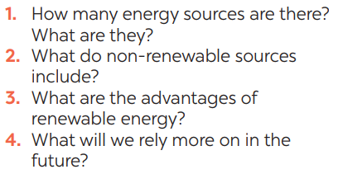
3
Read the text again and answer the questions
Aim of the task:
To help Ss further develop their reading skill for specific information (scanning).
1. There are two energy sources. They
are non-renewable sources and renewable sources.
2. Non-renewable sources are coal, oil
and natural gas.
3. Renewable sources are available, clean and safe to use.
4. In the future, we will rely more on
renewable energy sources.

Slide 19
LESSON 5: SKILLS 1
WARM-UP
Game: Hangman
* Vocabulary
* Discussion
* Practice
Task 1: Read the text and choose the best option to complete the sentences.
Task 2: Read the text again and answer the questions
READING
Task 3: Work in groups. Discuss and put the following words or phrases in the appropriate columns.
Task 4: Work in pairs. Ask and answer questions about the advantages and disadvantages of different energy sources.
SPEAKING

Slide 20
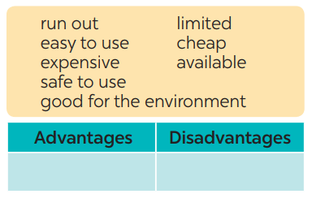
SPEAKING
4. Work in groups. Discuss and put the following words or phrases in the appropriate columns.
Aim of the task:
To prepare lexical items for Ss to talk about advantages and disadvantages of sources of energy
easy to use, safe to use, good for environment, cheap, available
run out, expensive, limited

Slide 21
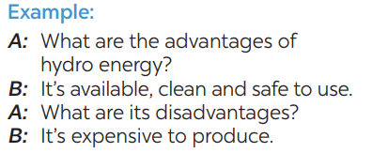
SPEAKING
5. Work in pairs. Ask and answer questions about the advantages and disadvantages of different energy sources
Aim of the task:
To provide Ss an opportunity to ask and answer questions about the advantages and disadvantages of different types of energy sources.

Slide 22
LESSON 5: SKILLS 1
WARM-UP
Game: Hangman
* Vocabulary
* Discussion
* Practice
Task 1: Read the text and choose the best option to complete the sentences.
Task 2: Read the text again and answer the questions
READING
Task 3: Work in groups. Discuss and put the following words or phrases in the appropriate columns.
Task 4: Work in pairs. Ask and answer questions about the advantages and disadvantages of different energy sources.
SPEAKING
PRODUCTION
Task 5: Presentation

Slide 23
PRODUCTION
5
Presentation: Advantages and disadvantages of a source of energy.

Slide 24
LESSON 5: SKILLS 1
WARM-UP
Game: Hangman
* Vocabulary
* Discussion
* Practice
Task 1: Read the text and choose the best option to complete the sentences.
Task 2: Read the text again and answer the questions
READING
Task 3: Work in groups. Discuss and put the following words or phrases in the appropriate columns.
Task 4: Work in pairs. Ask and answer questions about the advantages and disadvantages of different energy sources.
SPEAKING
PRODUCTION
Task 5: Presentation
CONSOLIDATION
Wrap-up
Home work

Slide 25
CONSOLIDATION
1
WRAP-UP
READING
SPEAKING

Slide 26
CONSOLIDATION
2
HOMEWORK
Prepare for the next lesson: Skills 2

