Slide 1
Unit 11: OUR GREENER WORLD lesson 4: communication
Grade 6

Slide 2
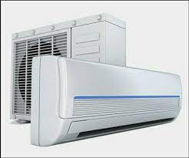
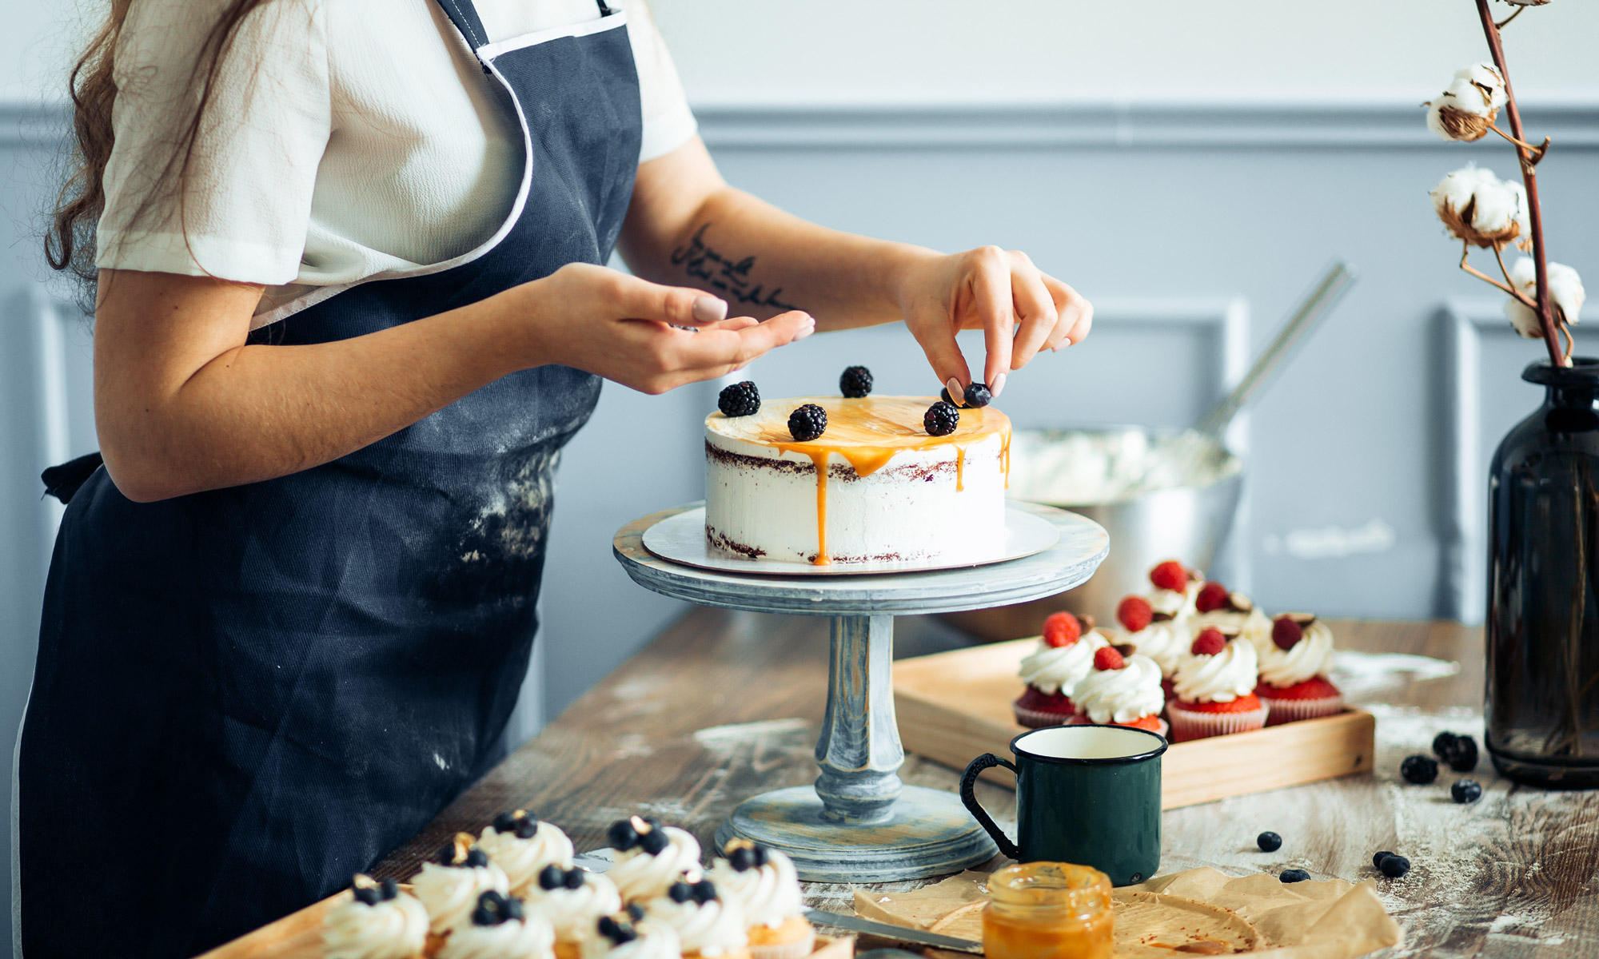
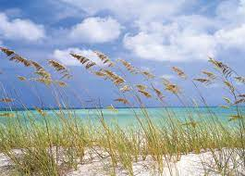
Vocabulary
1. Warning (n) /ˈwɔː.nɪŋ/
2. Breeze (n) /briːz/
3. Air conditioner (n)
/ˈeə kənˌdɪʃ.ən.ər/
4. Throw away (v)
5. Decorate (v)
6. Turn on (v)
Lời cảnh báo
Làn gió nhẹ lướt qua
Điều hòa
Vứt đi , quẳng đi
Trang trí
Bật lên

Slide 3
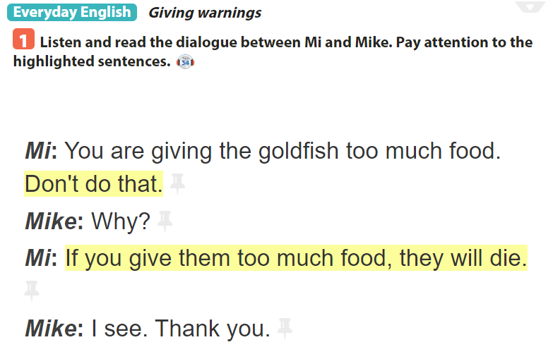

Slide 4
Example: A: Don’t water these flowers too much. B: Why? C: If you water them too much, they will die.

Slide 5
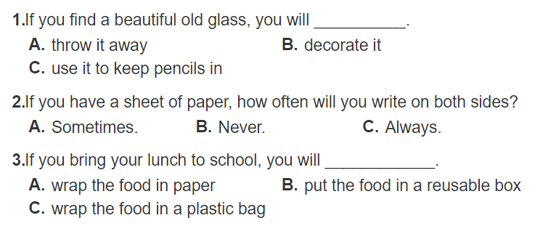

Slide 6
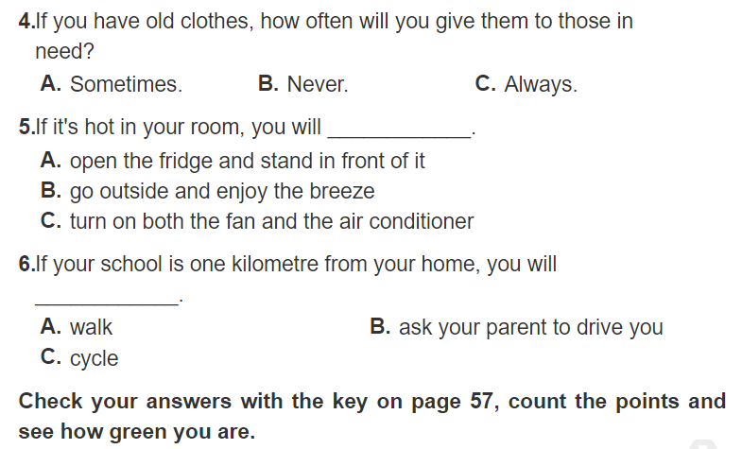

Slide 8
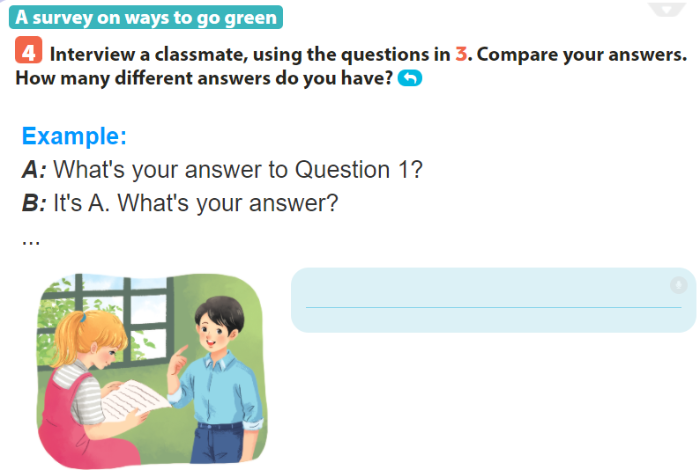
A: What’s your answer to question 2? B: It’s C. How about you? A: I choose B.

Slide 9
HOME WORK
By the end of the lesson, students can be able to:
- learn how to give warnings;
- practise using some grammar points and vocabulary related to the topic.
- Do exercise in Workbook and prepare Lesson: Skills 1

