Slide 2
Unit
1
LOCAL COMMUNITY
P.4
LESSON 3: A CLOSER LOOK 2
1

Slide 3
WARM-UP
BRAINSTORMING
QUESTION WORDS BEFORE TO-INFINITIVES
What do you do when you don’t know
how to get to a place in your neighbourhood?

Slide 4
I/ GRAMMAR:
1.QUESTION WORDS BEFORE TO-INFINITIVES
(Wh + to Vinf )
-We use a question word such as who, what, where, when, or how before a to-infinitive to express an indirect question about what we should do.(Chúng ta sử dụng từ để hỏi như who, what, where, when hoặc how trước động từ nguyên thể có "to" để diễn tả một câu hỏi gián tiếp về việc chúng ta nên làm gì.)
-We often use a verb such as ask, wonder, (not) decide, (not) tell, or (not) know before the question word + to-infinitive.(Chúng ta thường sử dụng các động từ như ask, wonder, (not) decide, (not) tell, hoặc (not) know trước từ để hỏi + to-V.)
“WHY” cannot be used with to V

Slide 5
* Form
S + ask + Wh + to V(inf)
+ wonder
+ (not) be sure
+ have no idea
+ (not) know
+ (not) decide
+ (not) tell
Example:
We don't know who we should contact.
→ We don't know who to contact
to -Vinf

Slide 6
PRACTICE
1
Fill in each blank with a suitable question word.
how
1. I don’t know ______ to deal with this problem.
2. My sister wondered ______ to buy the best cakes.
3. Could you tell me ______ to do to get on well with my new neighbours?
4. They asked ______ to take out the rubbish, at 5 or 6 p.m.
5. He can’t decide ______ to give his books to.
where
what
when
who

Slide 7
2
Rewrite the sentences using question words + to-infinitives.
1. I don’t know how I can get to the swimming pool.
2. They are wondering where they can buy traditional handicrafts.
3. She asked what she should give to her new neighbour at his house-warming party?
I don’t know how to get to the swimming pool.
They are wondering where to buy traditional handicrafts.
She asked what to give to her new neighbour at his house-warming party.
4. I can’t decide who I should ask for advice.
5. Could you tell me when I have to pay the water bill?
I can’t decide who to ask for advice.
Could you tell me when to pay the water bill?

Slide 8
2/ PHRASAL VERBS
– A phrasal verb consists of a verb and one or two particles, such as up, down, back, on, round, …
– A phrasal verb usually has a special meaning.
Example:
go out = leave your house to go to a social event
pass down = give or teach something to your children
cut down on = reduce the amount or number of something
run out of = have no more of

Slide 9
II. PRACTICE
3
Match each phrasal verb with its meaning.

Slide 10
4
Complete each sentence using the correct form of a phrasal verb in 3.
came back
1. We __________ from our home town last Saturday.
2. The artisans in my village usually ___________ their skills to their eldest children.
3. If you want to ________ about our community, you can go to the local museum.
4. When we aren’t at home, our neighbour ____________ our cats.
5. Whenever I go to a new place, I spend time _____________.
hand down
find out
takes care of
looking around

Slide 11
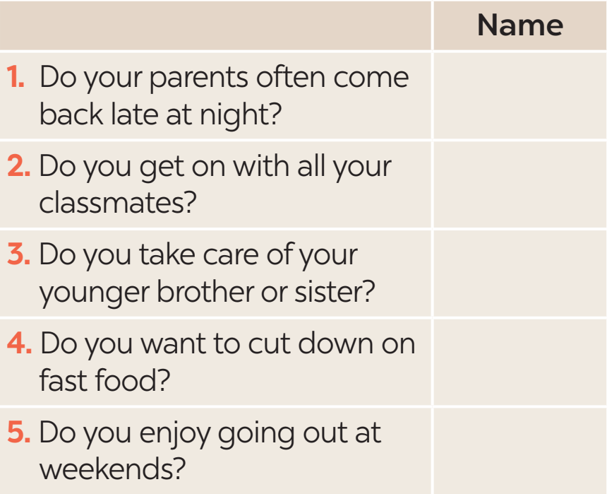
III. PRODUCTION
5
Find someone who … Ask as many friends as you can the following questions. Then write their names in the table if they say “yes”.

Slide 12
Homework
-Learn grammar
-Do exercises in the Workbook.
- Make 5 sentences using phrasal verbs.
- Prepare COMMUNICATION

Slide 13
Website: hoclieu.vn
Fanpage: facebook.com/www.tienganhglobalsuccess.vn/

