Slide 2
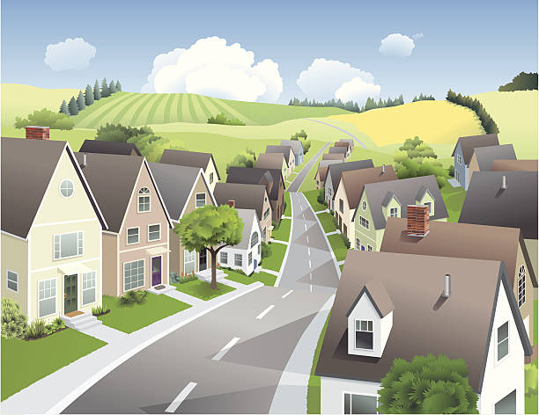
Unit
1
LOCAL COMMUNITY
P. 7
LESSON 6: SKILLS 2
1

Slide 3
BRAINSTORMING
WARM-UP
Who is your favourite community helper?
Why?

Slide 4
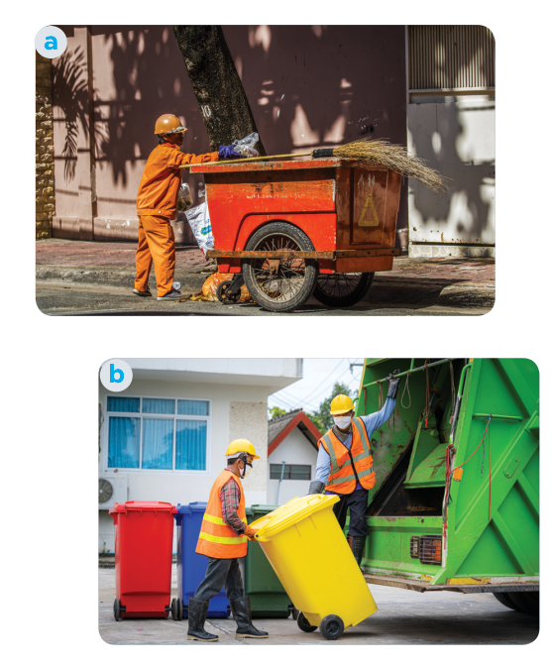
I/ LISTENING
1
Work in pairs. Discuss the questions.
1. Who can you see in the pictures?
2. What are they doing?
We can see garbage collectors.
They are taking the garbage away.

Slide 5
2
Listen and fill in each blank with no more than TWO words.
1. The name of the writing contest is “My Favourite
________________”.
2. Mr Vinh is a _______________.
3. He is tall and ______.
4. He is hard-working, responsible, and ________.
Community Helper
garbage collector
slim
friendly

Slide 6
3
Listen again and tick T (True) or F (False).
 | T | F
1. Mr Vinh wears an orange uniform.
2. He arrives at Mi’s neighbourhoodat 9 p.m. every day.
3. He instructs people to putrubbish in two types of bins.
4. He shares information about his work and the importance of sorting rubbish.
a green uniform with reflective
6 p.m

Slide 7
II/ WRITING
4
Work in pairs. Choose a community helper you like and answer the following questions.
- What is his / her job?
– What does he / she look like?
– What is he / she like?
– What does he / she do for the community?
– How do you feel about him / her?

Slide 8
1/ My favourite community helper is Mr Nam. He is a delivery person in my neighbourhood.
2/ He is tall and fat. He has short black hair and beautiful eyes. He smiles happily.
3/ He is hard-working and responsible. He is a friendly person.
4/ A delivery person plays an importance role in the community. This service supports local businesses, helps individuals receive necessary items without leaving their homes, and contributes to the overall convenience and efficiency of daily life.
5/ I think a delivery person is an essential. They work hard to ensure that packages and goods reach people reliably and on time. Their work helps keep the flow of everyday life moving, making it easier for people to access what they need. I respect the important role they play.

Slide 9
Write a paragraph (about 100 words) about your favourite community helper. Use the answers to the questions in 4 to help you.
5
My favourite community helper is Mr Nam. He is a delivery person in my neighbourhood.
He is tall and fat. He has short black hair and beautiful eyes. He smiles happily. He is hard-working and responsible. He is a friendly person. A delivery person plays an importance role in the community. This service supports local businesses, helps individuals receive necessary items without leaving their homes, and contributes to the overall convenience and efficiency of daily life. I think a delivery person is essential. They work hard to ensure that packages and goods reach people reliably and on time. Their work helps keep the flow of everyday life moving, making it easier for people to access what they need. I respect the important role they play.

Slide 10
Homework
- Rewrite the paragraph in the notebooks.
Do exercises in the workbook.
- Prepare LOOKING BACK AND PROJECT

Slide 11
Website: hoclieu.vn
Fanpage: facebook.com/www.tienganhglobalsuccess.vn/

